Slide 1
History
of
Immunization

Slide 2
Driving out the Devil – Witch Trials up to 1782
Teufelsaustreibung

Slide 3
Edward Jenner, English Doctor (1749 – 1823)
Jenner

Slide 4
Edward Jenner – his “Immunization Success”
1790:
He inoculated his 10-month-old
son against smallpox:
Mentally disabled
Died at the age of 21

Slide 5
Out of
14 808, 11 174
Were immunized!
Smallpox Epidemic London 1870 - 1872

Slide 6
Start of the 19th C.: Smallpox Vaccination Banned
In England and Holland,
The smallpox vaccination
Was illegal:
Lowest incidence of
disease in Europe!

Slide 7
Jenner at the End of His Life
"I don't know if I didn't
make a terrible mistake
and create something
monstrous!"

Slide 8
Strange Change in Terminology
Leprosy
Plague
Smallpox
Chickenpox

Slide 9
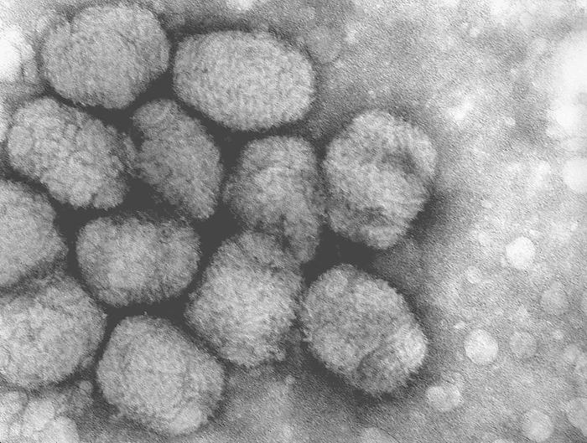
“Smallpox Virus”

Slide 10
Robert Koch (1843 – 1910)
Koch

Slide 11
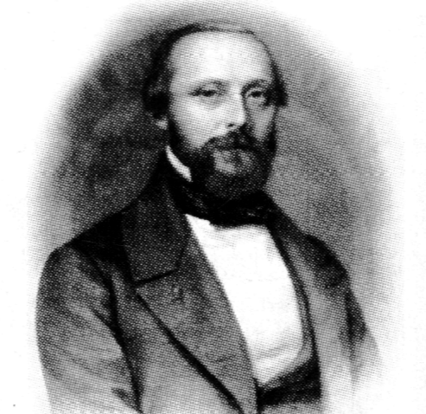
Rudolf Virchow (1821 – 1902)

Slide 12
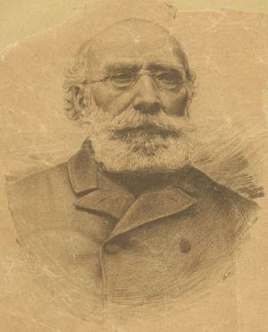
Antoine Bechamp (1816 – 1908)

Slide 13
Claude Bernard (1813 - 1878)

Slide 14
Claude Bernard – His Famous Quote:
“The microbe is
nothing, the milieu
in which they live
Is everything!”

Slide 15
Max von Pettenkofer (1813 – 1901)
Pettenkofer

Slide 16
7 Oct. 1892 he drinks
1 ml of a cholera culture in
front of an audience!
(ca. 1 mil. cholera bacteria)
and doesn’t get sick!
Max von Pettenkofer at the Age of 74:

Slide 17
Luis Pasteur (1822 – 1895)
Pasteur

Slide 18
Dr. Geison on Luis Pasteur:
Historian at
Princeton University:
“There is no doubt that
Pasteur committed scientific
fraud on several occasions.”

Slide 19
20 Years of Research: Dr. Geison on Luis Pasteur

Slide 20
Luis Pasteur at the End of His Life
“The germ is
nothing, what matters is the milieu!

Slide 21
Smallpox in Germany from 1865 – 1822
1874: Introduction
of 2nd Mandatory
Vaccination

Slide 22
Smallpox Cases
Sick
Vaccinated
Unvaccinated

Slide 23
Smallpox Cases after the 2nd World War

Slide 24
Prize Competition – 1911

Slide 25
1885: Poster in the Streets of London
Health care, not vaccinations!
Better to go to jail than have a poisoned child!
Smallpox isn’t being eliminated, but rather human lives!
Refusal of bad laws is a Christian virtue and our civic duty!

Slide 26
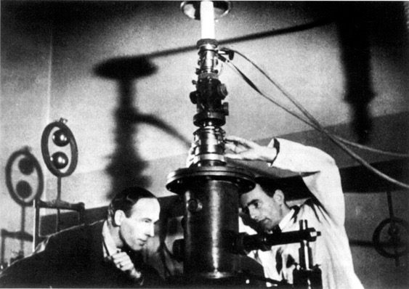
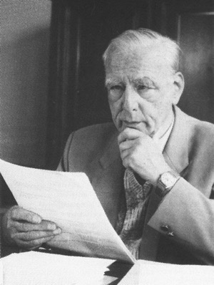
History of the Virus Theory
1931: Erstes Elektronenmikroskop
Ernst Ruska (1906 – 1988)

Slide 27
Infant Mortality in Hamburg 1821 - 1964

Slide 28
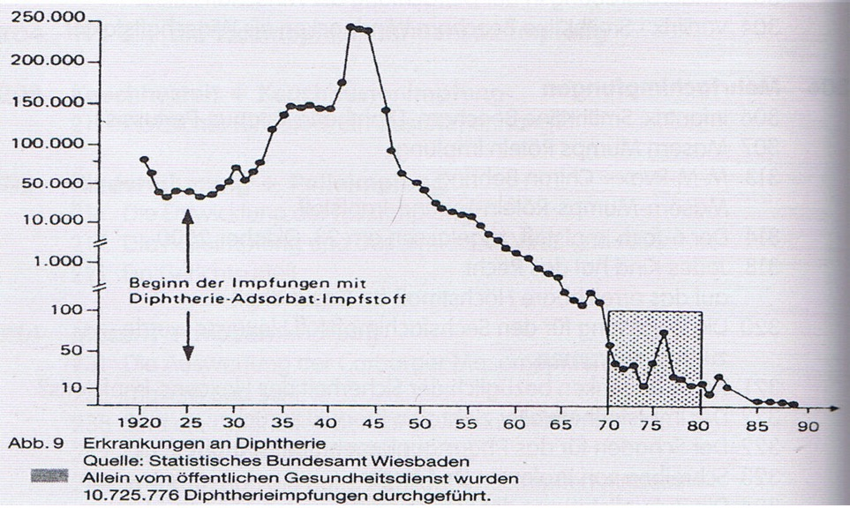
Diphtheria Cases from 1920 – 1990

Slide 29
Infection Theory

Slide 30
Infection Theory

Slide 31
Infection Theory

Slide 32
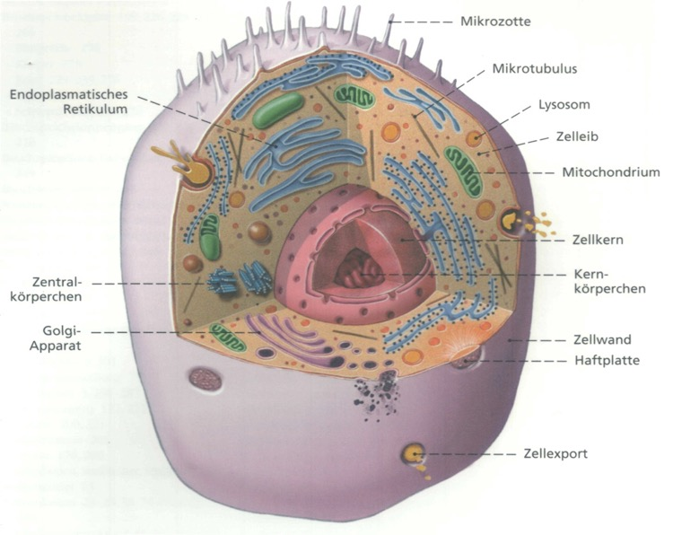
Mitochondria are unprotected (antibiotics)

Slide 33
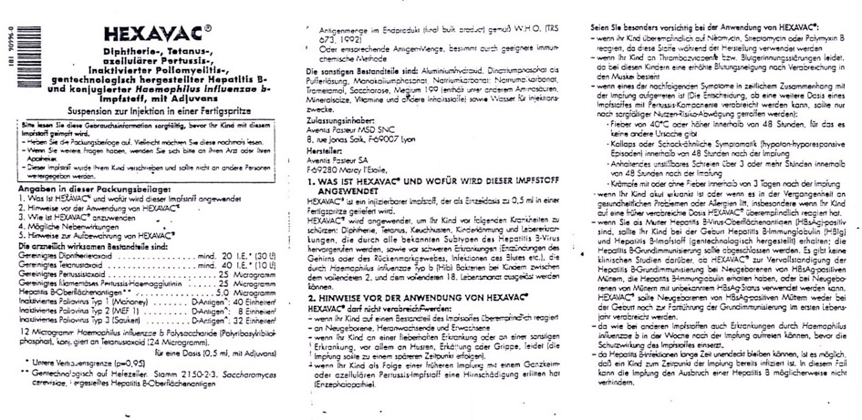
6-Fold Juvenile Vaccination – Hexavac

Slide 34
Hexavac – Package Instructions

Slide 35
Hexavac Taken off the Market

Slide 36
99.9 % of Accompanying Substances
Antibiotics
Betapropriolactone
Mercury (Thiomersal)
Aluminum hydroxide
Formaldehyde
Benzene

Slide 37
Vaccines – Run for Your Lives!

