Slide 1
Orgasm
Pregnancy

Slide 2
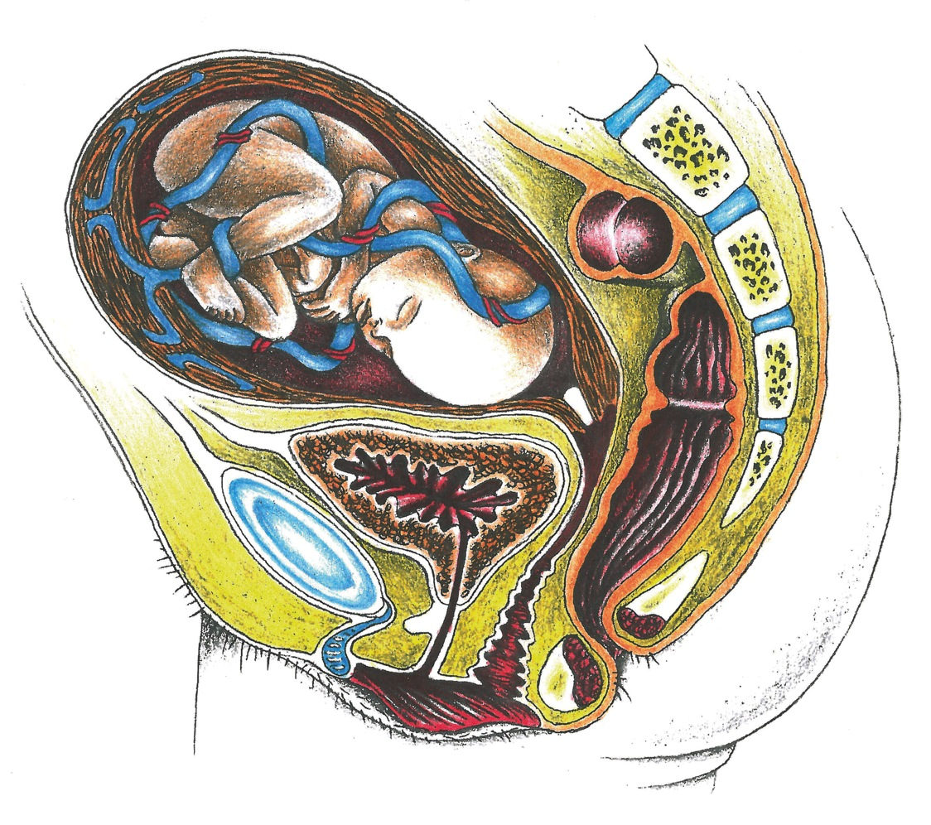
Pregnancy

Slide 3
Insemination

Slide 4
The 1st Week of Pregnancy

Slide 5
Embryo

Slide 6
Screams during the Ultrasound Procedure
1. Baby

Slide 7
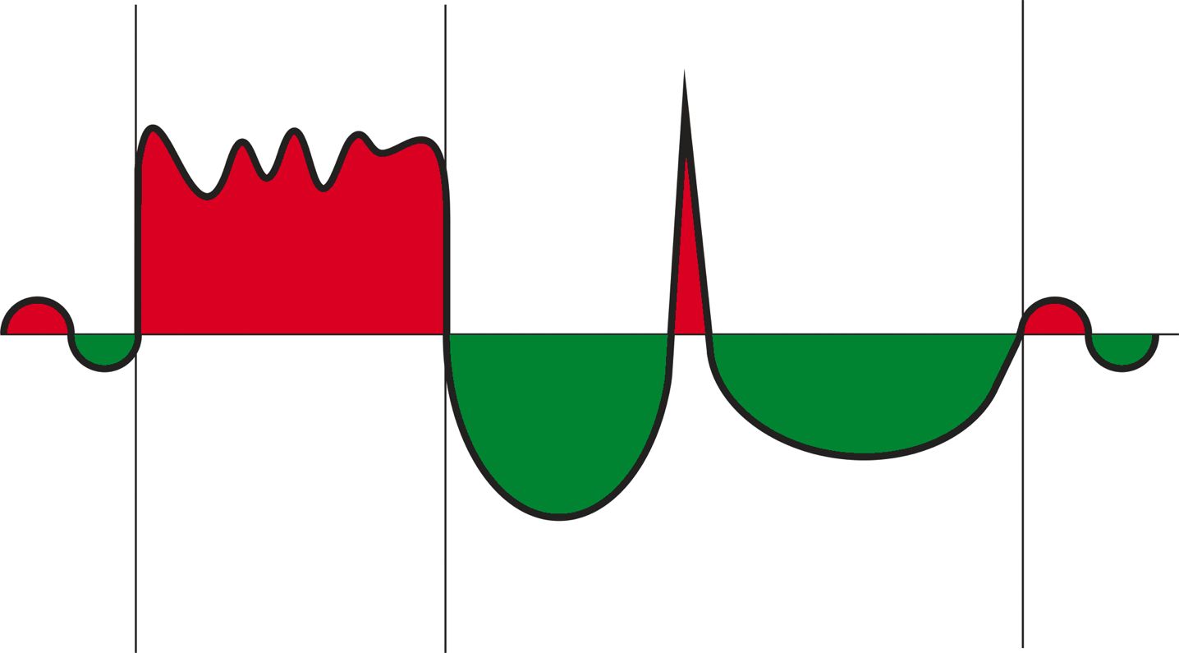
Orgasm = “Epi-Crisis”

Slide 8
Birth = “Epi-Crisis”

Slide 9
First 2-3 Months of the Pregnancy
Sympathicotonic
emphasis

Slide 10
Remaining Pregnancy
Parasympathetic
Emphasis

Slide 11
Birth = Epi-Crisis

