Slide 1
Skin
Hair

Slide 2
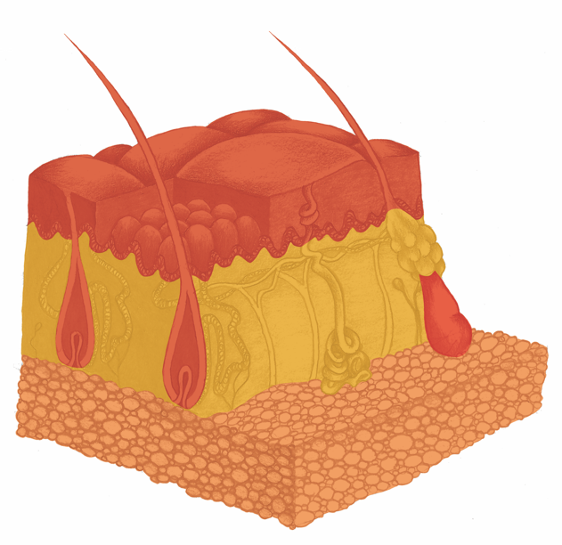
Skin, Hair
Haut - Übersicht

Slide 3
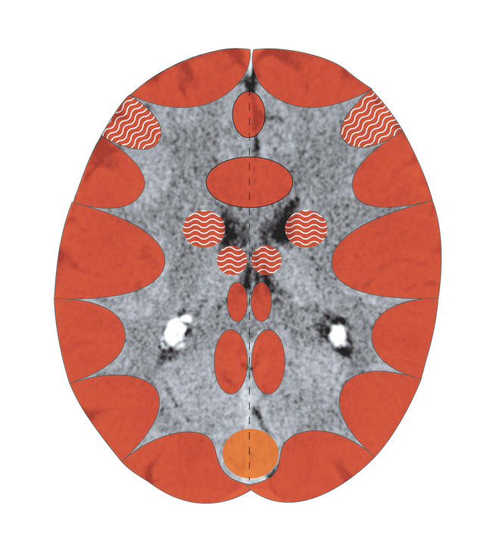
Cerebral Cortex – Epidermis in the Sensory Cortex
Notes:
3

Slide 4
Haut – Sensorik - Großhirnrinde
Sensorik

Slide 5
CT: Cerebral Cortex, Sensory Cortex, Active

Slide 6
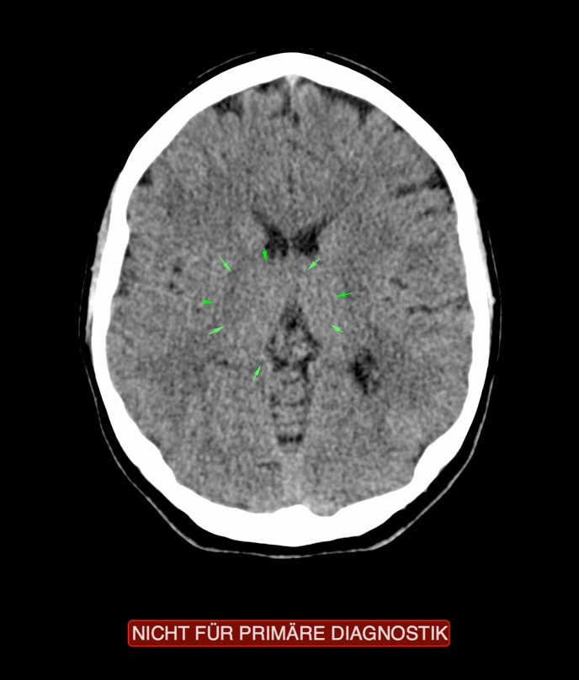
CT: Epidermis of the Leg, Active Conflict

Slide 7
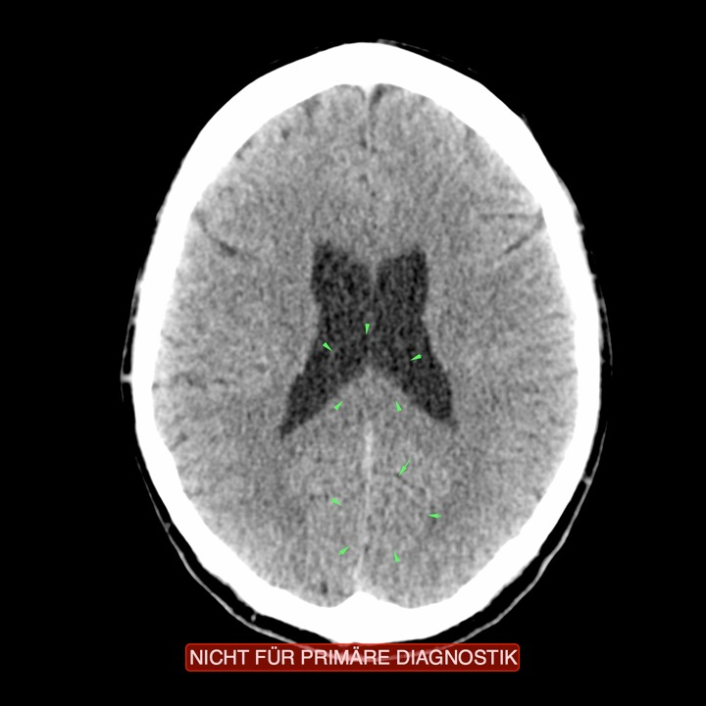
CT (above): Leg Epidermis, Recurring Conflict

Slide 8
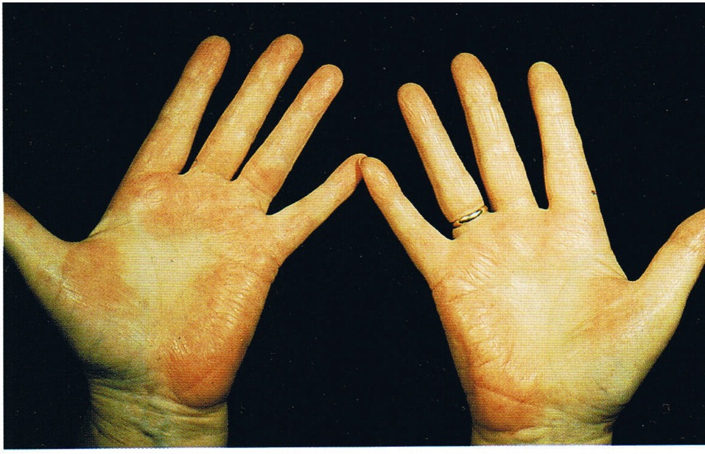
Neurodermatitis – Separation Conflict in Repair

Slide 9
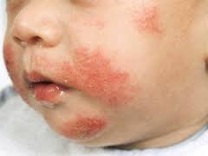
Separation Conflict in Repair: Neurodermatitis

Slide 10
Neurodermatitis: Separation Conflict in Repair

Slide 11
Eczema – Separation Conflict in Persistent Repair

Slide 12
Age Warts – Separation, Persistent Repair

Slide 13
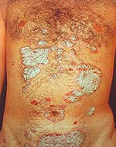
Psoriasis – Separation

Slide 14
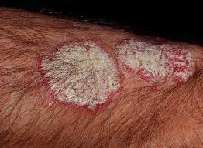
Psoriasis – Separation

Slide 15
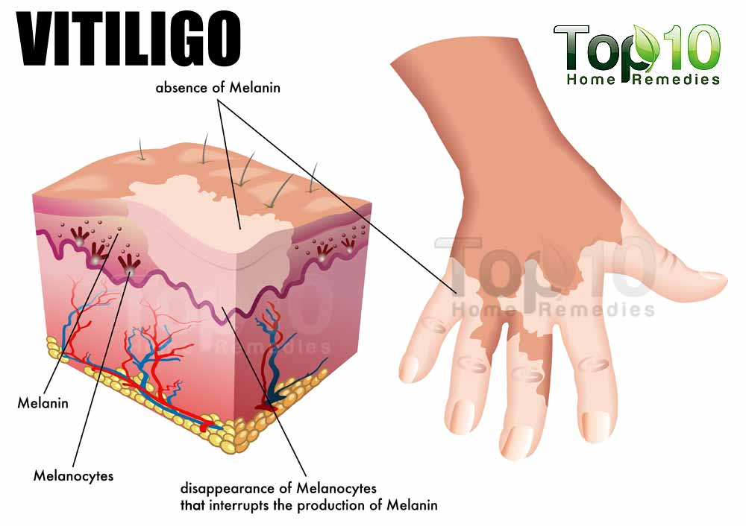

Slide 16
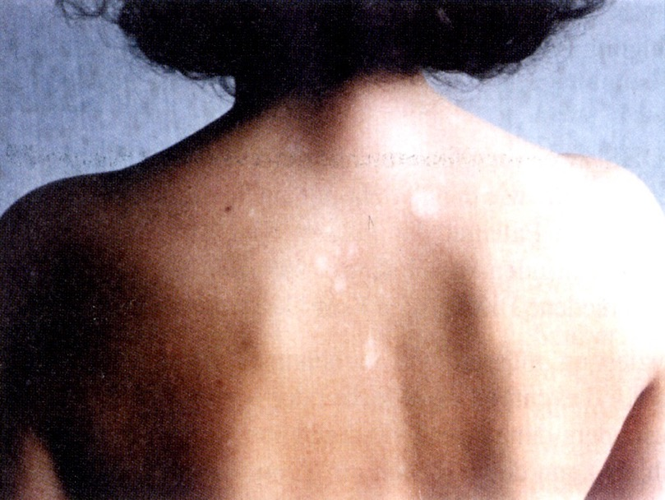
Vitiligo – Separation Conflict

Slide 17
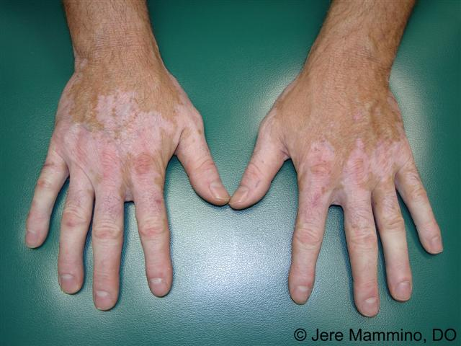
Vitiligo – Separation Conflict

Slide 18
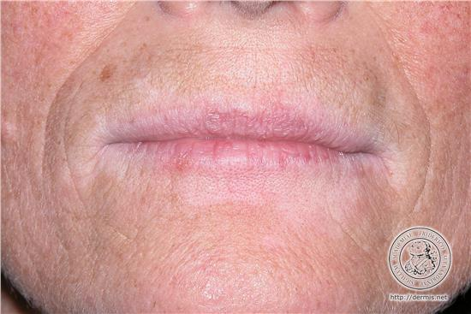
Vitiligo – Separation Conflict

Slide 19
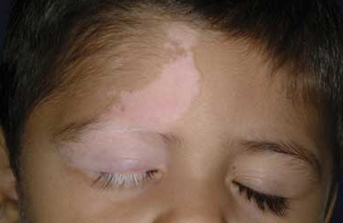
Vitiligo – Separation Conflict

Slide 20
Vitiligo – Separation Conflict

Slide 22
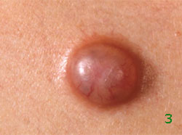
Basal Cell Cancer – Epidermis – Persistent Repair

Slide 23
Basal Cell Cancer – Basalioma

Slide 24
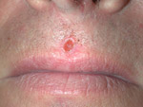
Basal Cell Cancer – Basalioma

Slide 25
Liver Spots – Separation Conflict Persistent

Slide 26
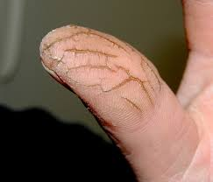
Cracked Skin, Heels: Separation Conflict

Slide 27
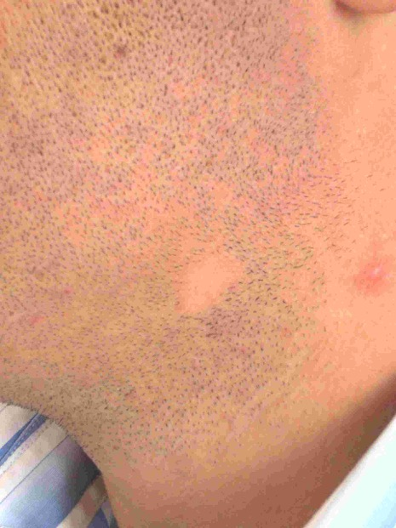
Circular Hair Loss – Alopecia

Slide 28
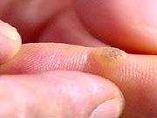
Warts – Epidermis – Separation Conflict

Slide 29
Skin, Hair
Haut - Übersicht

Slide 30
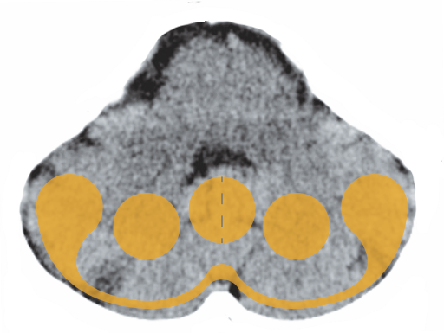
Cerebellum – Dermis

Slide 31
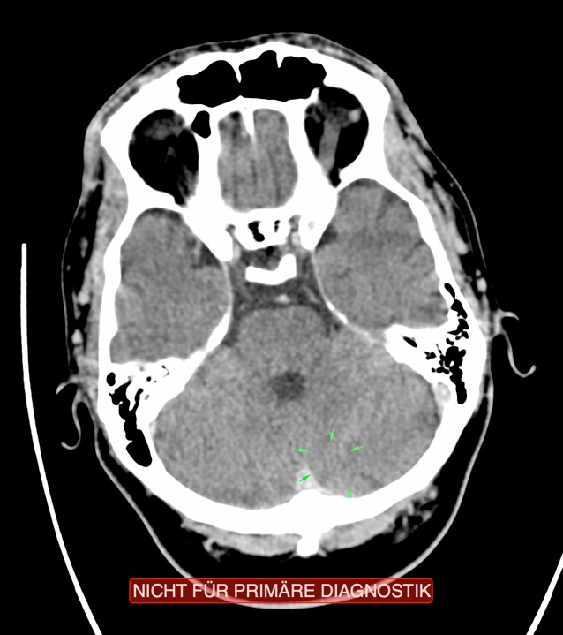
CT: Dermis, Active Conflict
Akne

Slide 32
Melanoma – Dermis

Slide 33
Shingles – Disfigurement Conflict, Repair Phase

Slide 34
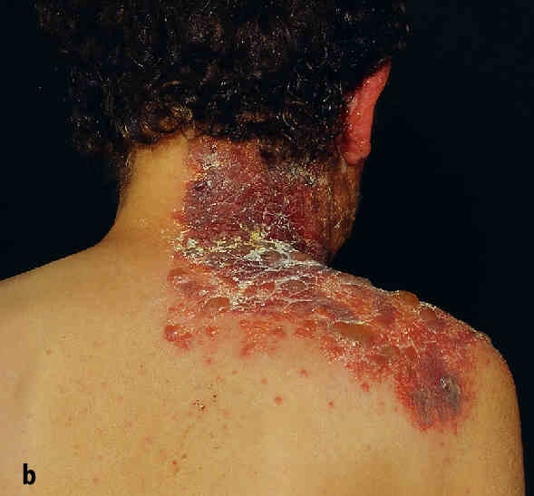
Shingles – Disfigurement Conflict, Repair Phase

Slide 35
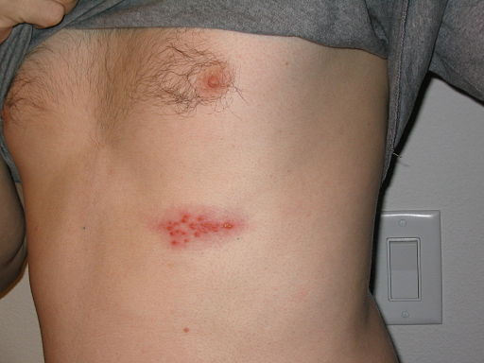
Shingles – Disfigurement Conflict, Repair Phase

Slide 36
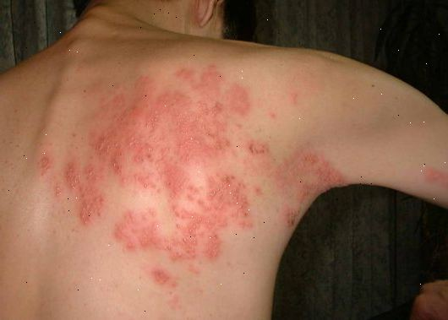
Shingles – Disfigurement Conflict, Repair Phase

Slide 37
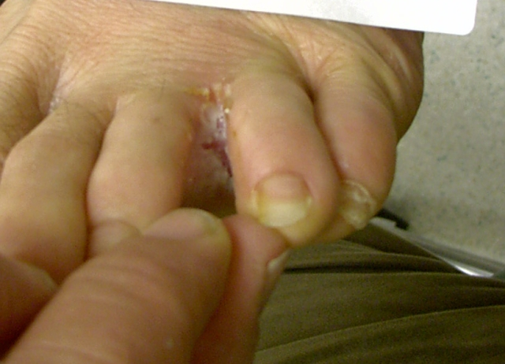
Skin and Nail Fungus – Disfigurement Conflict

Slide 38
Using Black Salve on a Basalioma

Slide 39
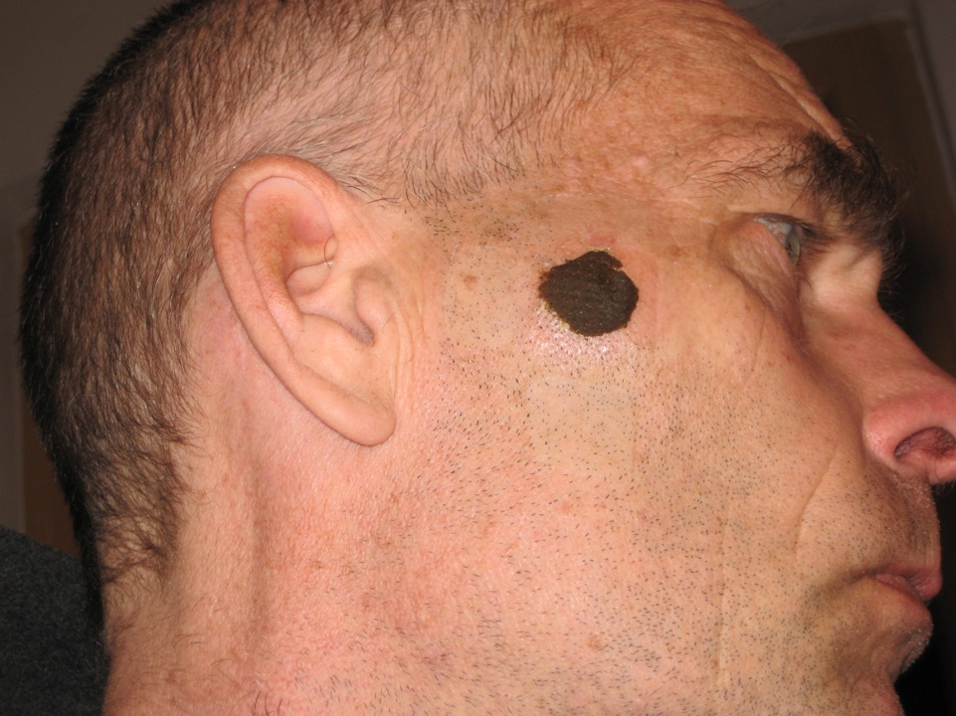
1. Tag

Slide 40
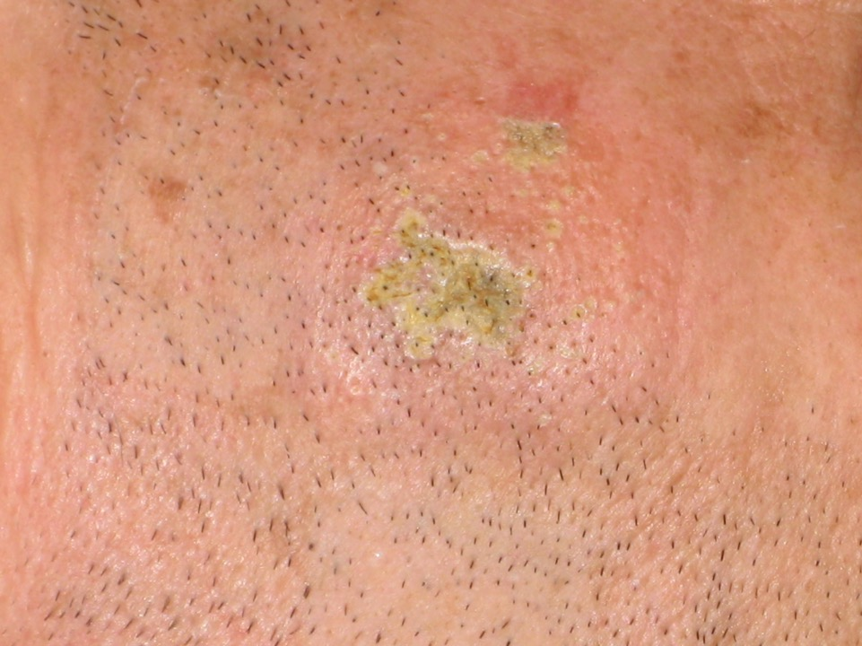
1. Tag

Slide 41
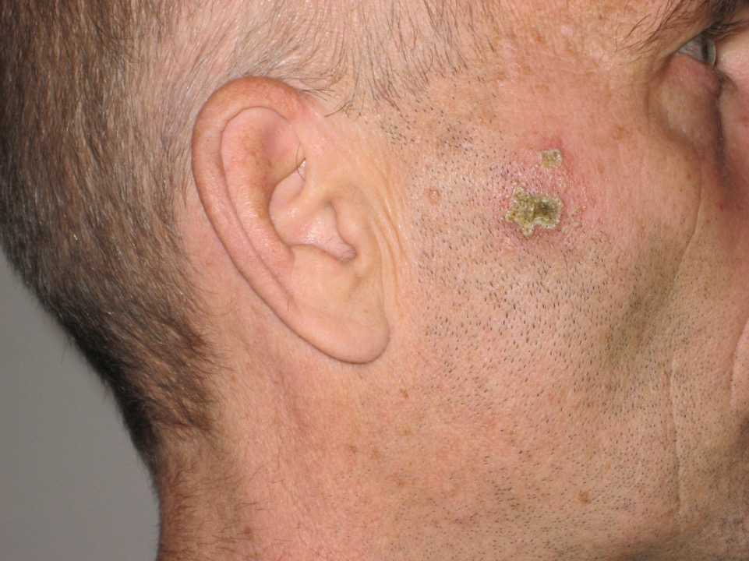
2. Tag

Slide 42
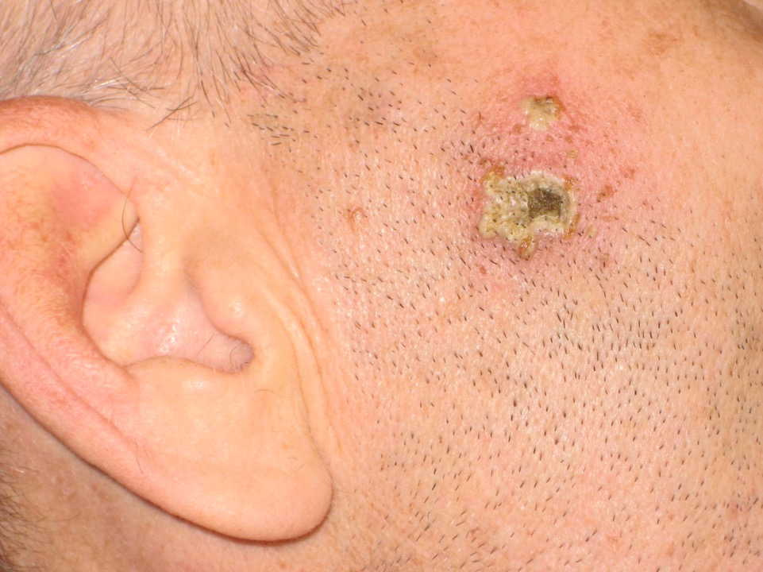
3. Tag

Slide 43
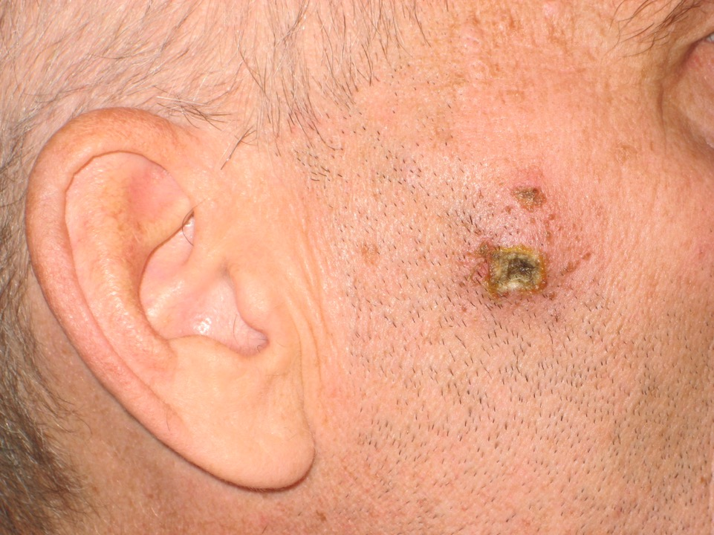
4. Tag

Slide 44
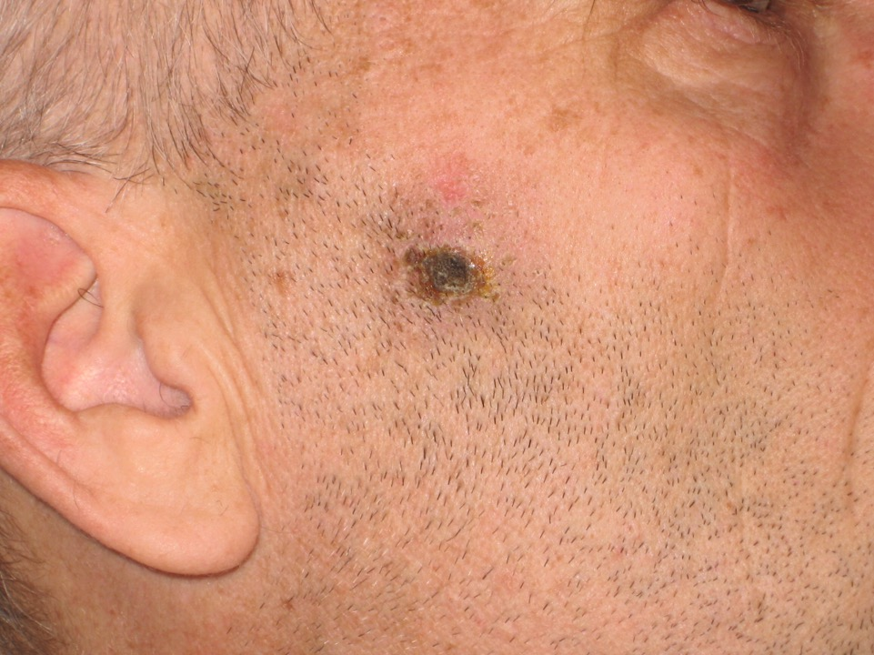
6. Tag

Slide 45
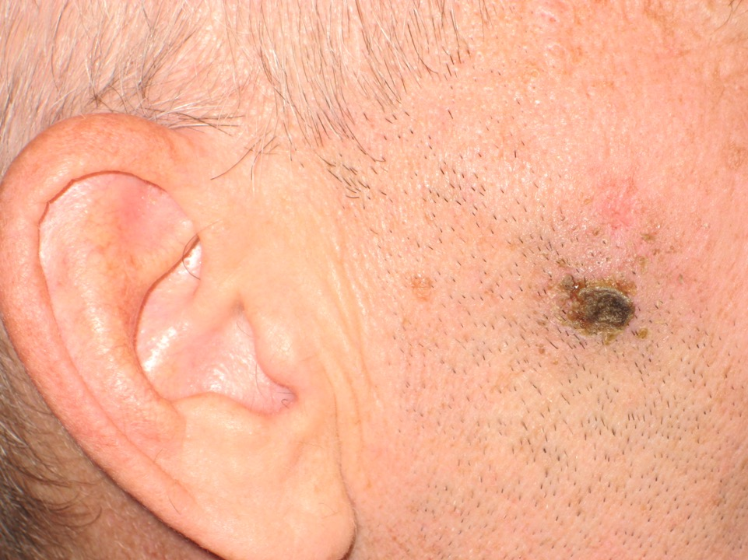
7. Tag

Slide 46
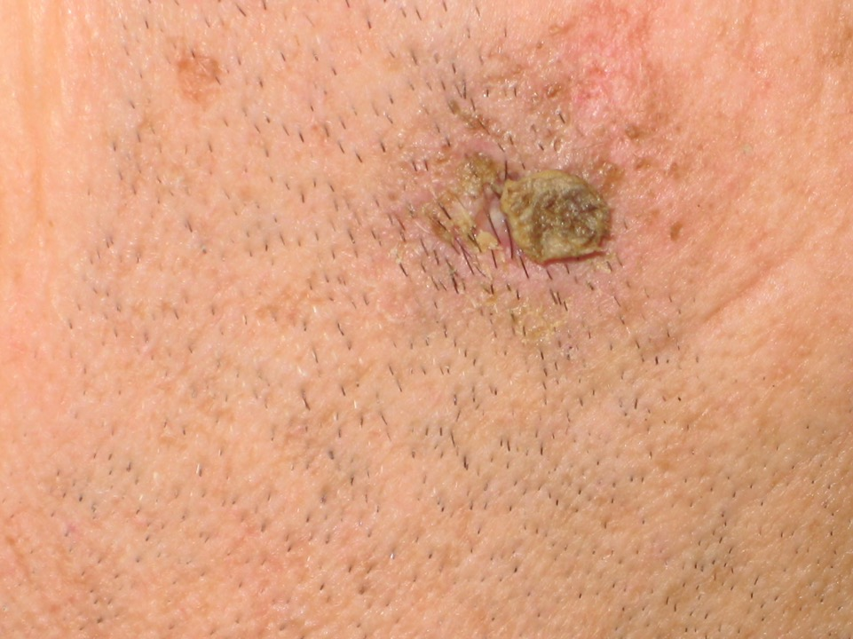
9. Tag

Slide 47
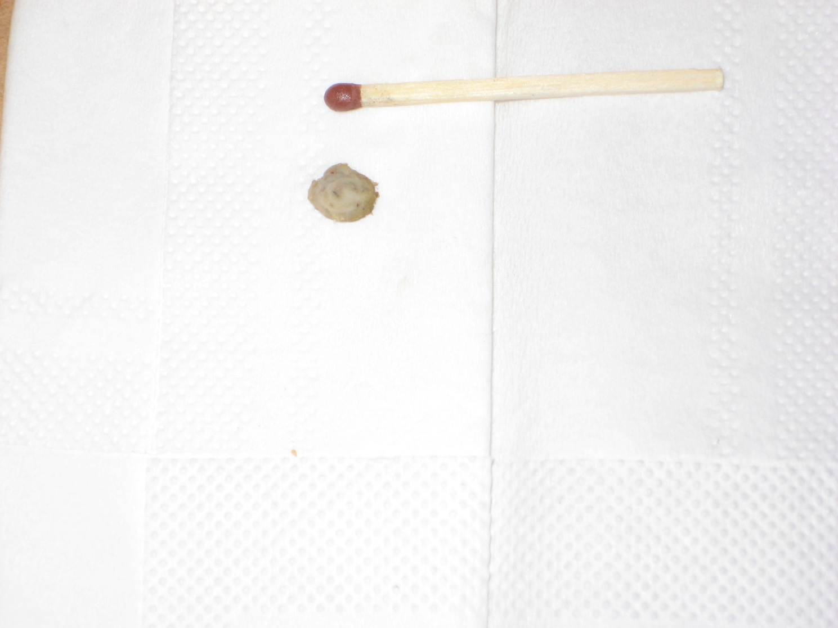
9. Tag

Slide 48
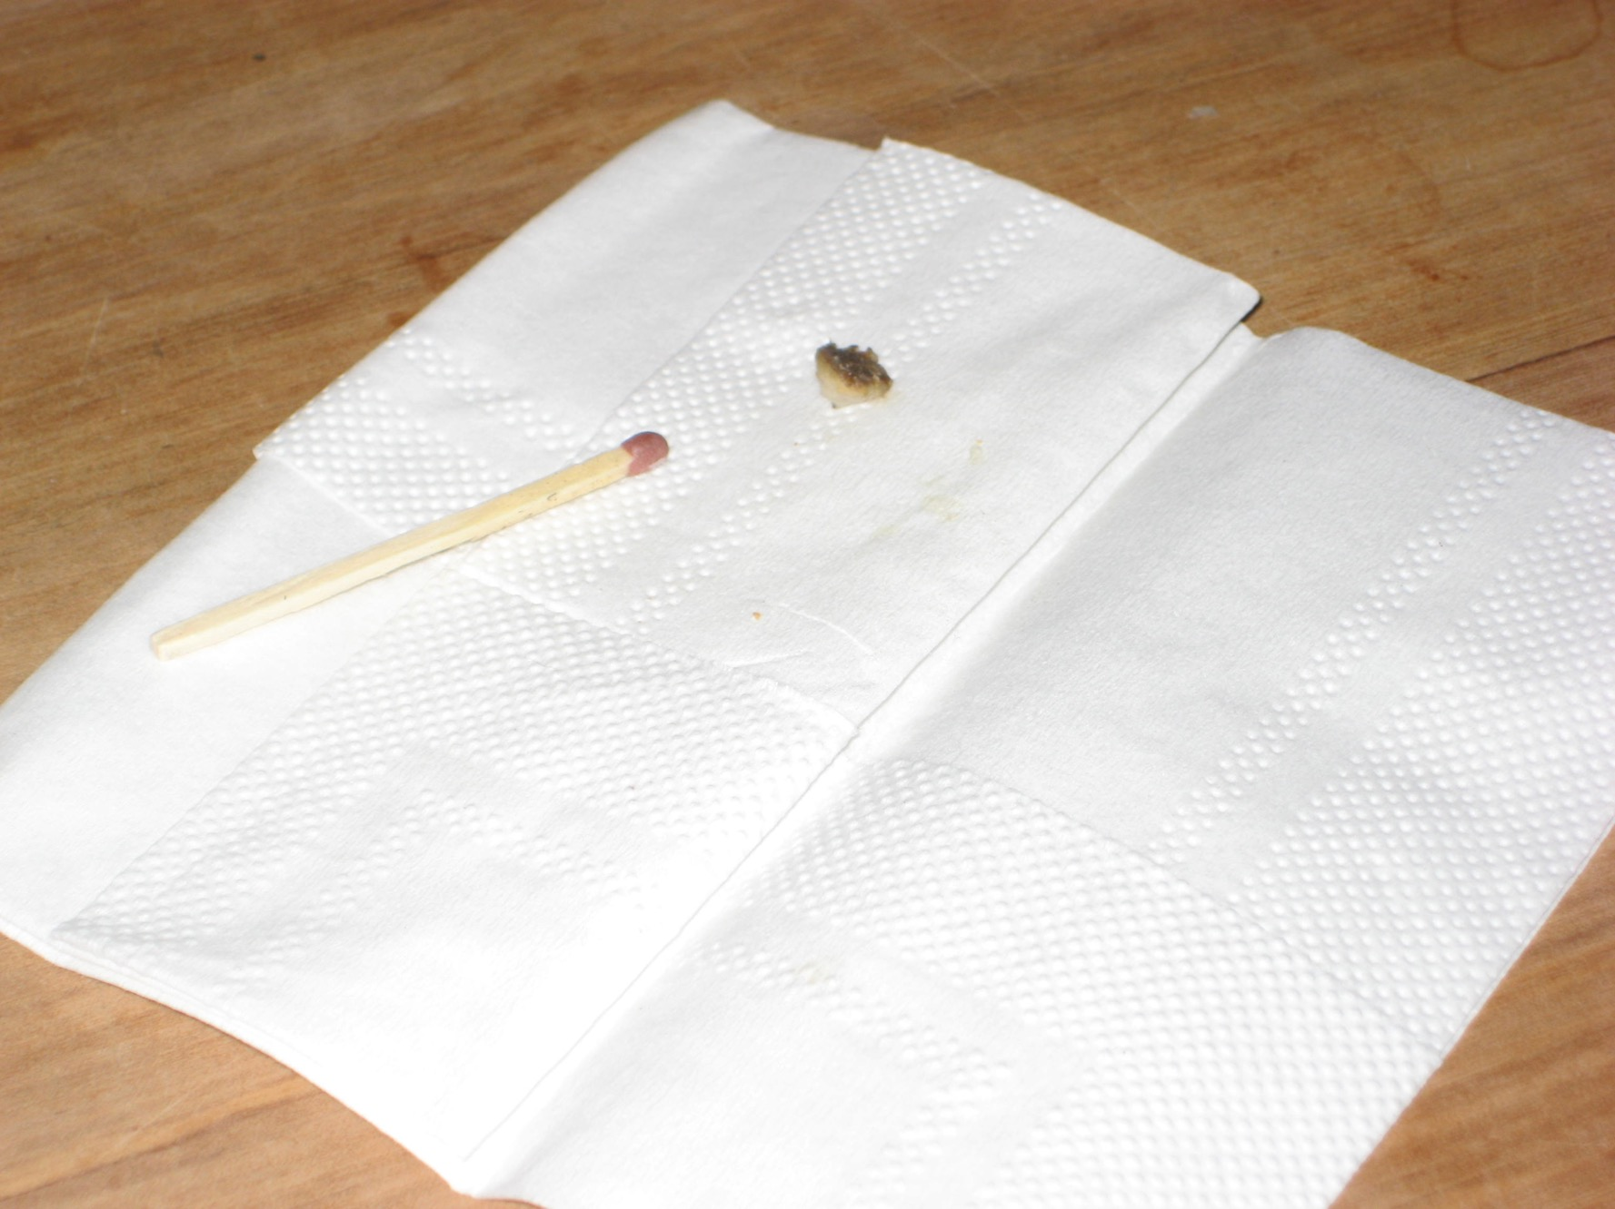
9. Tag

Slide 49
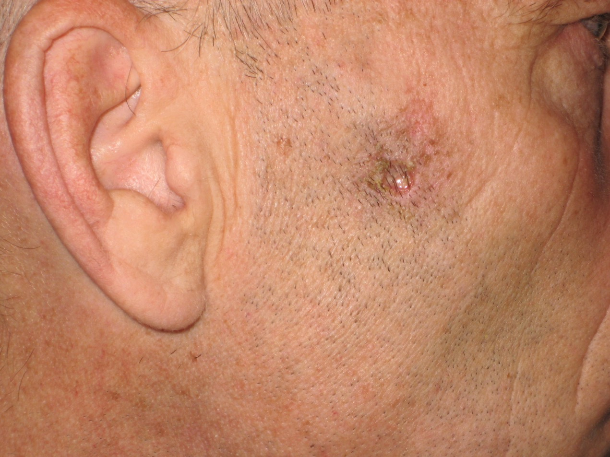
9. Tag

Slide 50
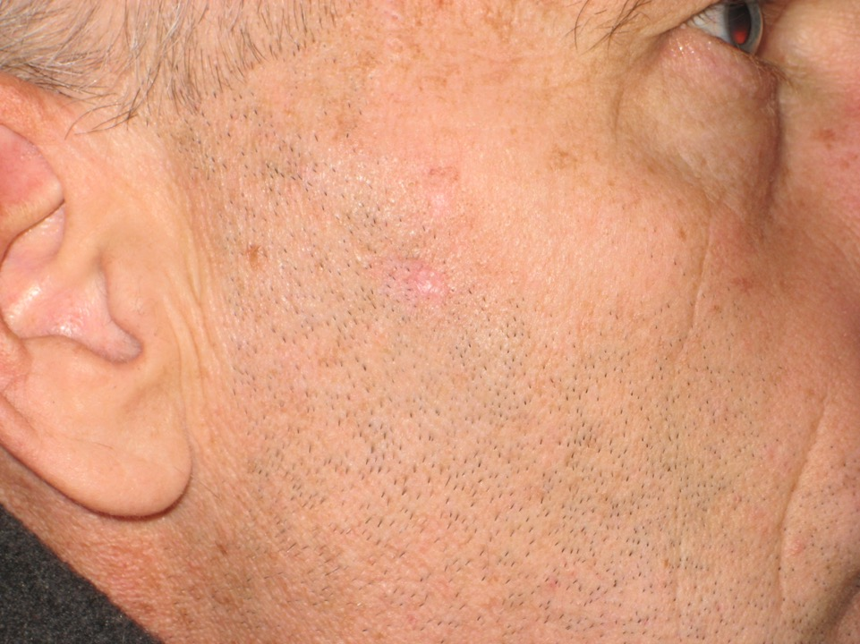
32. Tag

Slide 51
Melanoma
Boy:
Black Salve

Slide 52
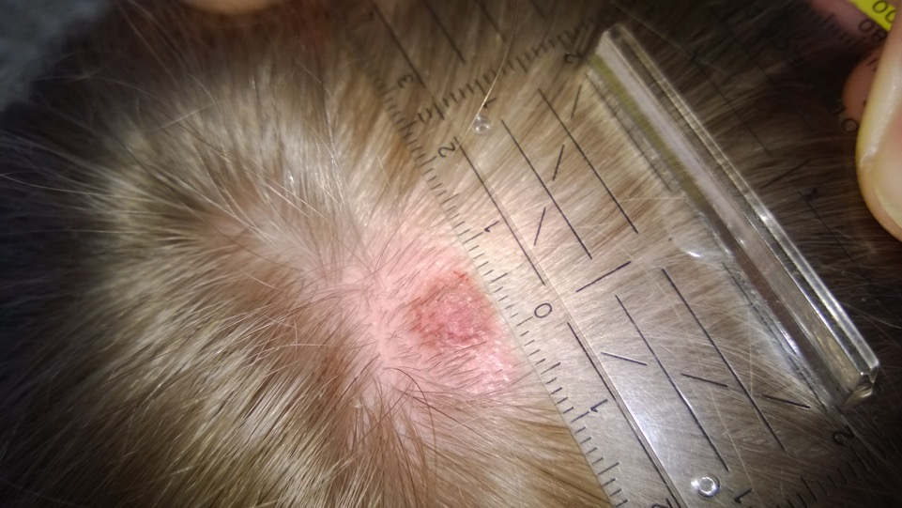
1. Tag

Slide 53
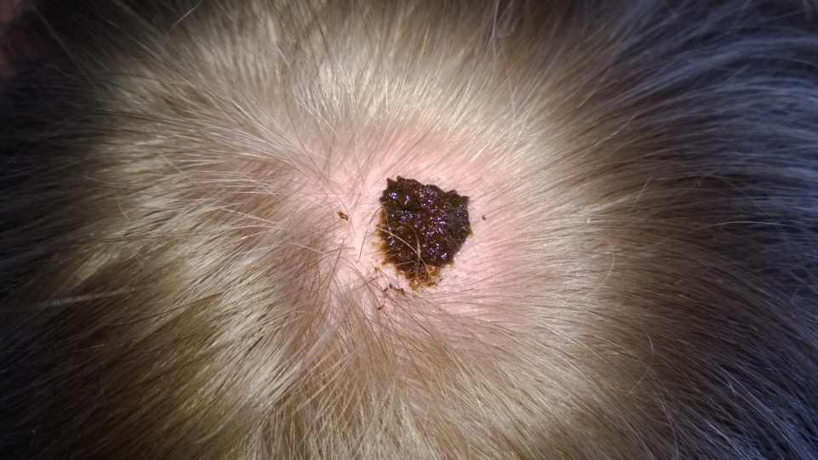
2. Tag

Slide 54
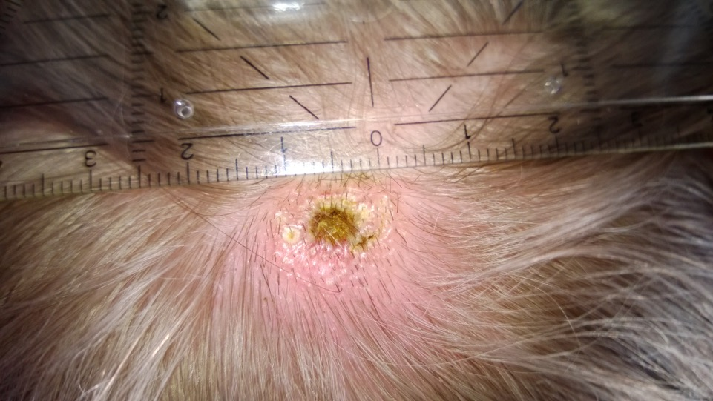
3. Tag

Slide 55
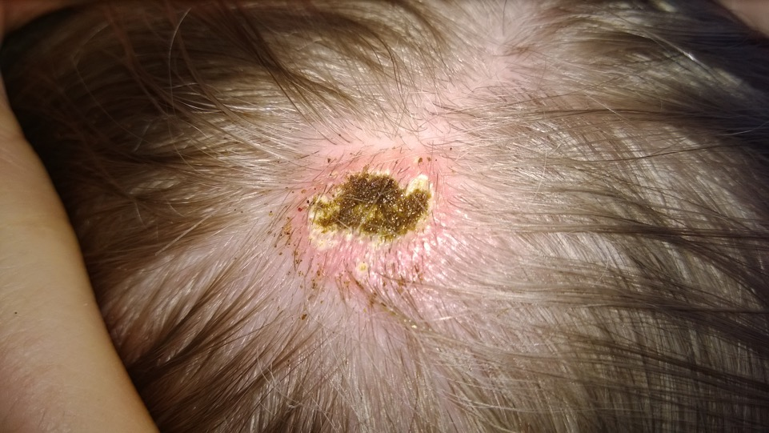
4. Tag

Slide 56
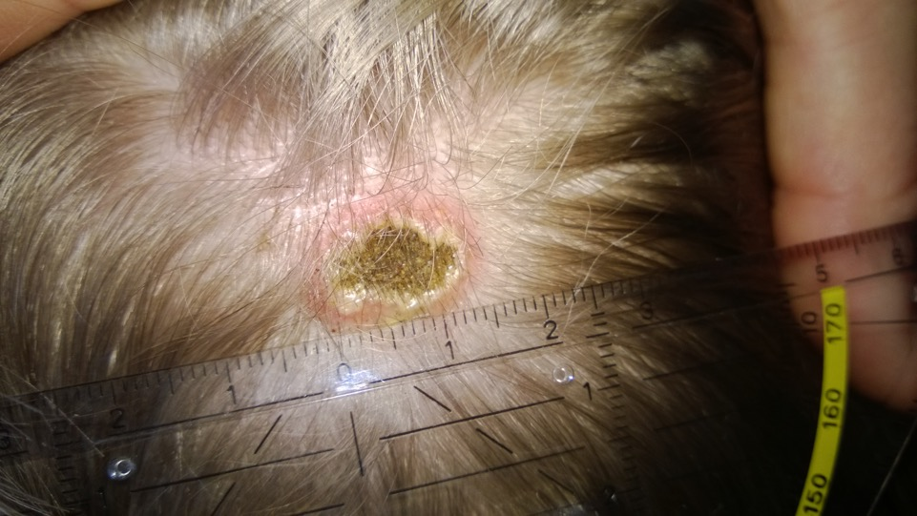
5. Tag

Slide 57
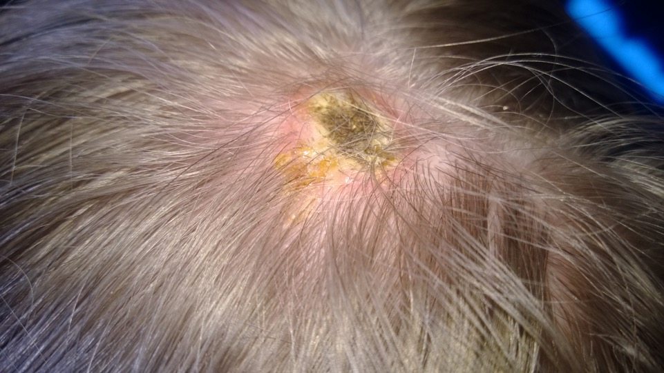
5. Tag

Slide 58
7. Tag

Slide 59
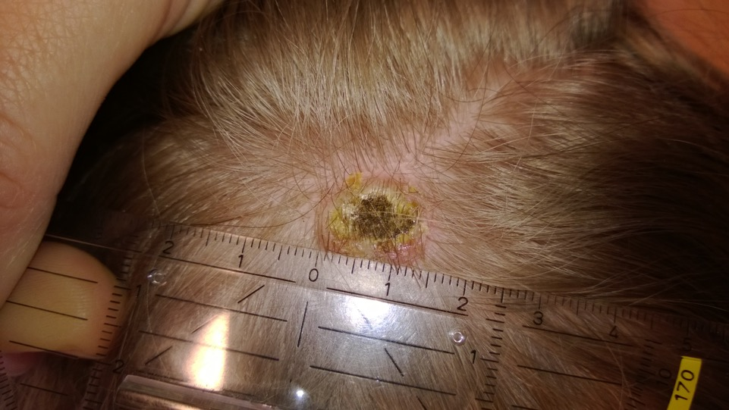
8. Tag

Slide 60
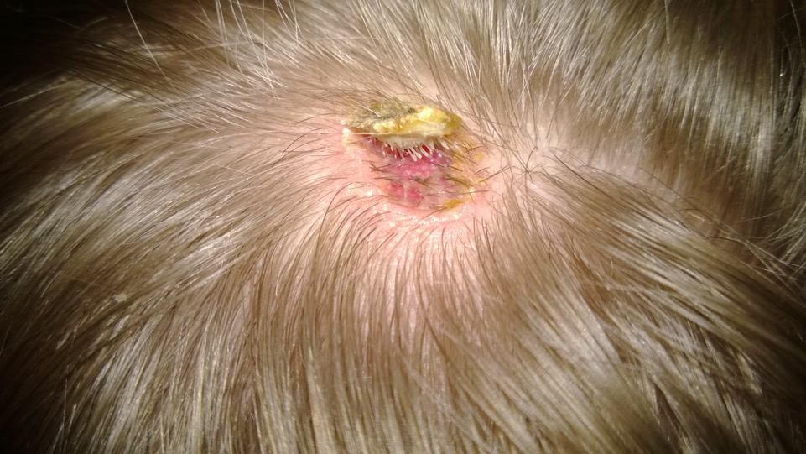
9. Tag

Slide 61
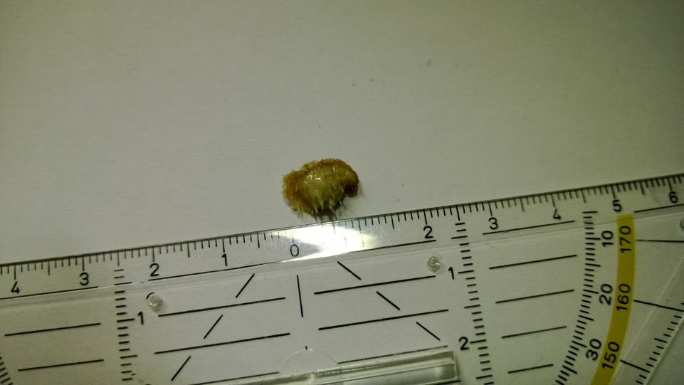
9. Tag

Slide 62
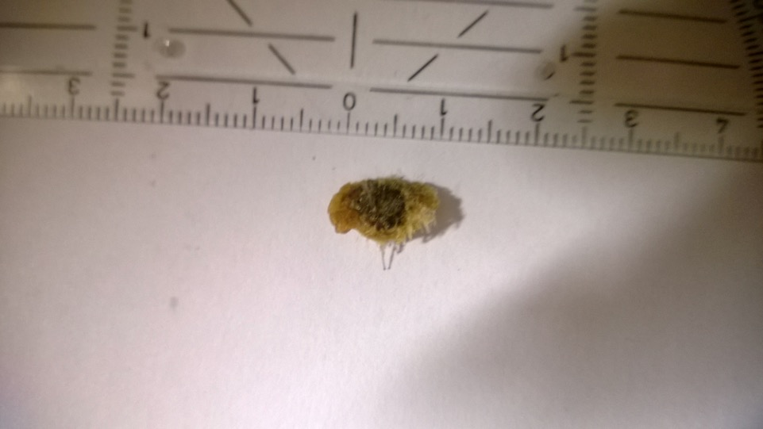
9. Tag

Slide 63
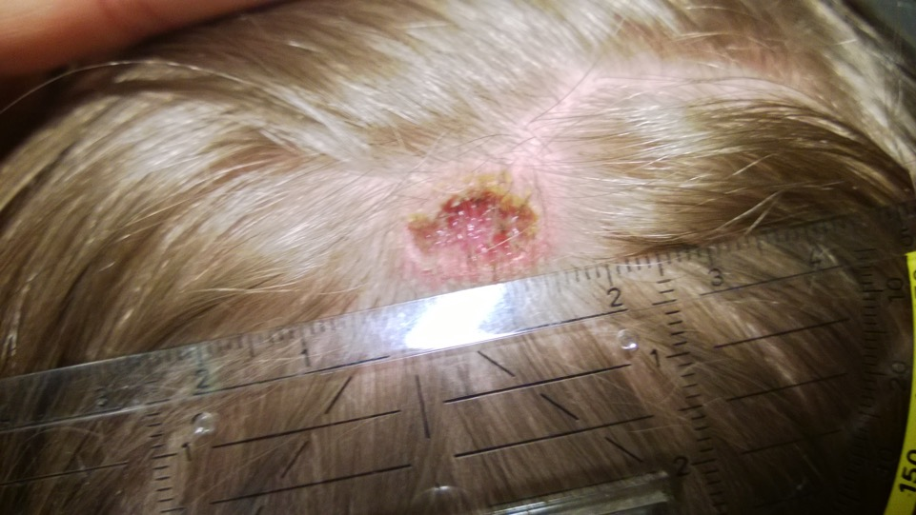
9. Tag

Slide 64
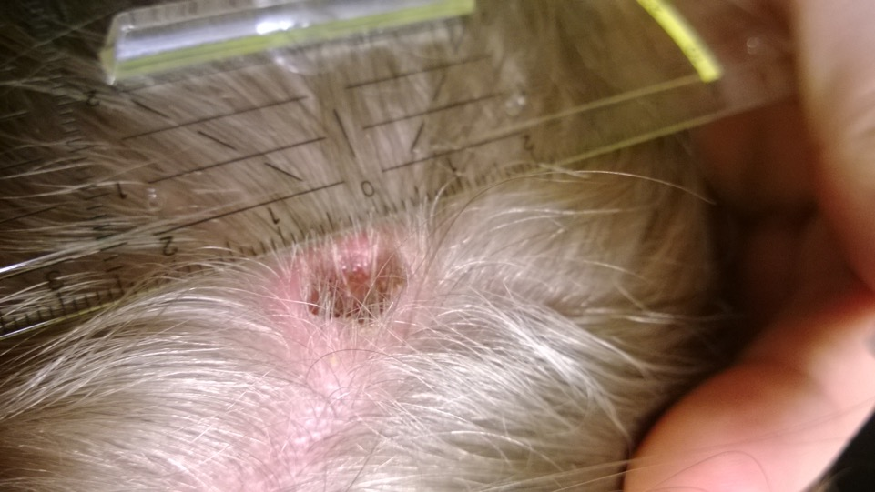
10. Tag

Slide 65
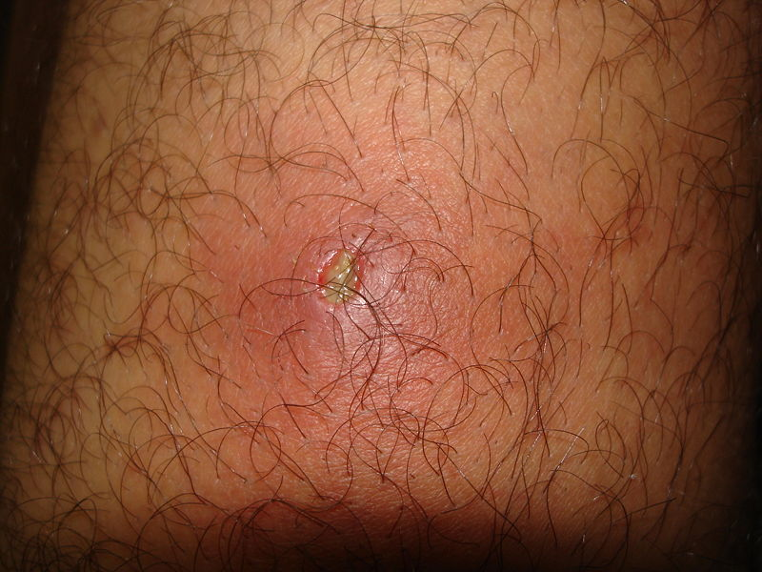
Furuncle – Folliculitis

Slide 66
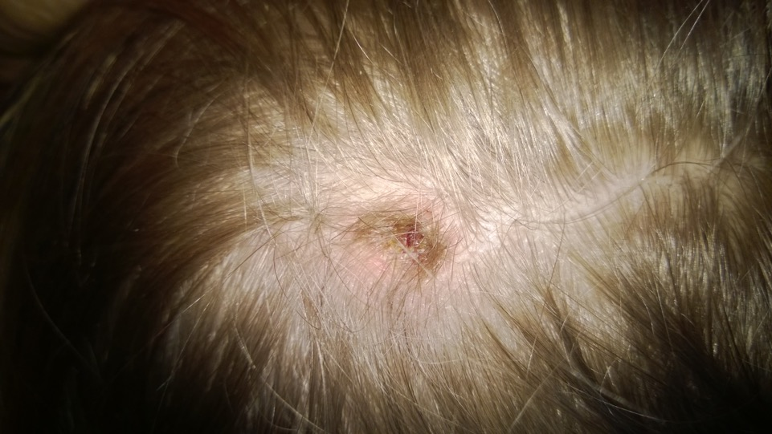
15. Tag

Slide 67
Skin, Hair
Haut - Übersicht

Slide 68
Cerebral White Matter –
Subcutis: Connective and Fatty Tissue

Slide 69
Cellulite – Aesthetic Self-esteem

Slide 70
Stretch Marks – Striae: Self-esteem

Slide 71
Stretch Marks – Striae: Self-esteem

Slide 72
Telangiectasia – Spider Veins: Self-worth Conflict
Besenreiser

Slide 73
Keloid – Self-esteem in Relation to the OP ...

Slide 74
Strawberry Mark (Hamangioma) – Self-esteem C.

Slide 75
Lipoma (Operation) – Aesthetic Self-esteem

Slide 76
Keloid Scarring – Self-esteem

Slide 77
Keloid Scarring – Self-esteem

Slide 78
Rhinophyma – Self-worth

Slide 79
Cellulite – Aesthetic Self-esteem

Slide 80
Stretch Marks – Aesthetic Self-esteem

Slide 82
Circular Hair Loss – Active Separation

