Slide 1
Prostate

Slide 2
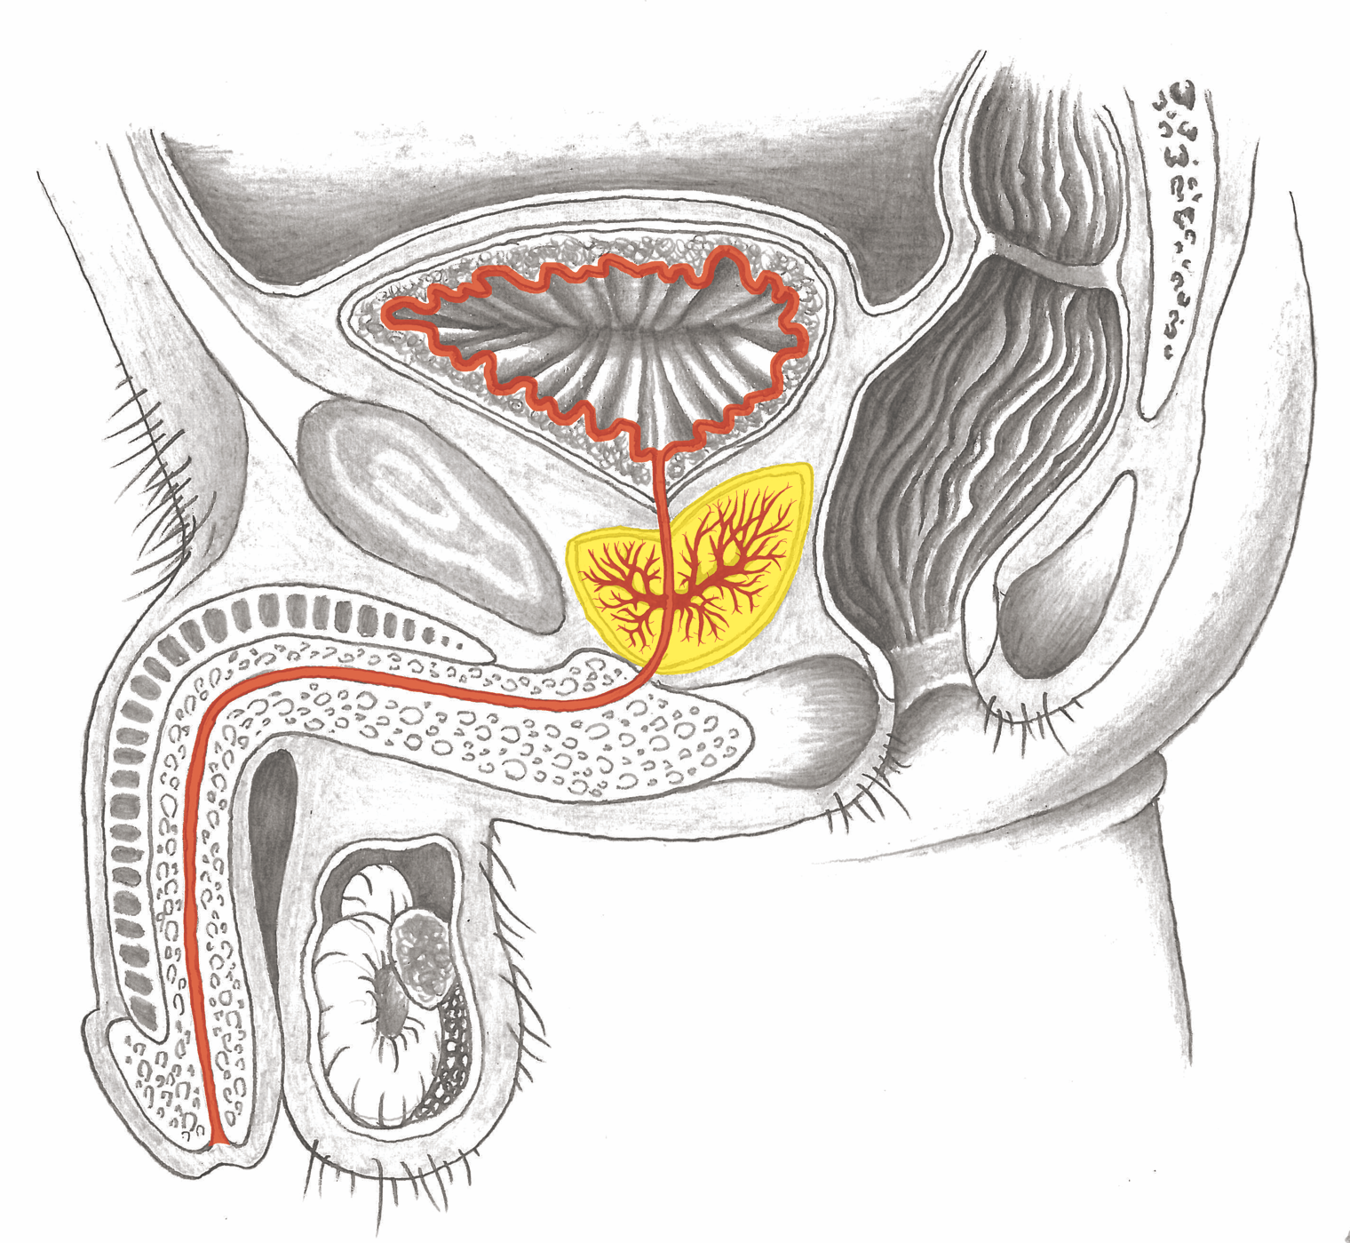
Prostate

Slide 3
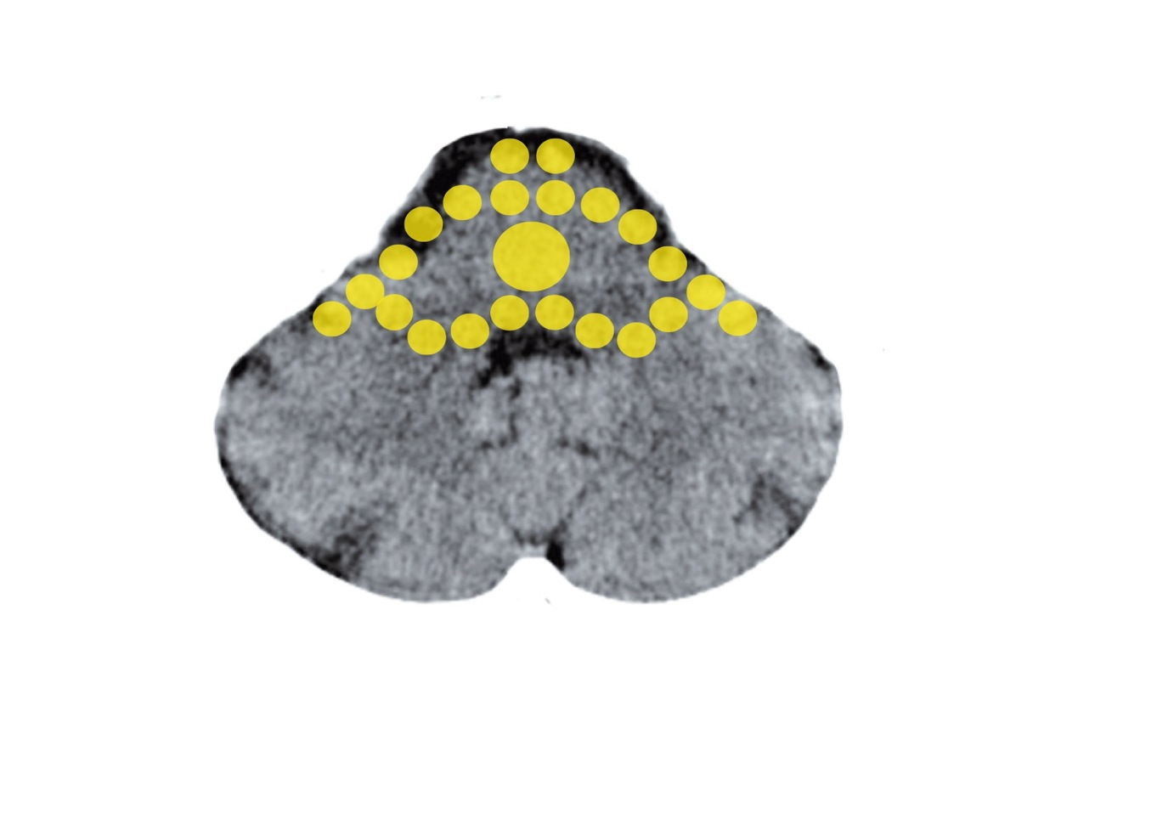
Brain Stem – Prostate
Mittelohr und Tuba eustachii - Stammhirn

Slide 4
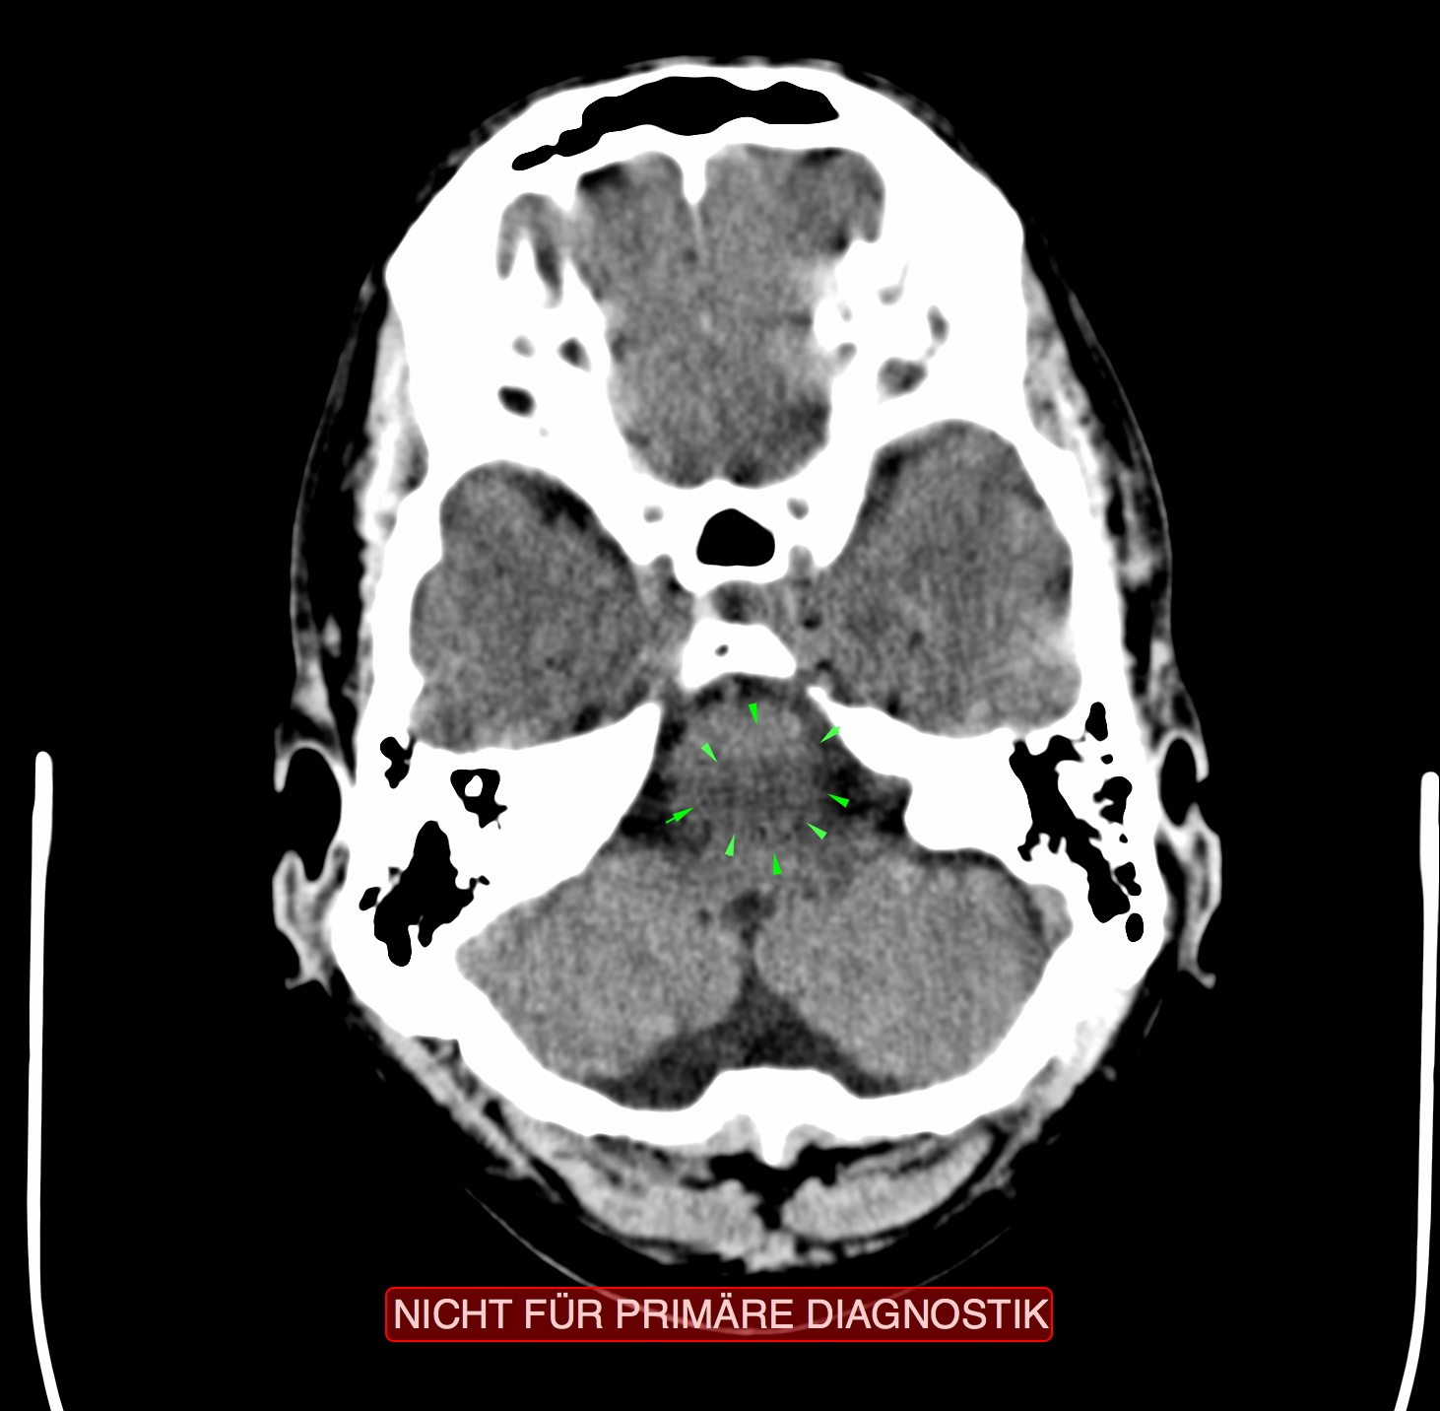
CT – Prostate in the Brain Stem

Slide 6
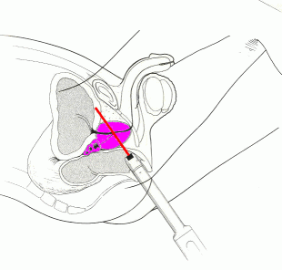
Prostate – Biopsy

