Slide 1
Testicles
and Penis

Slide 2
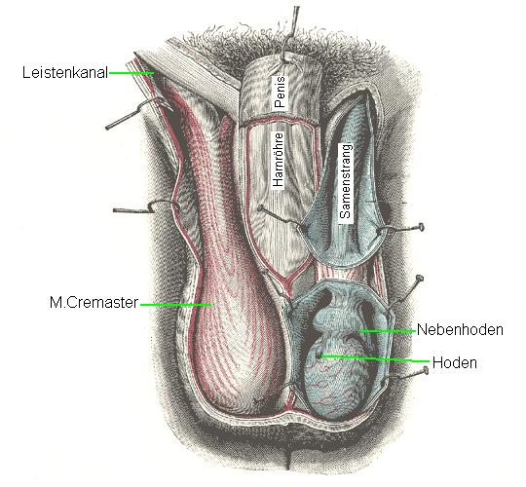
Testicles, Epididymides, Spermatic Cord
Hoden

Slide 3
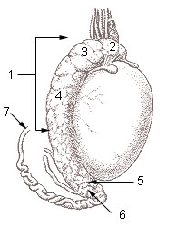
Epididymidis
Hoden

Slide 4
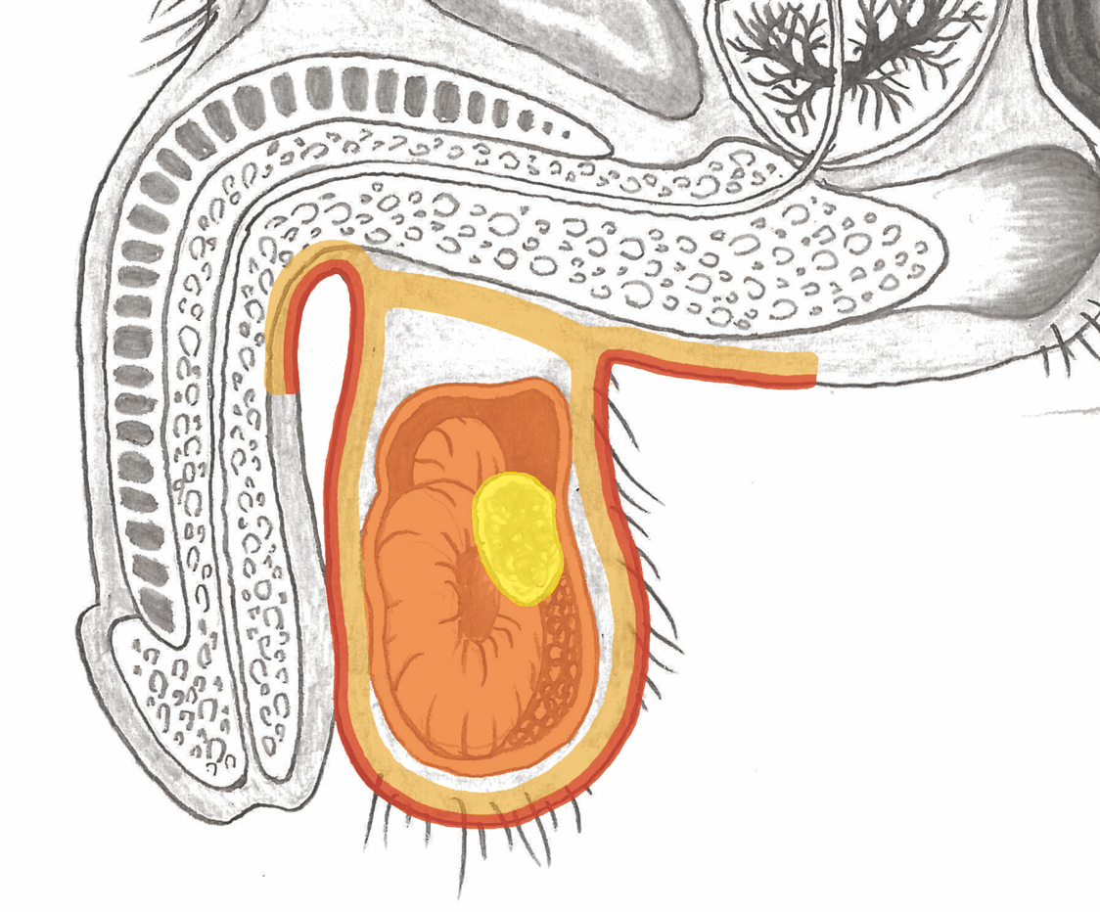
Testicle

Slide 5
Historic Picture: Collective Giant Testicles?

Slide 6
Testicles – “Elephantiasis” ?

Slide 7
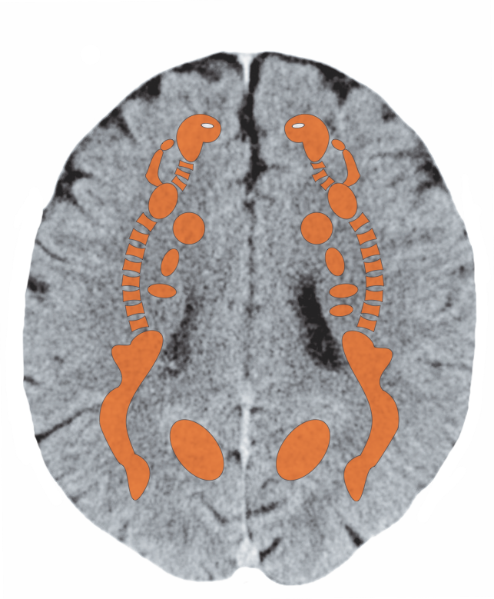
Cerebral White Matter – Testicles, Ovaries

Slide 8
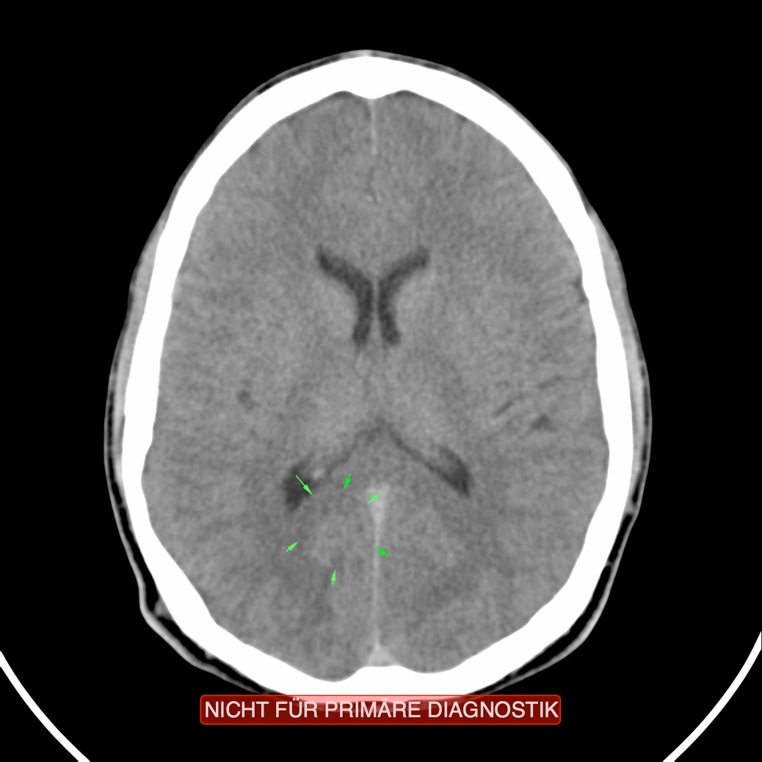
CT – Testicle, Active Conflict

Slide 9
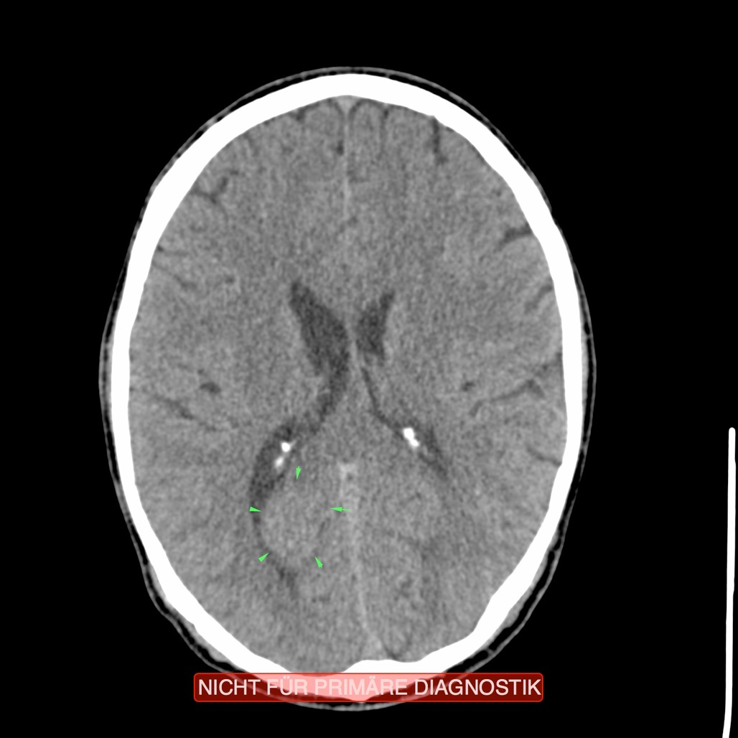
CT – Testicle, Recurring, Active Conflict

Slide 10
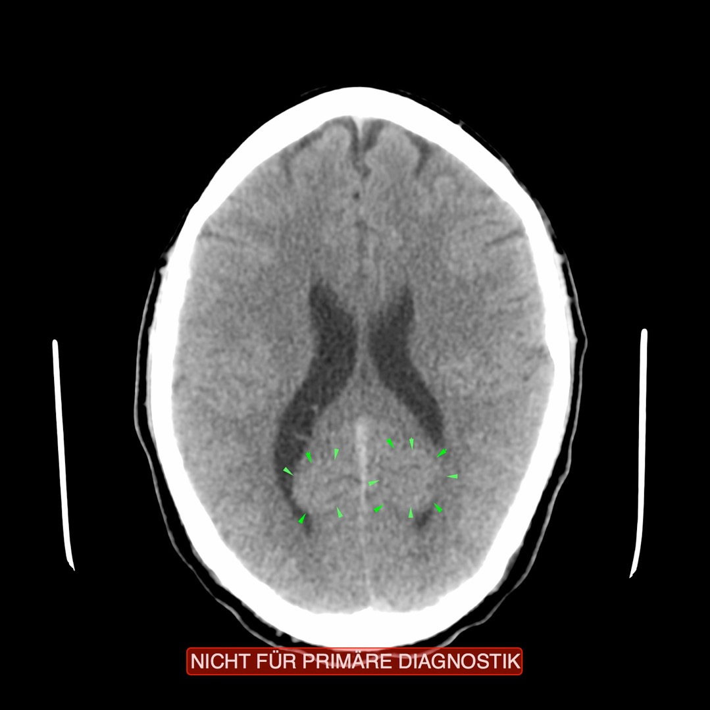
CT – Testicles, Recurring Conflict, Both Sides

Slide 11
Testicle

Slide 12
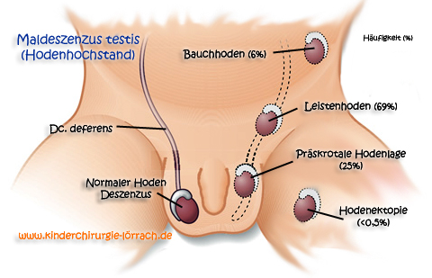
Testicular Descent: most often a proxy conflict
for the parents in relation to masculinity
Hoden

Slide 13
Hydrocele: Conflict – Attack on the Testicles
Hoden

Slide 14
Penis

Slide 15
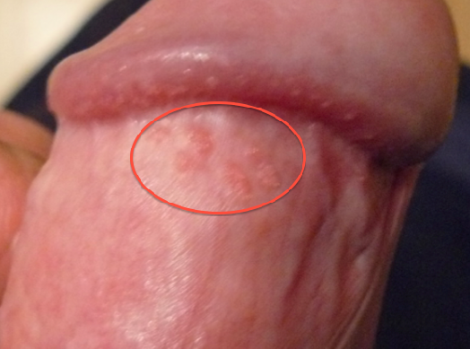
Hirsuties Coronae Glandis – Separation Conflict

Slide 16
Hirsuties Coronae Glandis – Separation Conflict

Slide 17
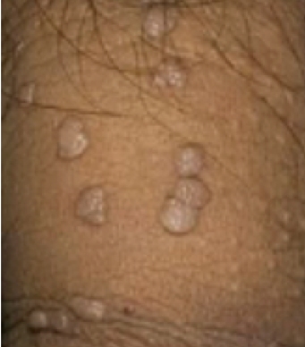
Genital Warts – Separation Conflict

Slide 18
Phimosis (Narrowing of the Foreskin)

Slide 19
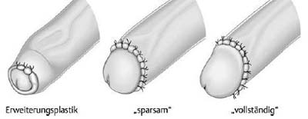
Phimosis – Operation

