Slide 1
External
Female
Sex Organs
- Vulva

Slide 2
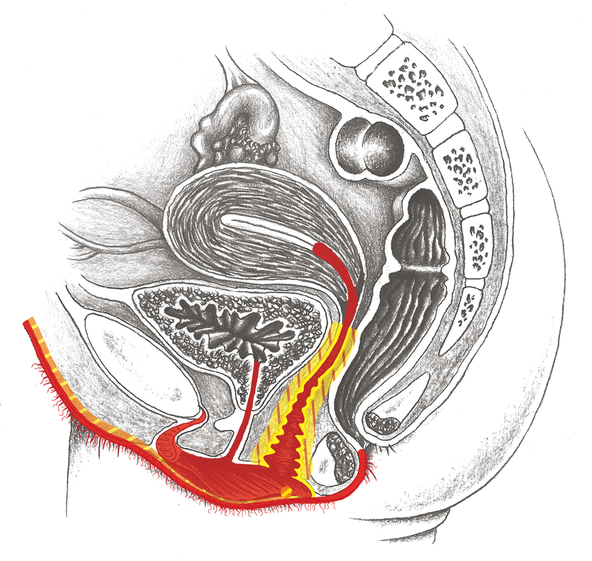
External Female Genitals, Vagina

Slide 3
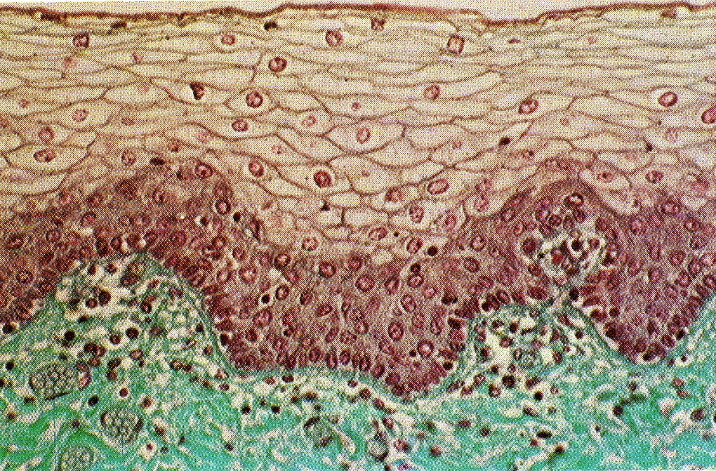
Vagina – Squamous Epithelium – Tissue Cross Section

