Slide 1
Uterus

Slide 2
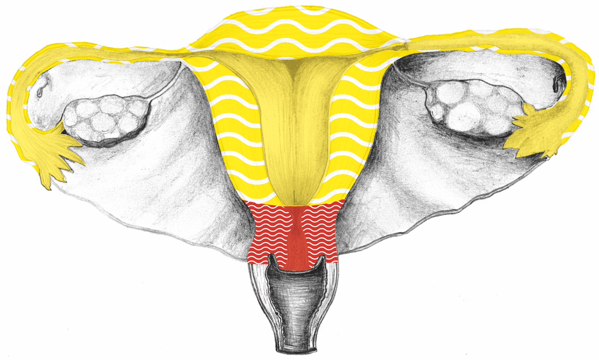
Uterus, Fallopian Tubes

Slide 3
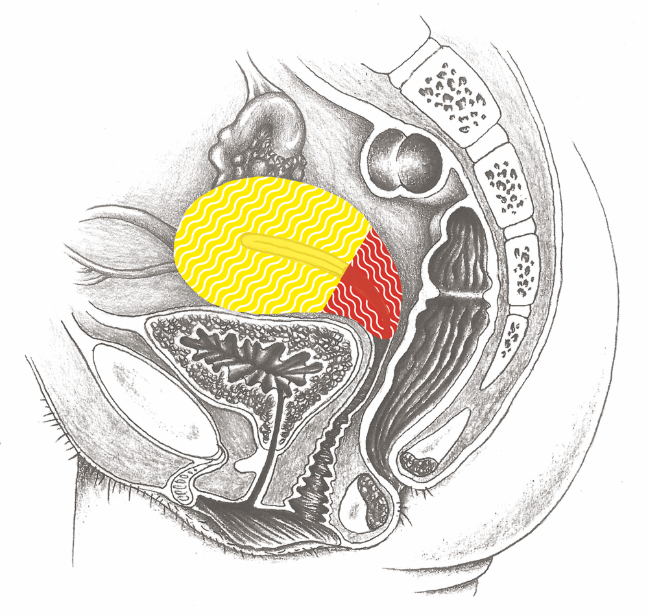
Uterus

Slide 4
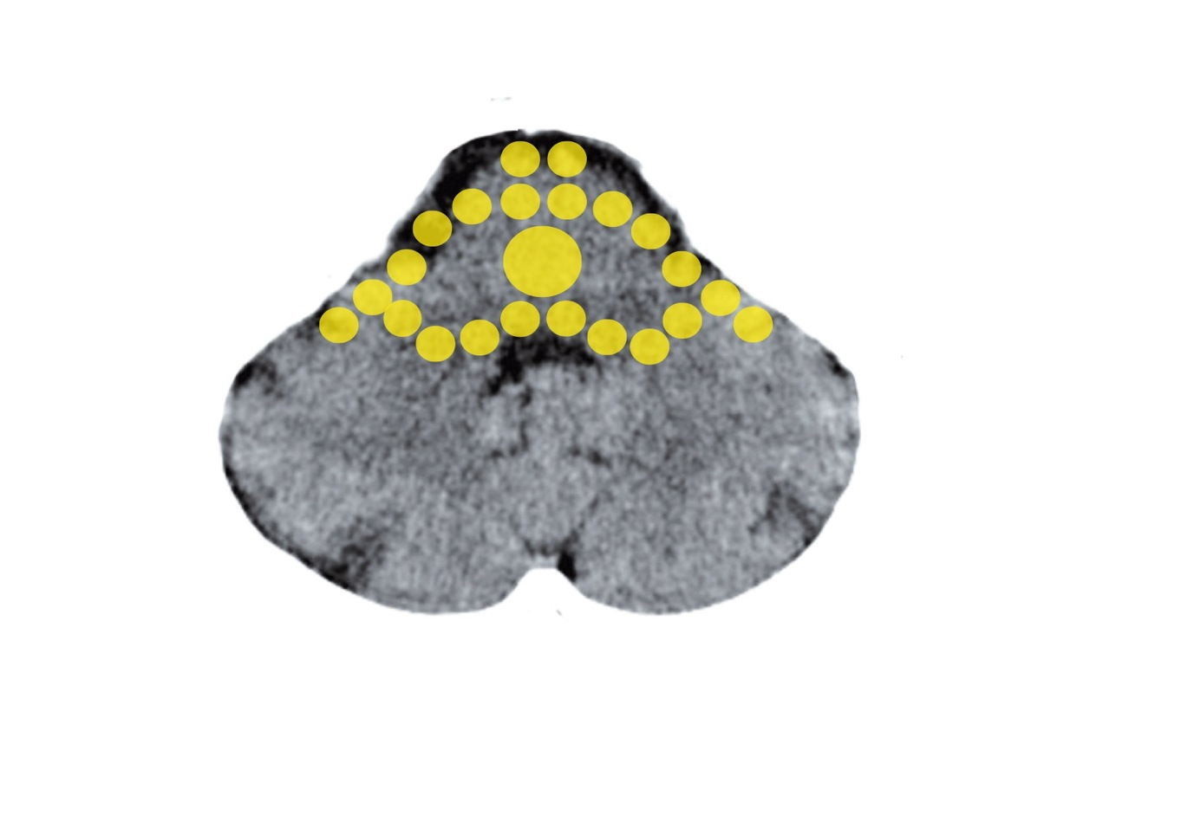
Brain Stem – Uterine Mucosa
Mittelohr und Tuba eustachii - Stammhirn

Slide 5
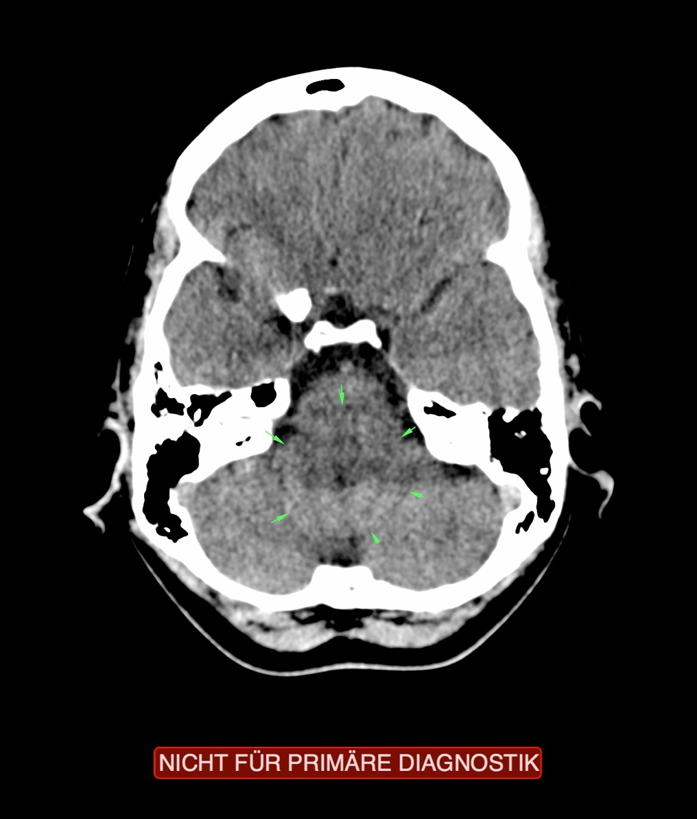
CT: Uterine Body, Active Conflict

Slide 6
Musculature of the Uterus

Slide 7
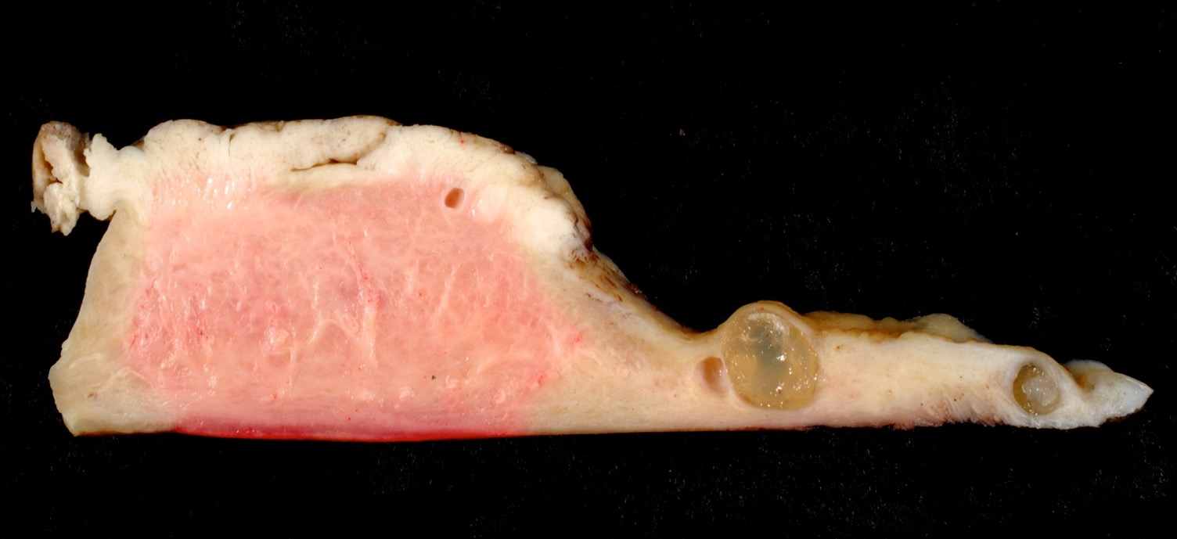
Uterus – Cancer – Specimen

Slide 8
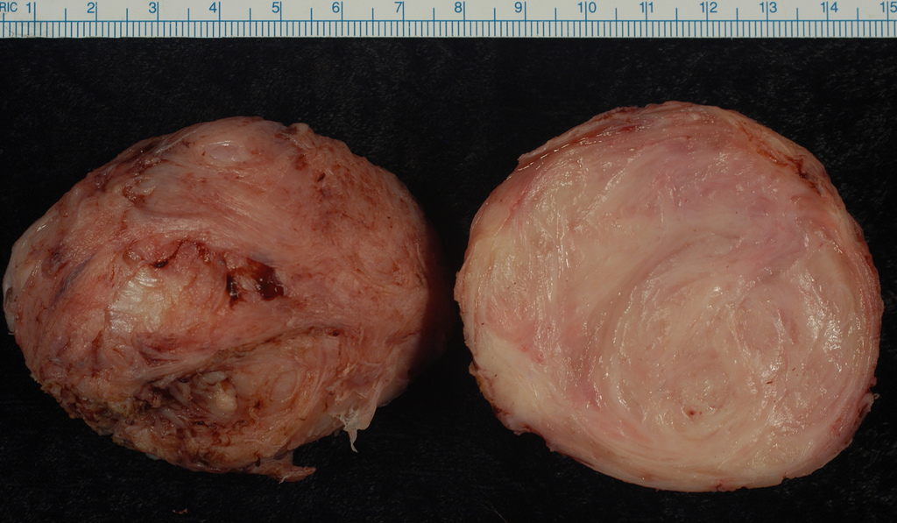
Specimen: Uterine Muscle – Rhabdomyoma

Slide 9
Retroverted Uterus: Avoiding Conception

Slide 10
Cervix

Slide 11
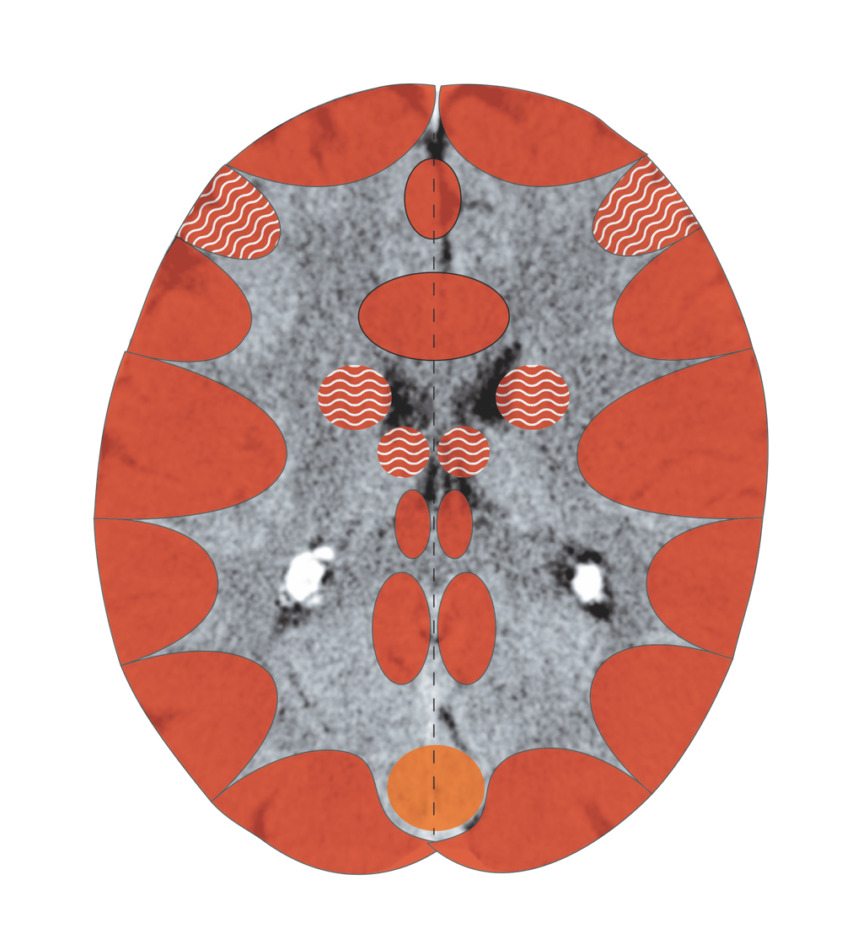
Cerebral Cortex – Cervix Mucosa
Notes:
11

Slide 12
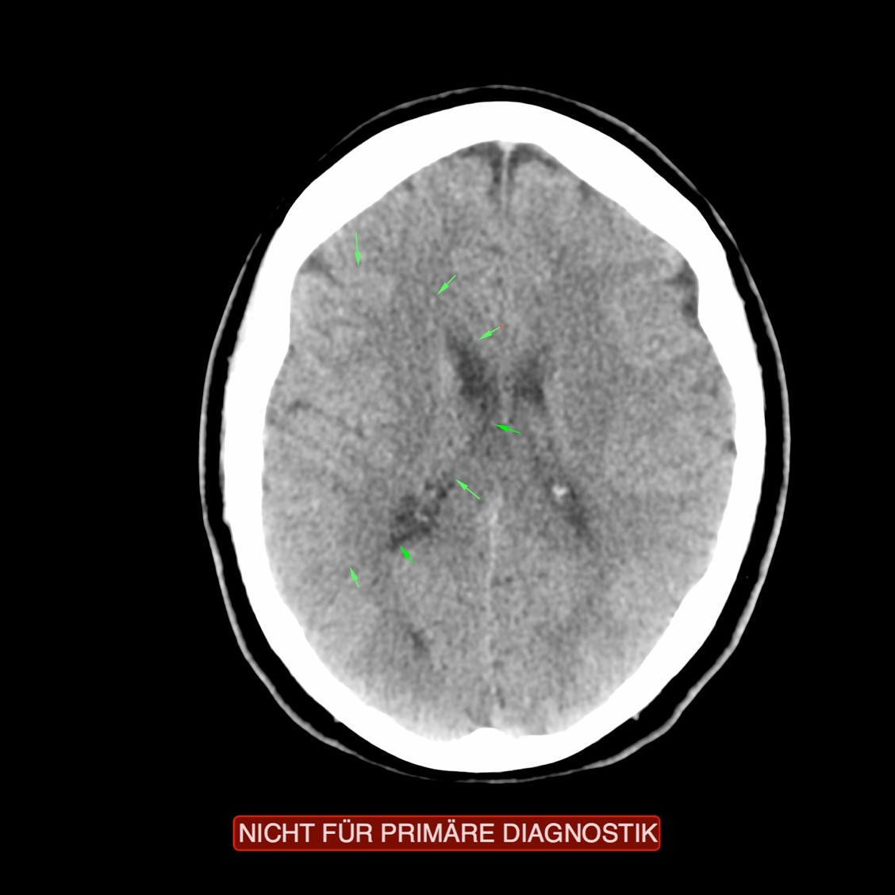
CT: Cervix, Large, Moderately Active Focus

Slide 13
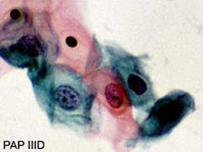
PAP Smear

Slide 14
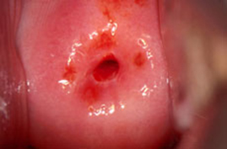
Healthy Cervix (Cervical Neck)

Slide 15
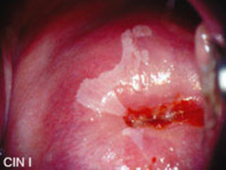
Slight Dysplasia
Female-sexual Territorial Conflict

Slide 16
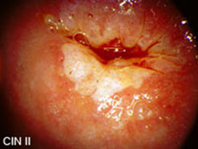
Moderate Dysplasia
Female-sexual Territorial Conflict

Slide 17
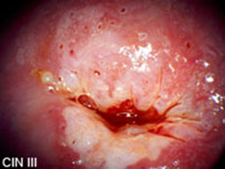
Serious Dysplasia
Female-sexual Territorial Conflict

