Slide 1
Ovaries Fallopian Tubes

Slide 2
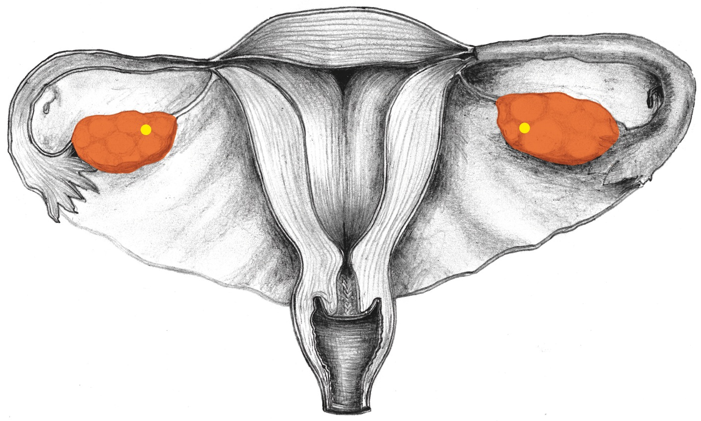
Ovaries

Slide 3
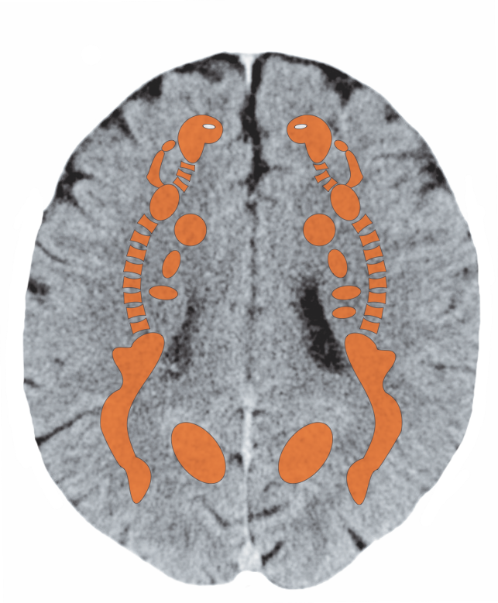
Cerebral White Matter – Ovaries

Slide 4
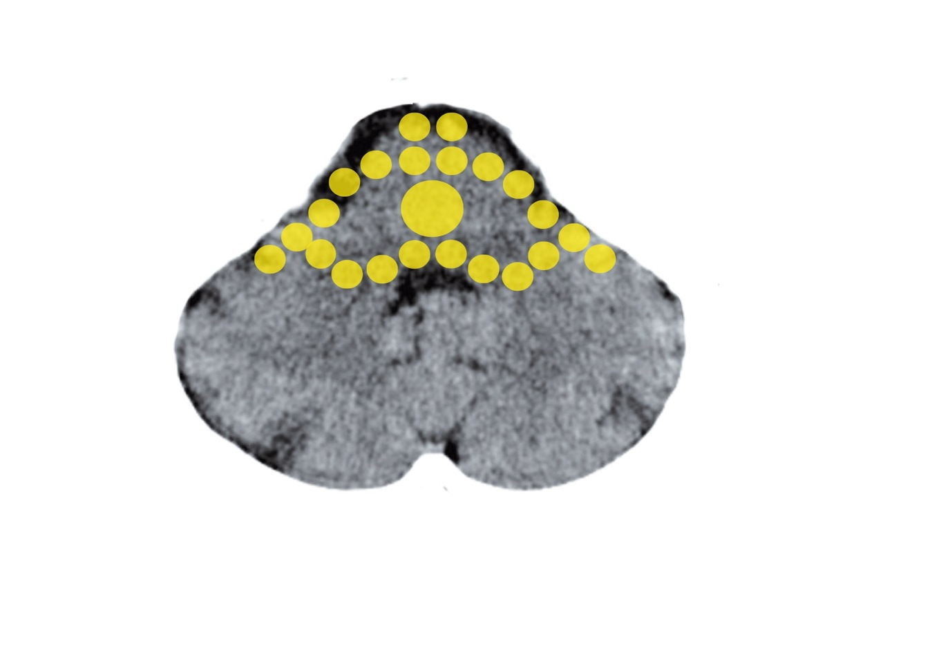
Brain Stem – Fallopian Tube, Uterine Mucosa
Mittelohr und Tuba eustachii - Stammhirn

Slide 5
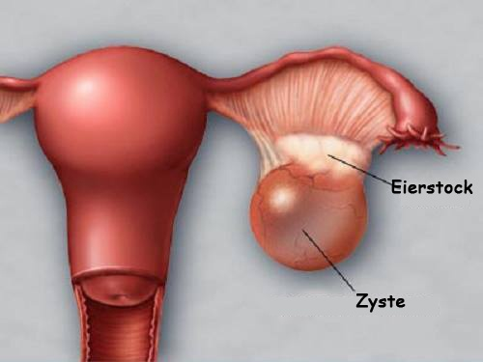
Ovarian Cyst

Slide 6
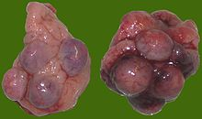
Ovarian Cysts – Loss-Conflict in Repair

Slide 7
Endometriosis - Tissue

