Slide 1
Peritoneum
Diaphragm

Slide 2
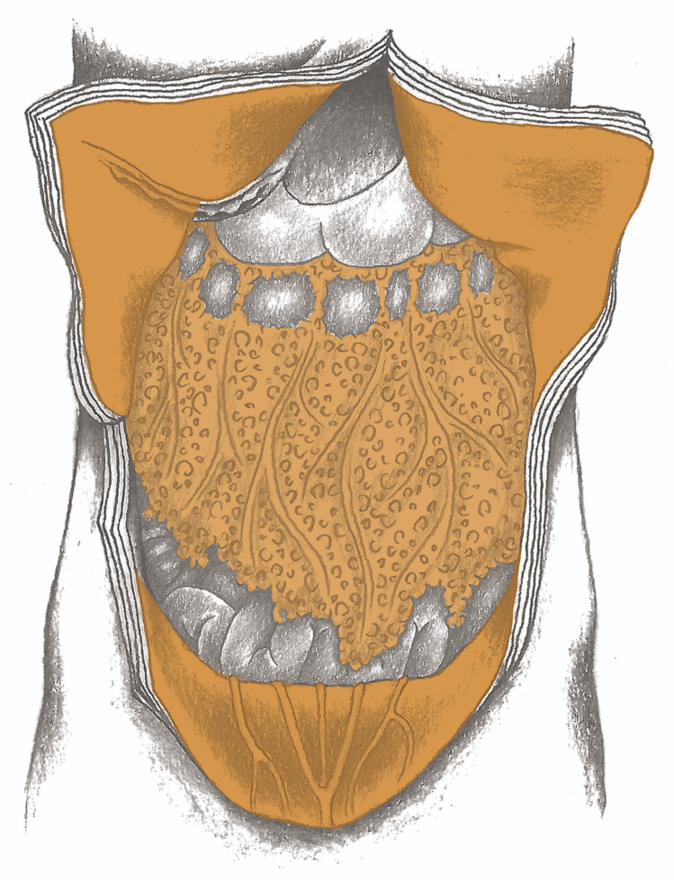
Peritoneum

Slide 3
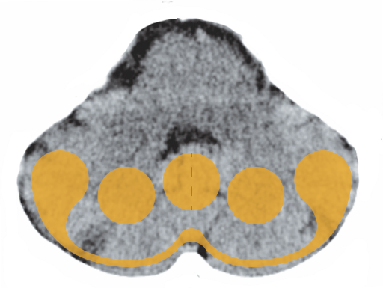
Cerebellum – Peritoneum, Pulmonary Pleurae

Slide 4
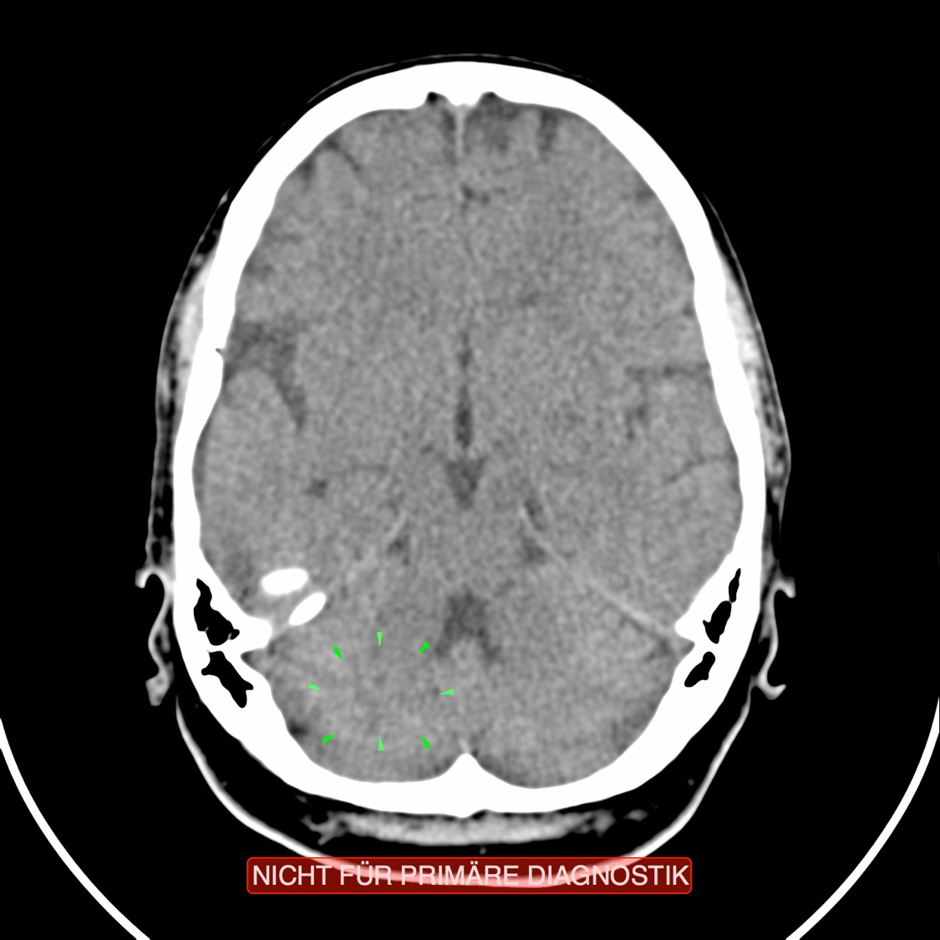
CT: Peritoneum, Active Conflict

Slide 5
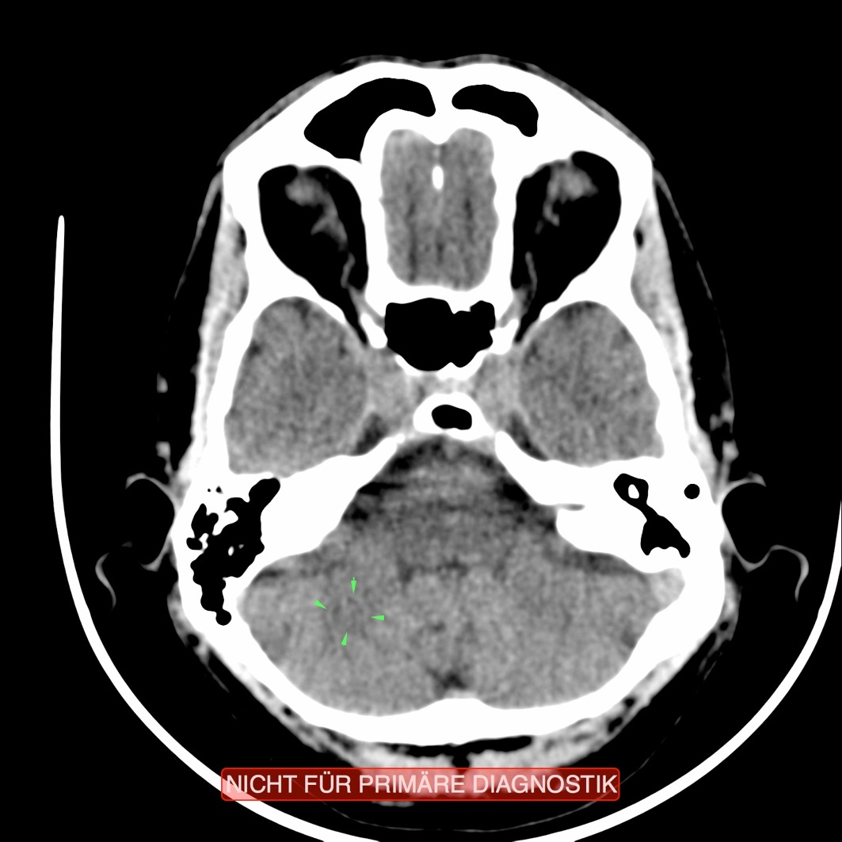
CT: Peritoneum, Recurring Conflict

Slide 6
Peritoneum – Ascites

Slide 7
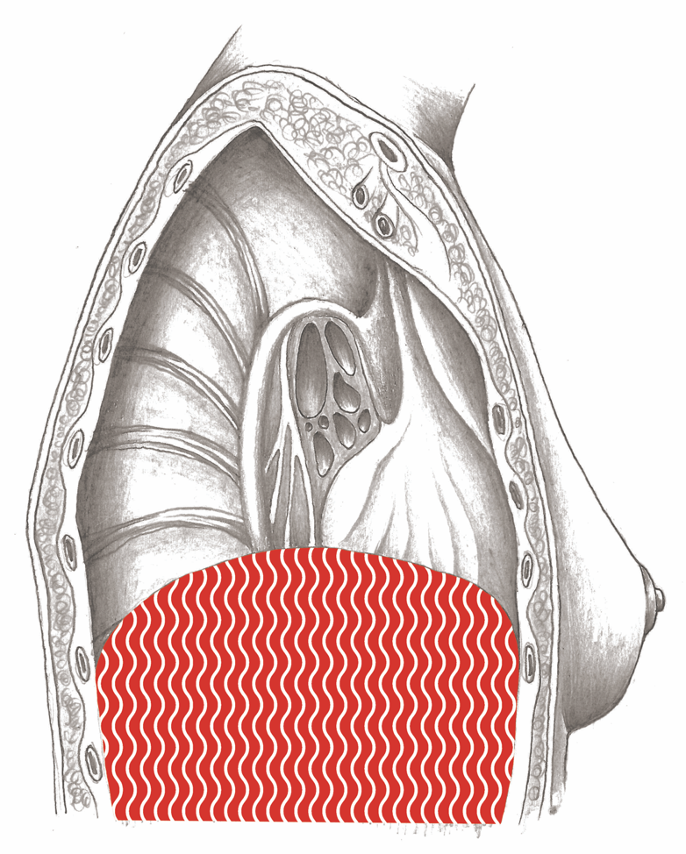
Diaphragm

Slide 8
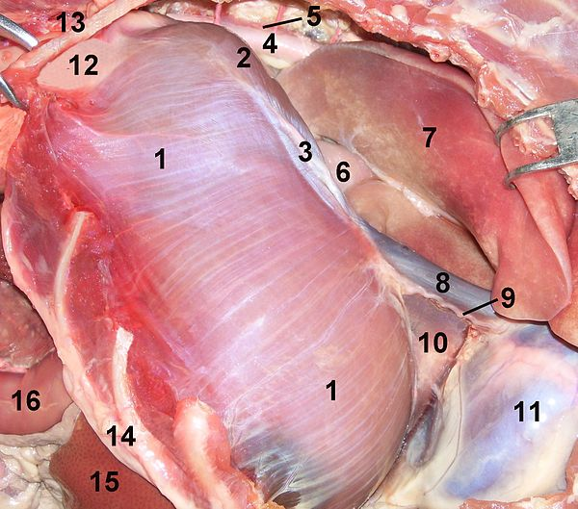
Diaphragm of a Cat

Slide 9
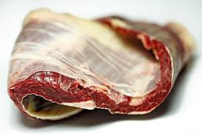
Diaphragm of a Cow

Slide 10
Navel – “Belly Button”

