Slide 1
Stomach and
Duodenum

Slide 2
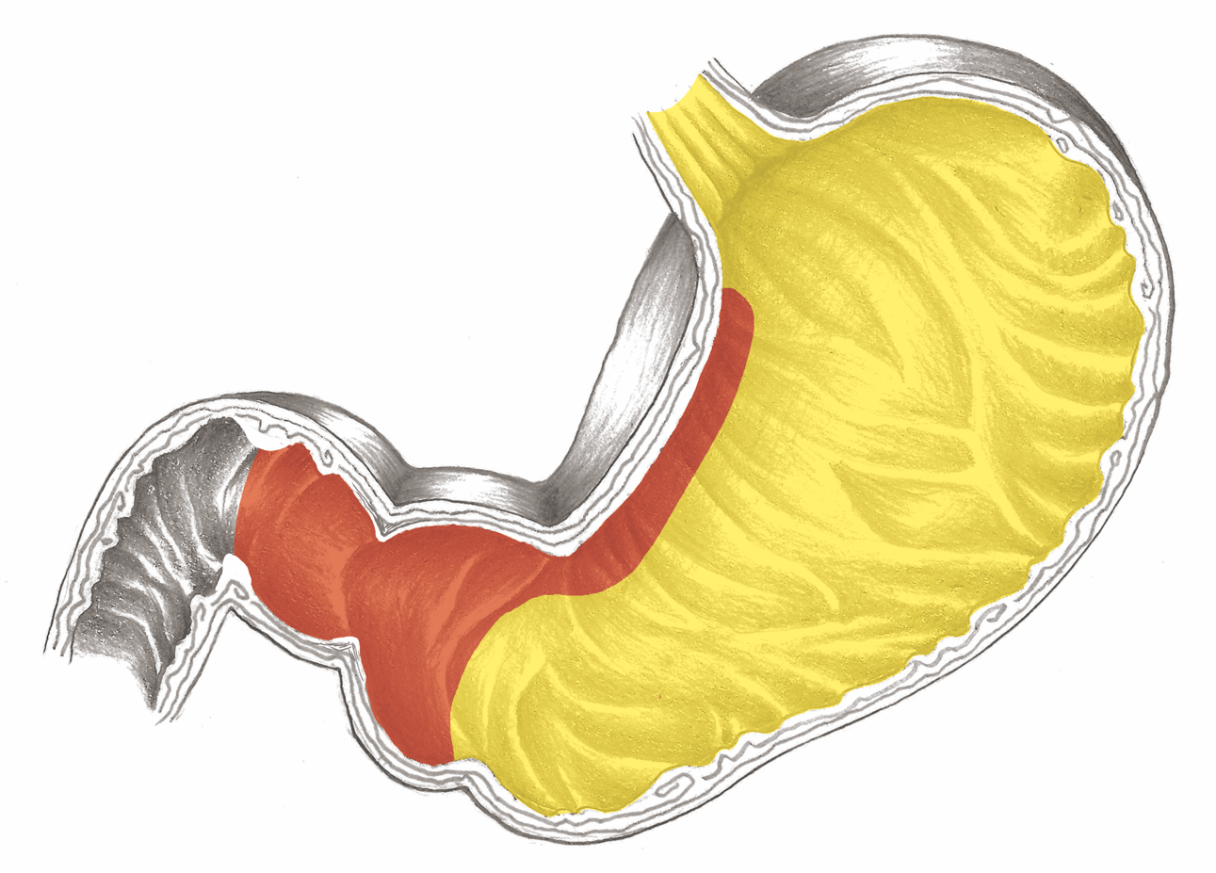
Stomach Overview

Slide 3
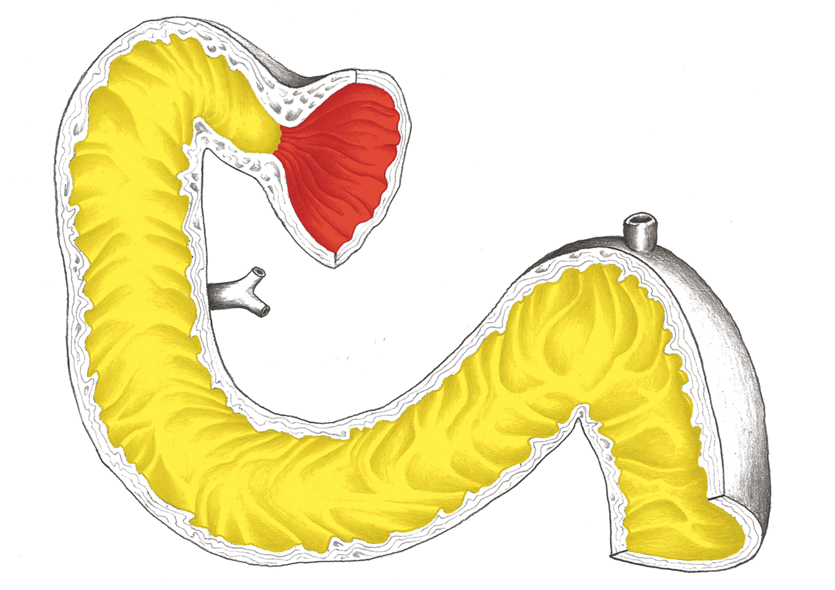
Duodenum: Pylorus – Ectodermic
Magen - Übersicht

Slide 4
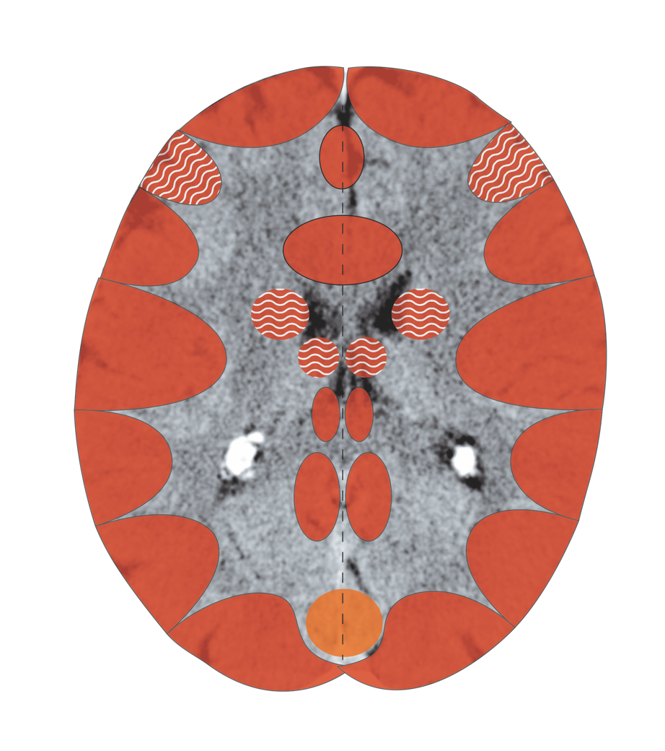
Cerebral Cortex – Gastric, Duodenal
and Bilious Mucosae
Notes:
4

Slide 5
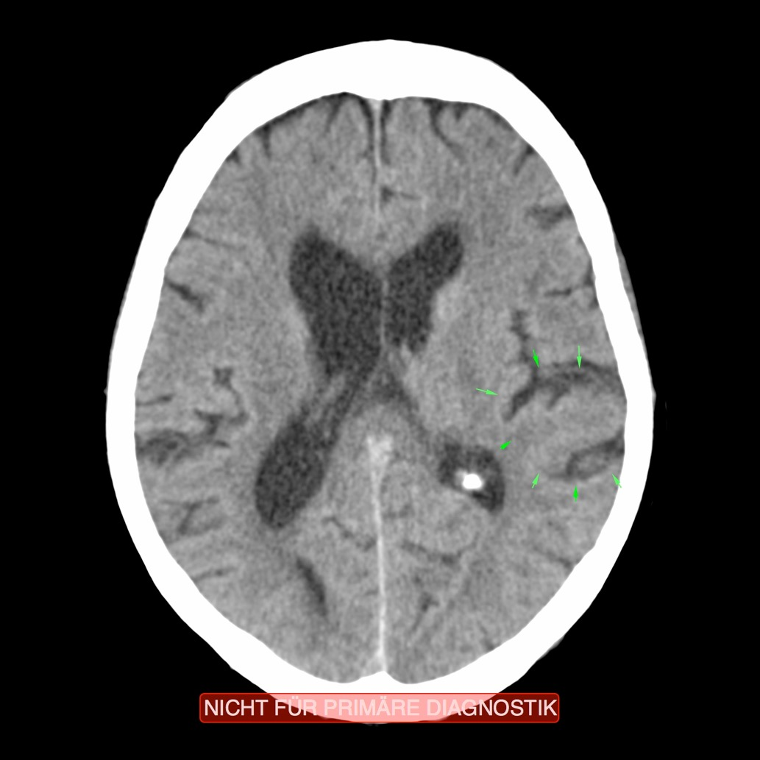
CT: Stomach, Ectodermal (slightly overarching)
into the Coronary Artery Relay), Recurring C.

Slide 6
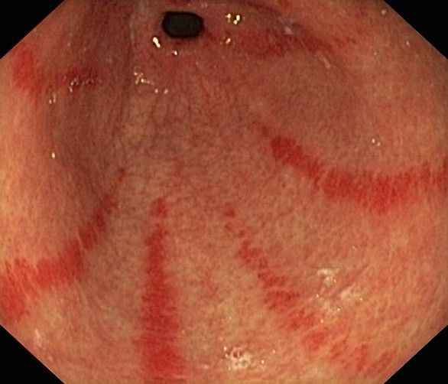
Gastroscopy: Gastritis – Territorial Anger

Slide 7
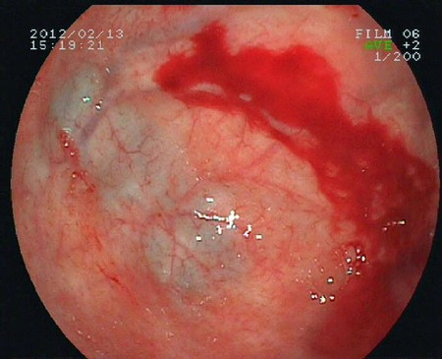
Gastroscopy: Gastric Bleeding (Stomach)

Slide 8
Stomach - Ulcer

Slide 9
Esophageal Narrowing Due to Reflux

Slide 10
Stomach – Endoderm

Slide 11
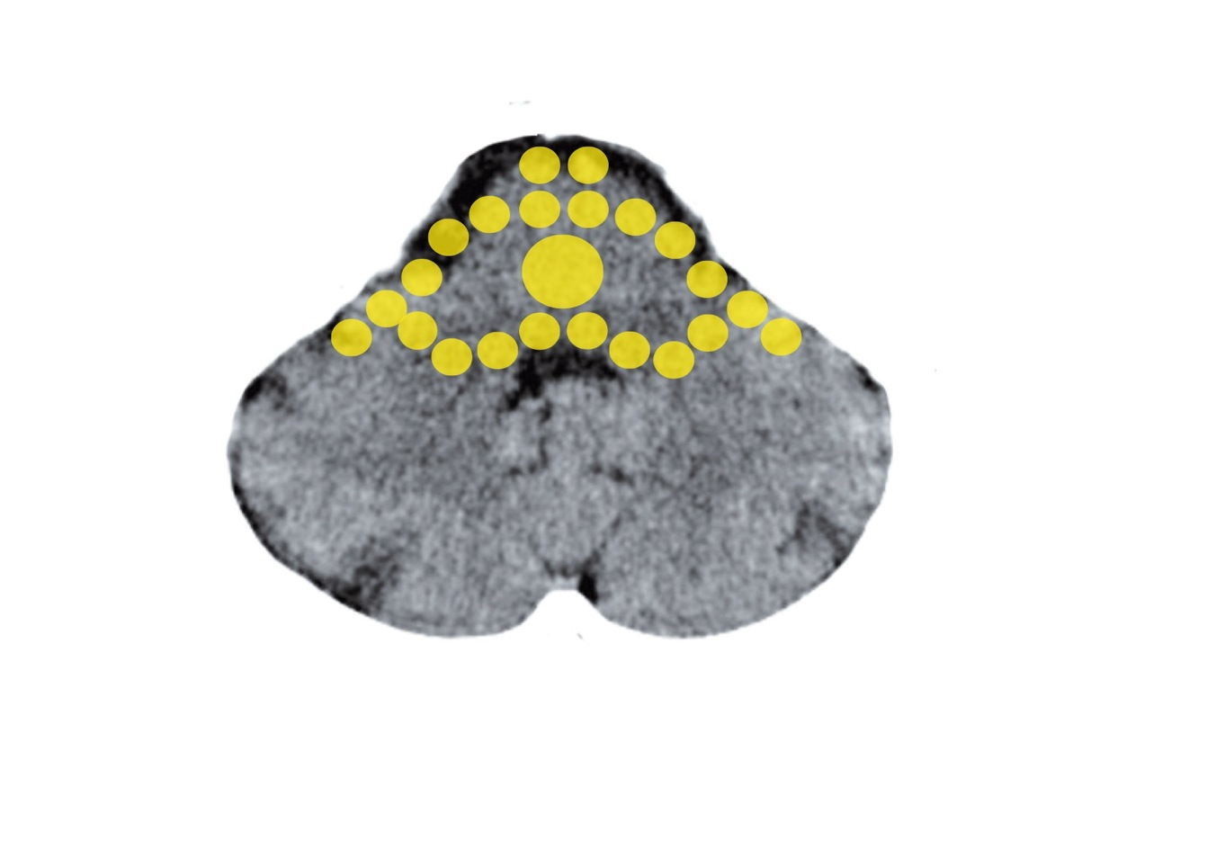
Brain Stem – Stomach
Mittelohr und Tuba eustachii - Stammhirn

Slide 12
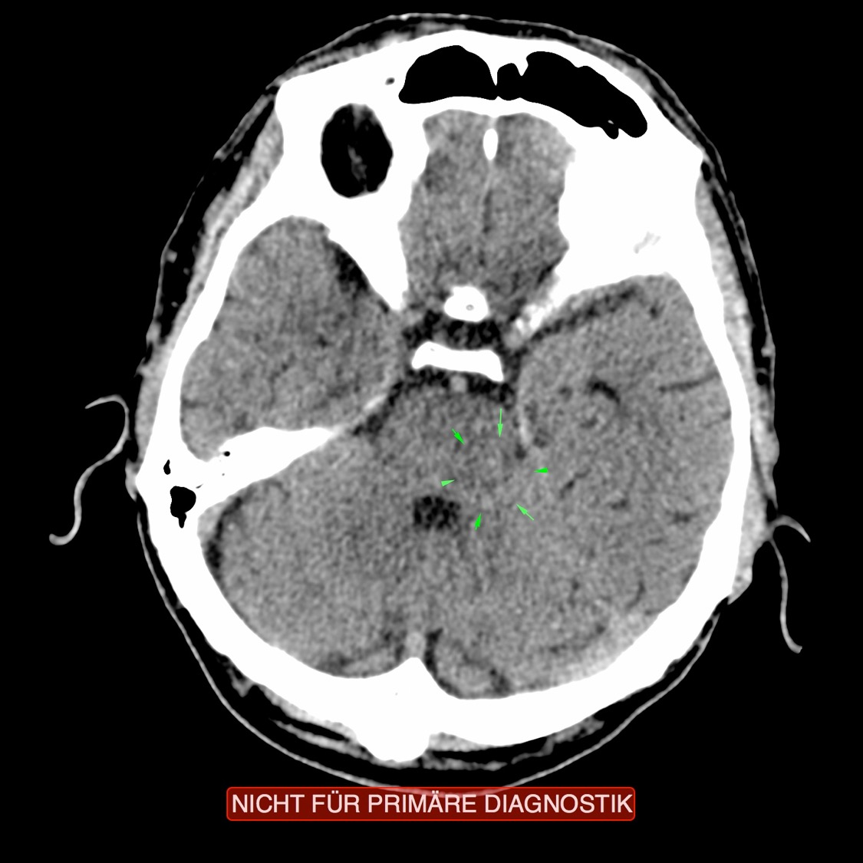
CT: Stomach – Endodermal, Recurring C.

Slide 13
Stomach – Cancer (Adeno-ca)

Slide 14
Candida – Fungi

