Slide 1
Mouth Lips
Throat

Slide 2
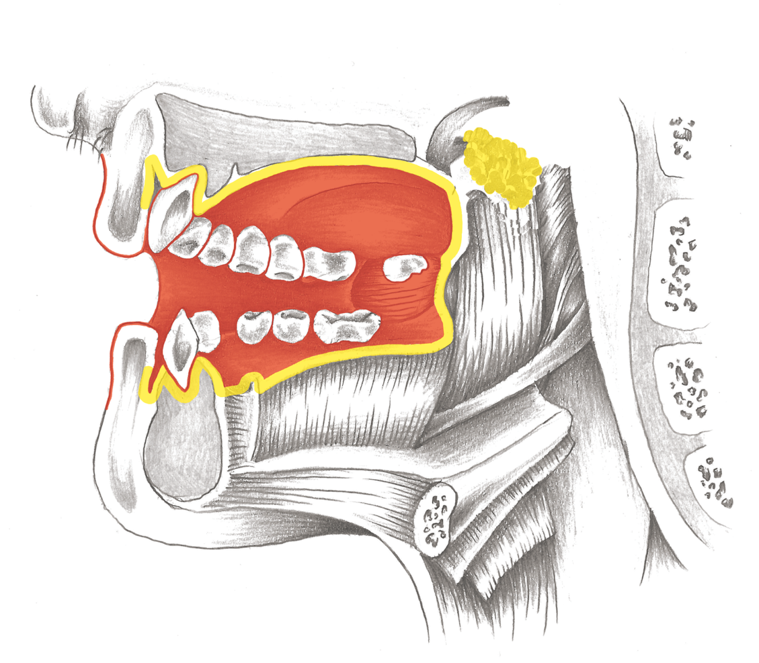
Mouth Overview

Slide 3
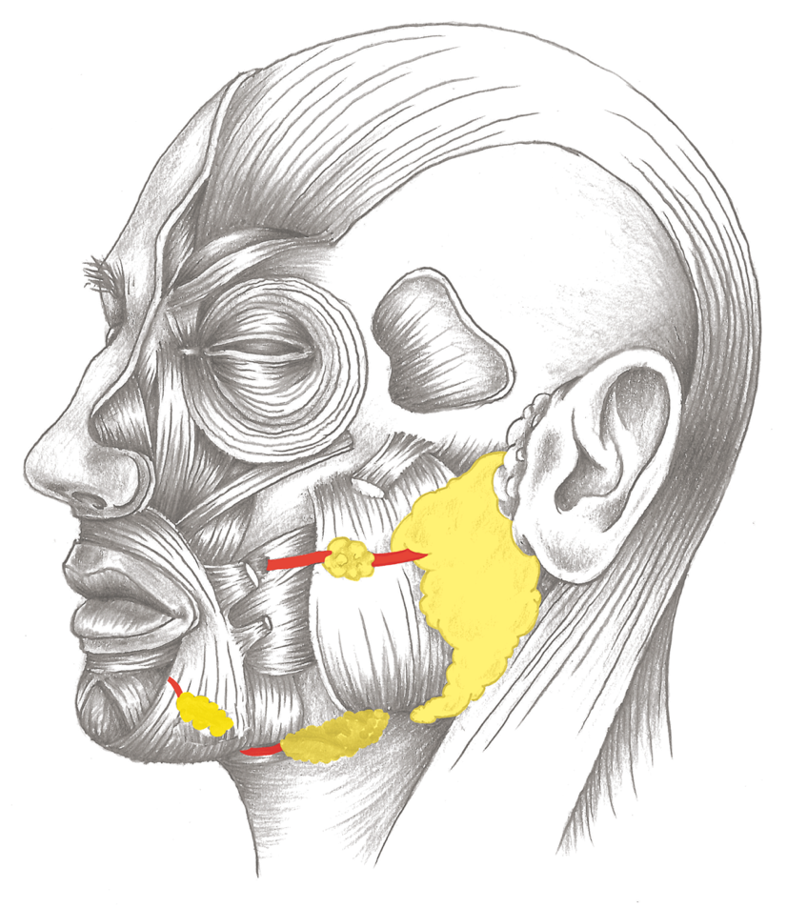
Salivary Glands and Duct System

Slide 4
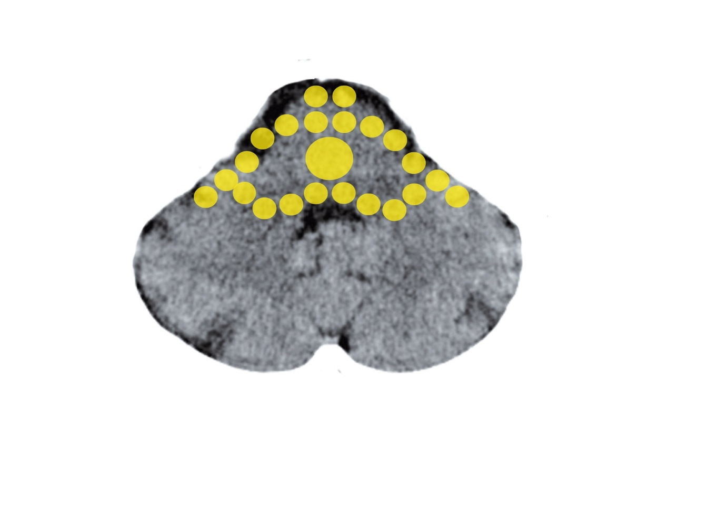
Brain Stem – Deep Oral Mucosa,
Tonsils, Salivary Glands
Mittelohr und Tuba eustachii - Stammhirn

Slide 5
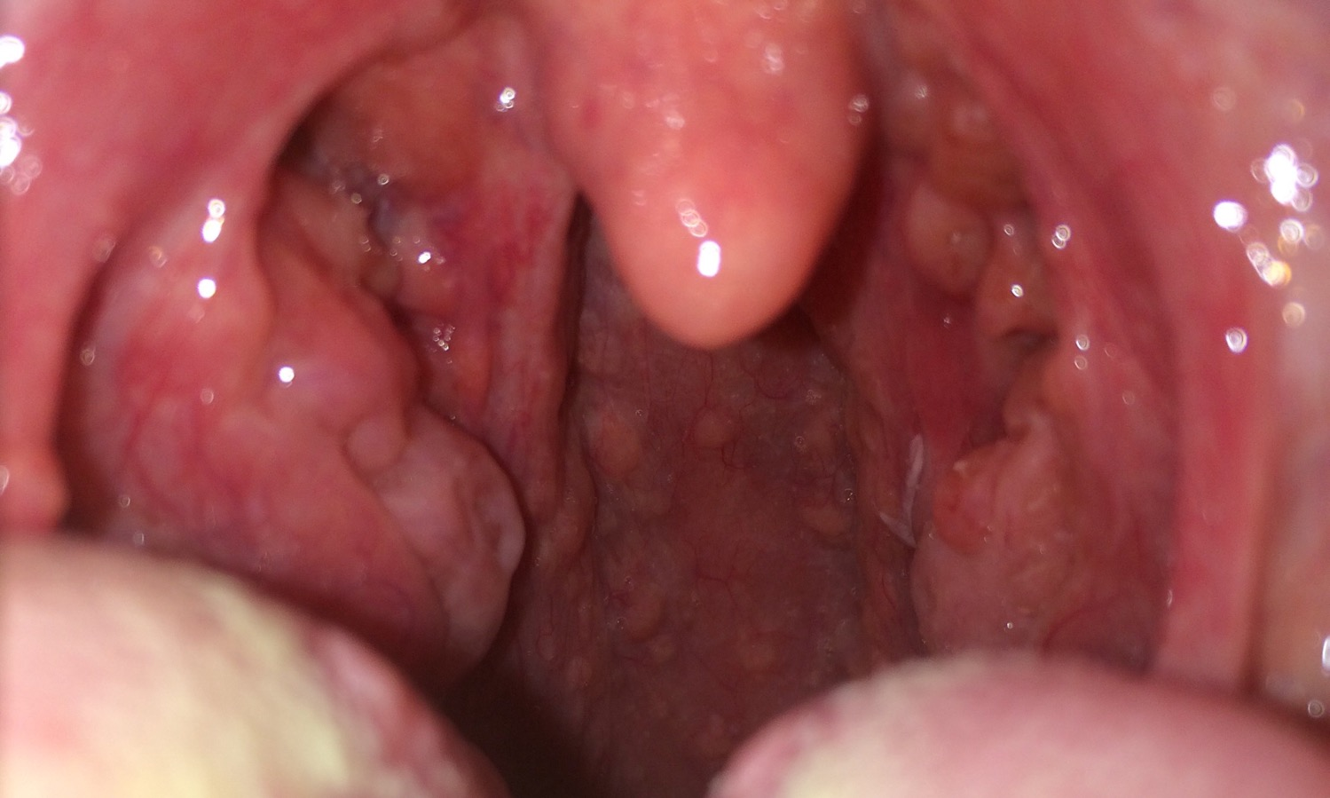
Tonsils: Left Normal, Right Enlarged

Slide 6
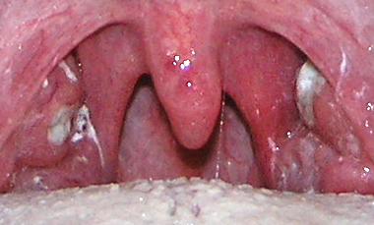
Tonsillitis – Chunk/Morsel Conflict

Slide 7
Thrush: Candidiasis – Chunk Conflict, Repair

Slide 8
Thrush: Candidiasis – Chunk Conflict, Repair

Slide 9
Mouth Overview

Slide 10
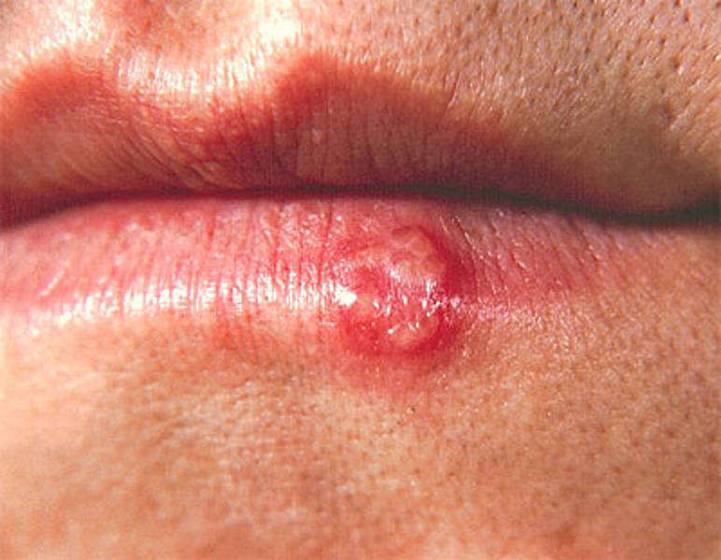
Cold Sores, Herpes: Separation in Repair

Slide 11
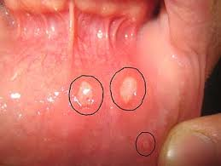
Canker Sores: Aphthous stomatits – Separation

Slide 12
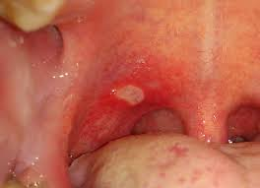
Canker Sores: Aphthous stomatits – Separation

Slide 13
Salivary Glands and Duct System

Slide 14
Parotid, Submandibular and
Sublingual Salivary Glands

Slide 15
Parotid, Submandibular and
Sublingual Salivary Glands

Slide 16
Mumps – Parotid Salivary Gland Duct(s)

Slide 17
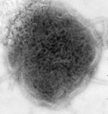
Orthodox Medicine: Parotid Virus - Mumps

Slide 18
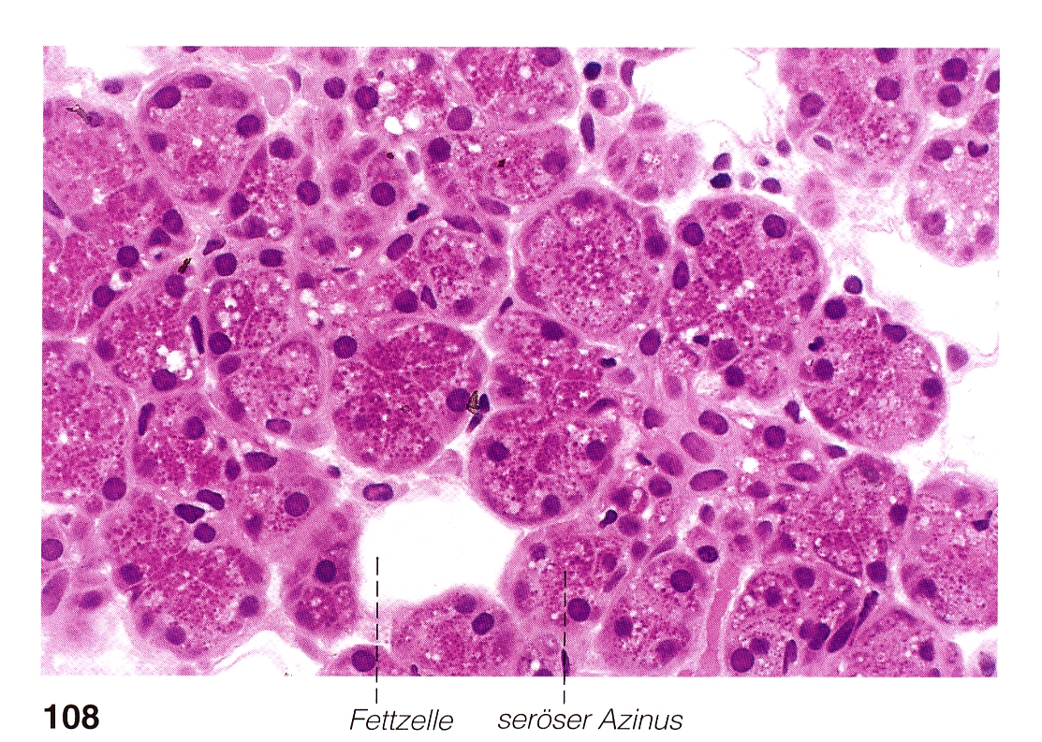
Glandular Tissue of the Salivary Glands

Slide 19
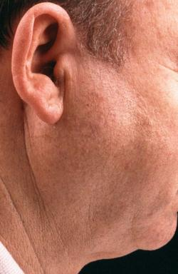
Parotid Gland Inflammation – Chunk Conflict

Slide 20
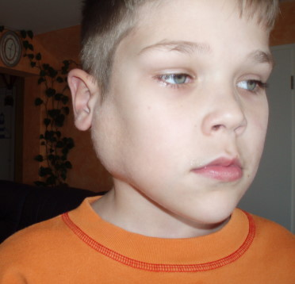
Parotid Gland Inflammation – Chunk Conflict

Slide 21
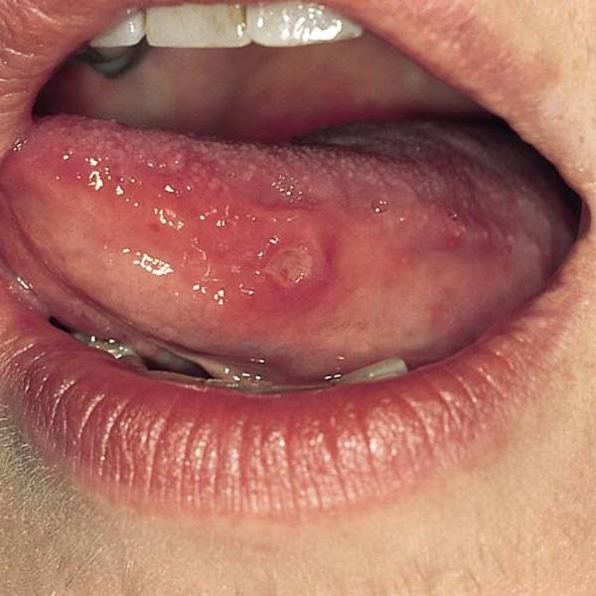
Oral Mucosa: Canker Sores – Separation

