Slide 1
Lungs Bronchial Tubes

Slide 2
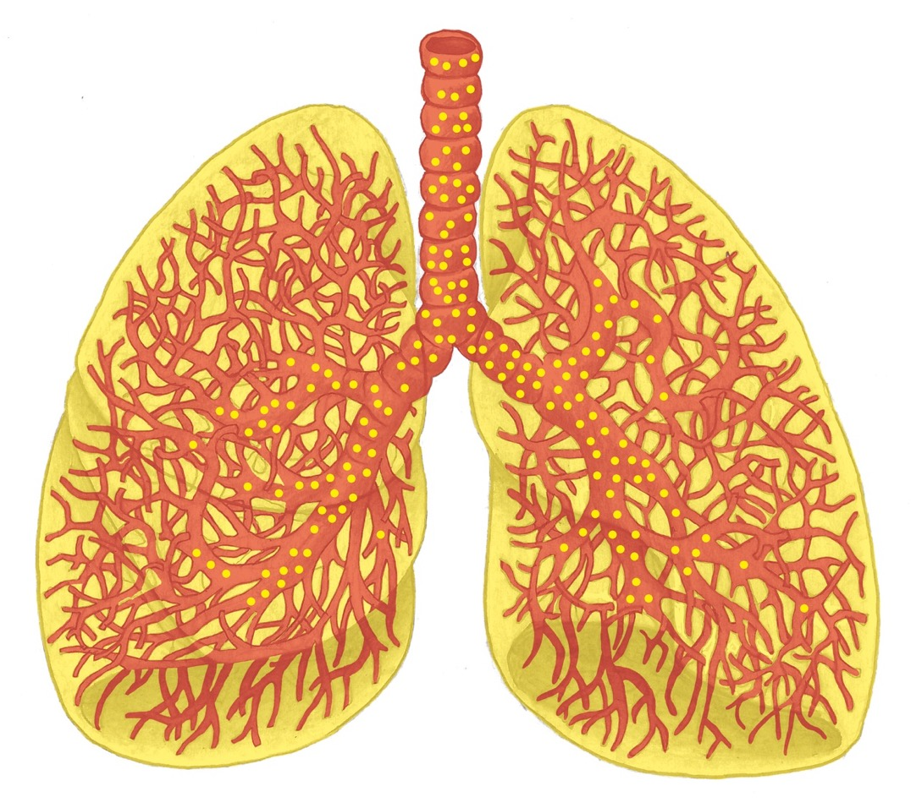
Lungs Overview

Slide 3
Bronchial Tubes, Bronchial Musculature, Goblet Cells

Slide 4
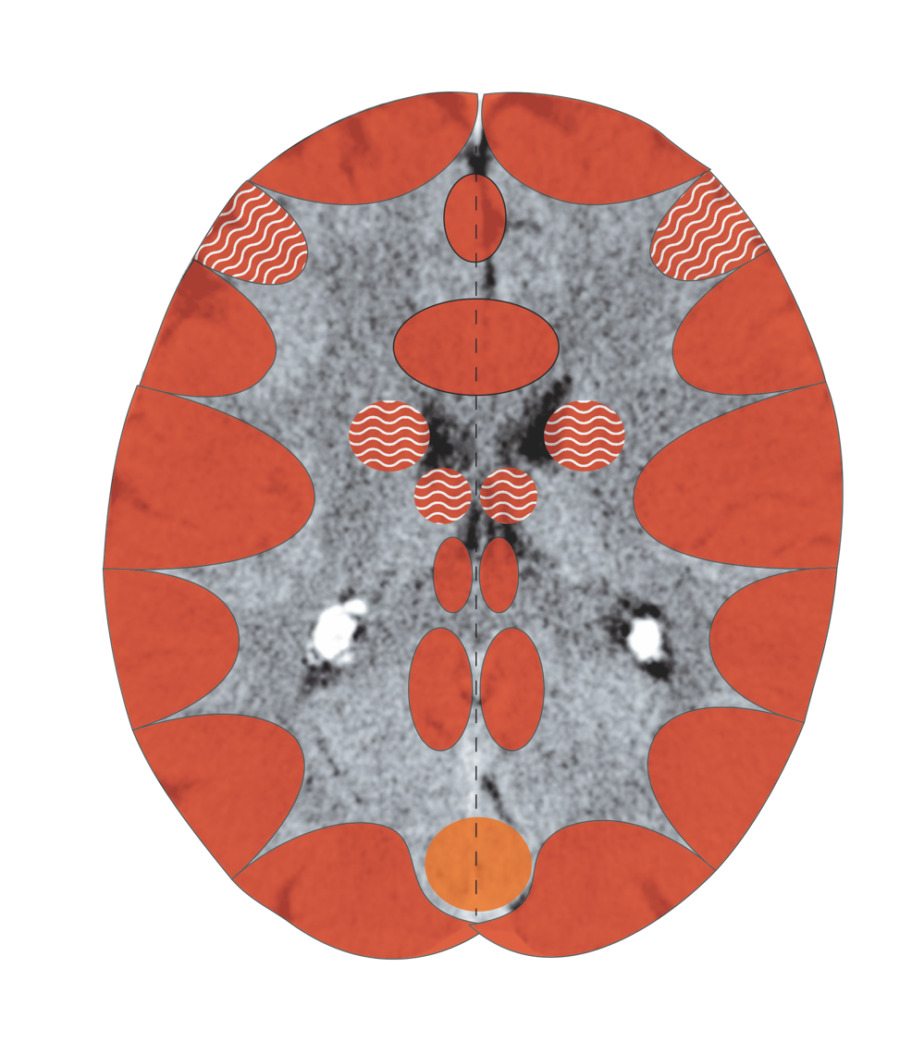
Cerebral Cortex – Bronchial Musculature, Mucosa
Notes:
4

Slide 5
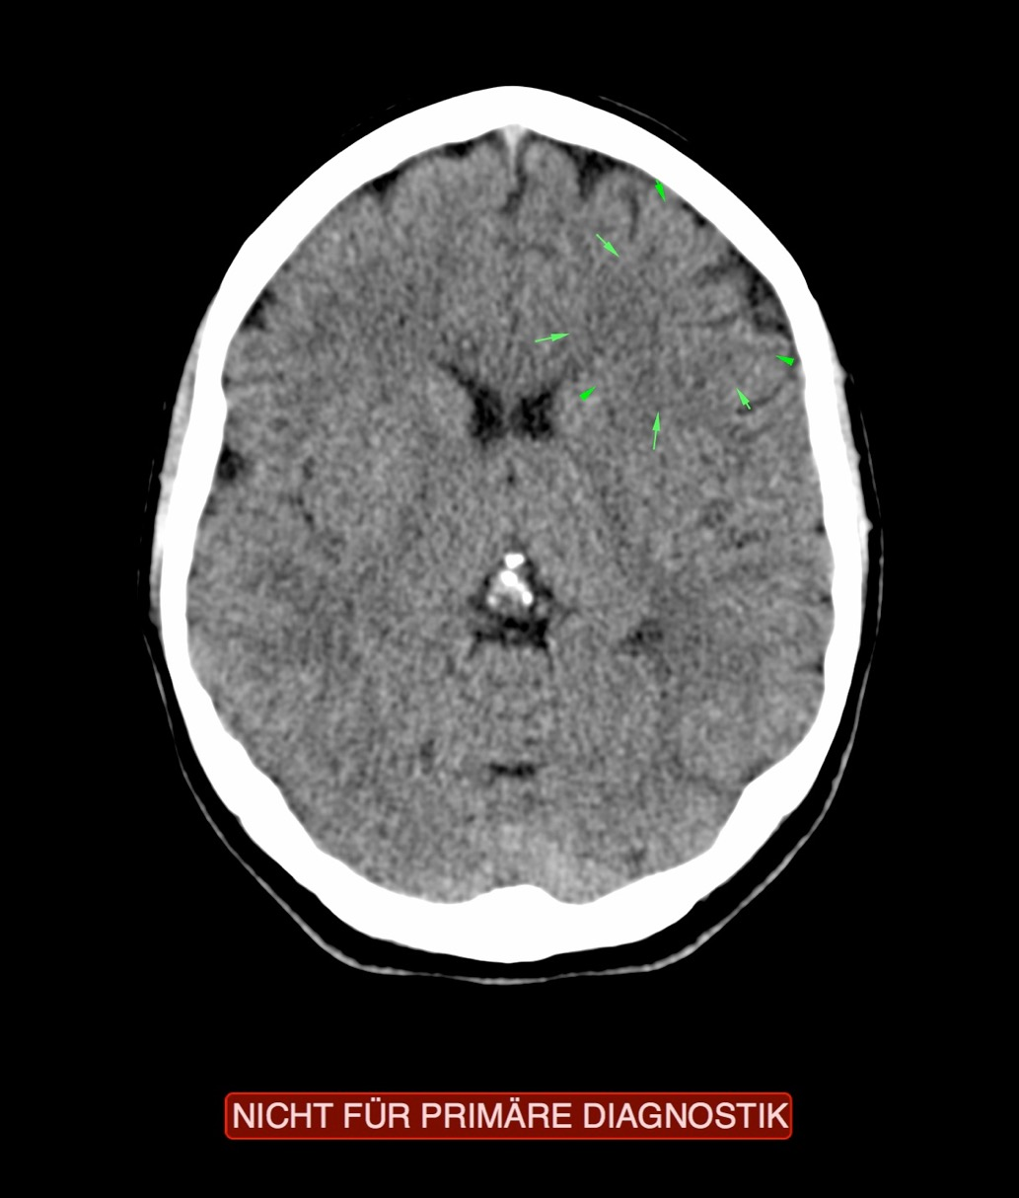
CT: Bronchial Tubes, Bronchial Musculature Active

Slide 6
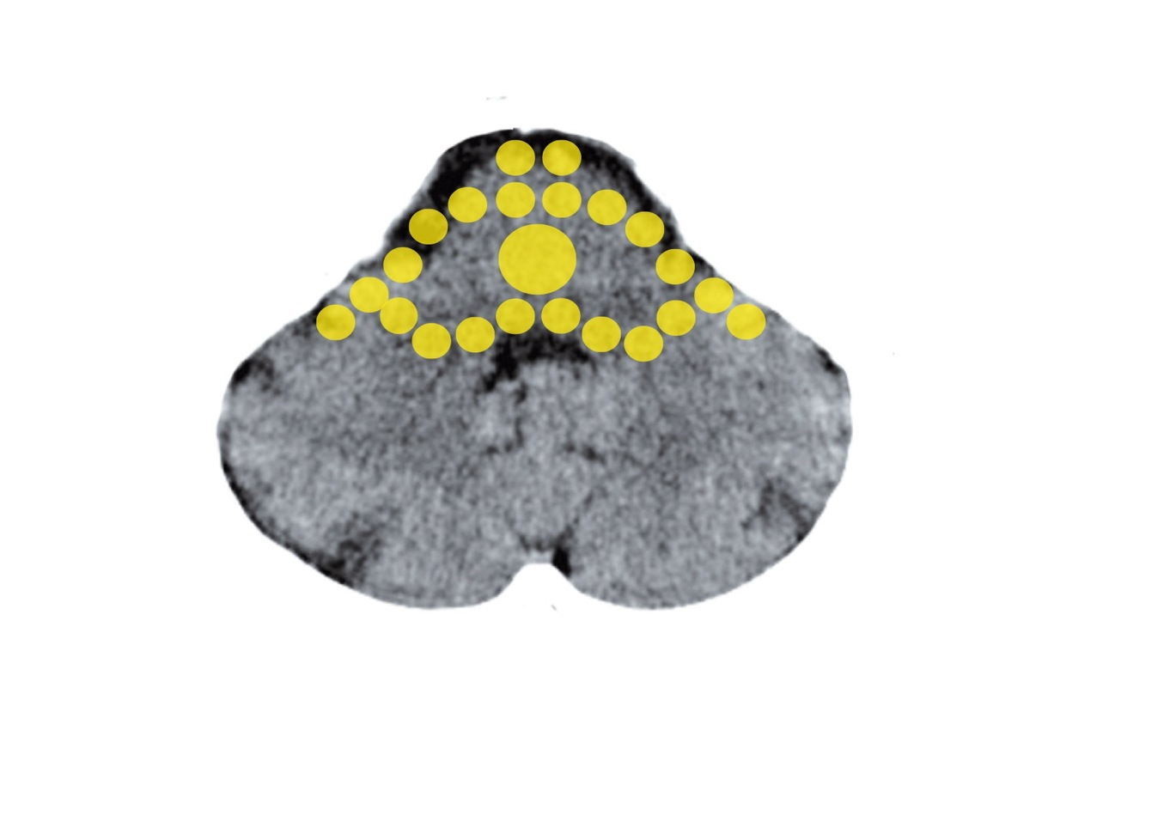
Brain Stem – Alveoli, Goblet Cells
Mittelohr und Tuba eustachii - Stammhirn

Slide 7
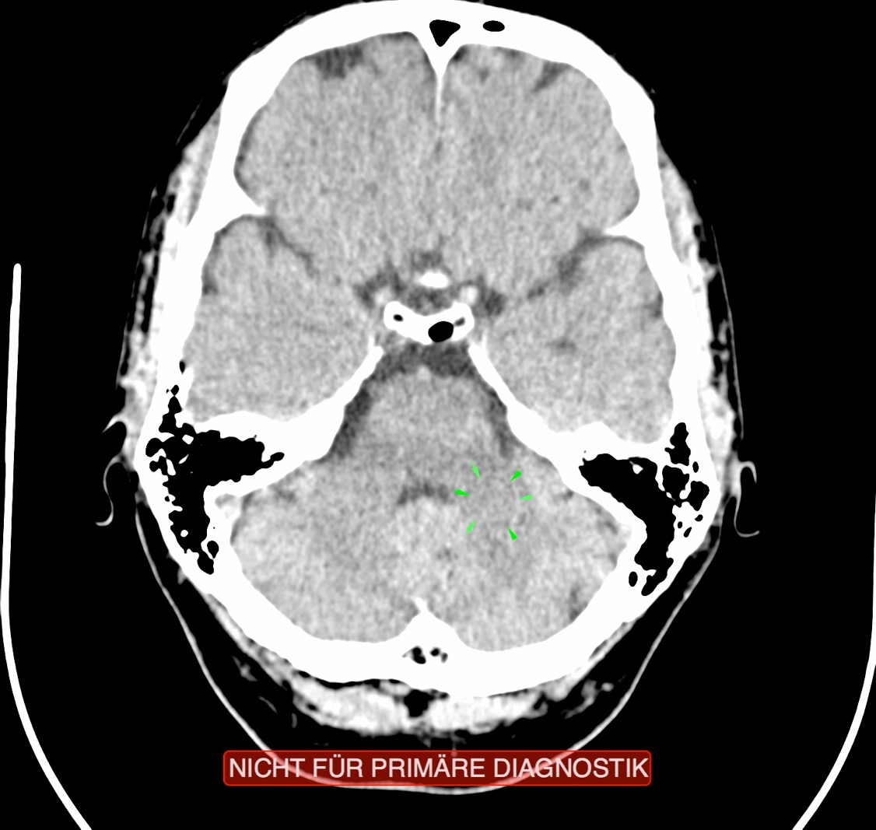
CT: Alveoli, Recurring Conflict

Slide 8
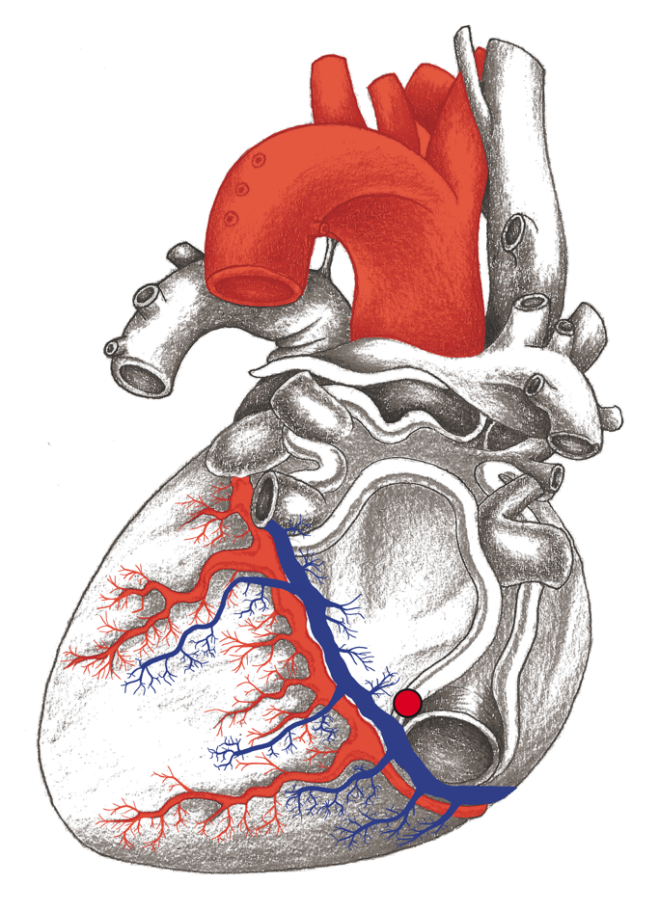
Pulmonary Embolism

Slide 9
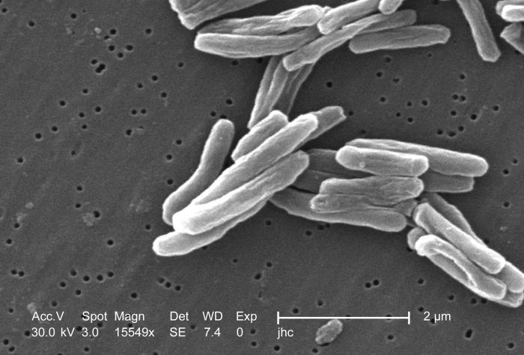
Tubercle Bacteria

Slide 10
Pneumokokken
Pneumococci

Slide 11
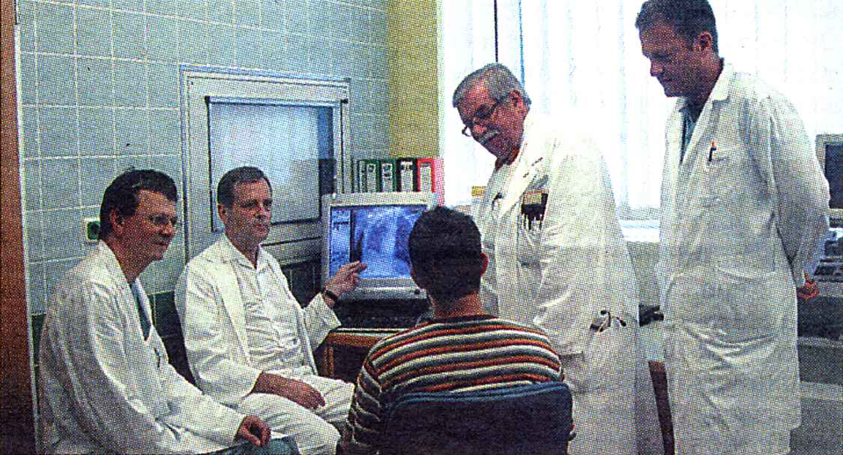
Iatrogenic-induced Fear of Death

Slide 12
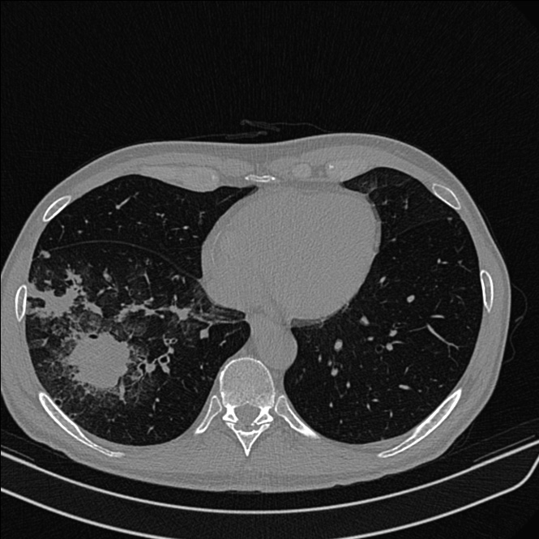
CT: Alveolar Adeno-ca
21/2 bruster 3B

Slide 13
Pulmonary Round Foci
22/2 heidenreich 3B

Slide 14
Pulmonary Emphysema

Slide 15
Bronchial Tubes

Slide 16
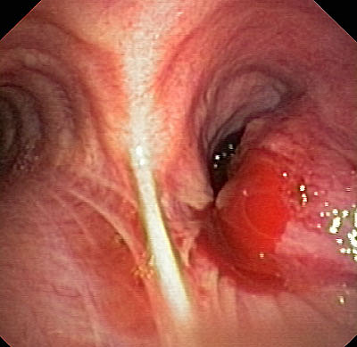
Tumor at the Bronchial Branch
22/2 heidenreich 3B

Slide 17
Tumor in the Trachea
22/2 heidenreich 3B

Slide 18
Man, bronchial
tubes diagnosed as sarcoidosis

Slide 19
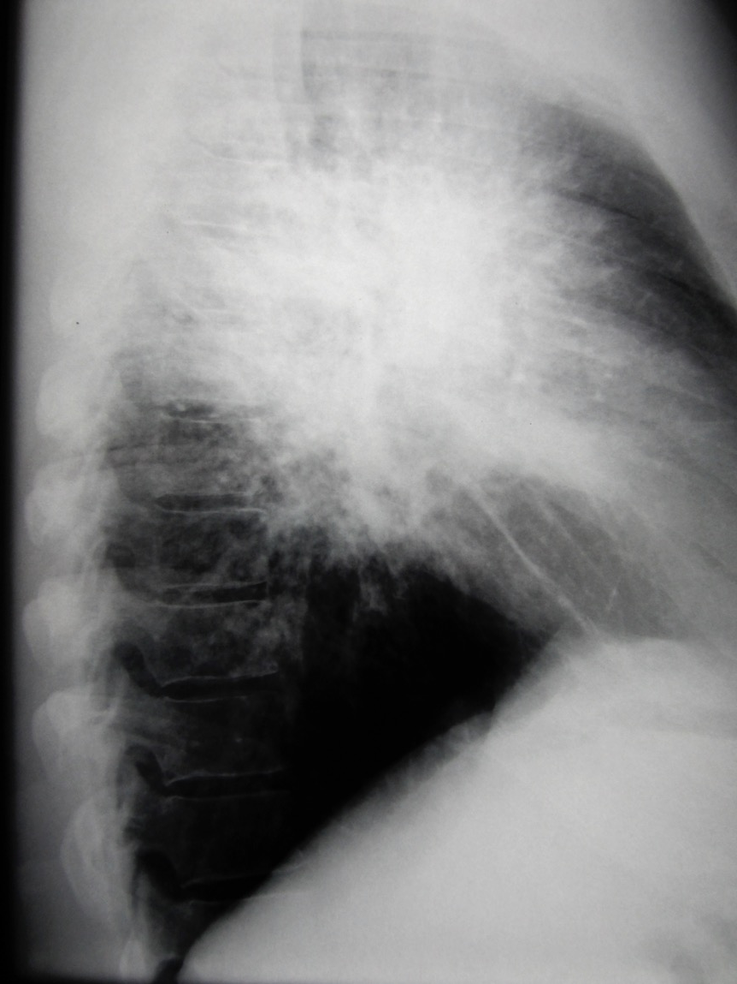

Slide 20
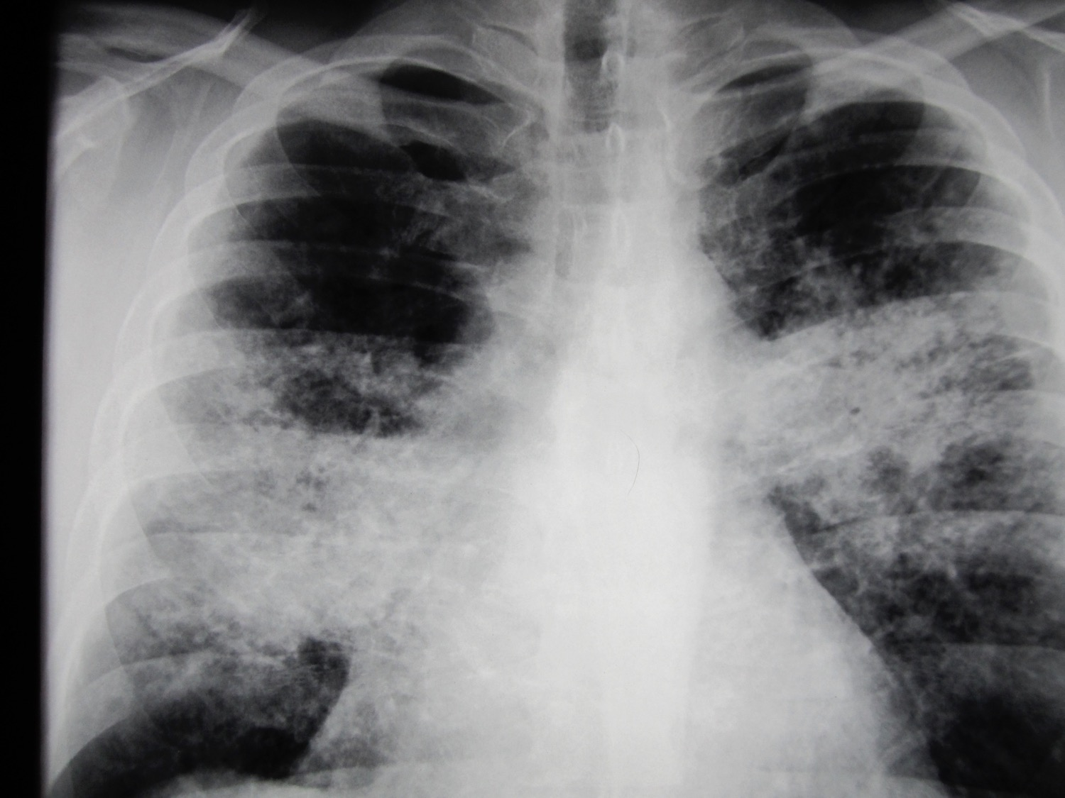
Lungenrundherd
22/2 heidenreich 3B
Orthodox Medicine, X-ray: “Suspected
Sarcoidosis” Territorial-Fear Conflict Resolved

