Slide 1
Nose
Sinuses

Slide 2
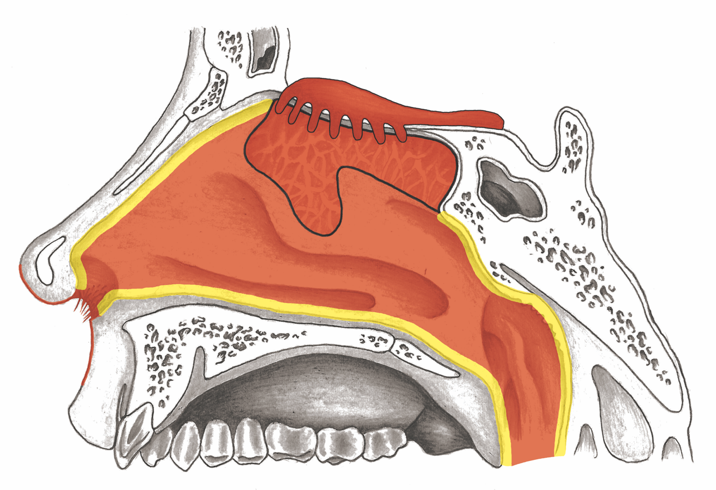
Nose

Slide 3
Paranasal Sinuses

Slide 4
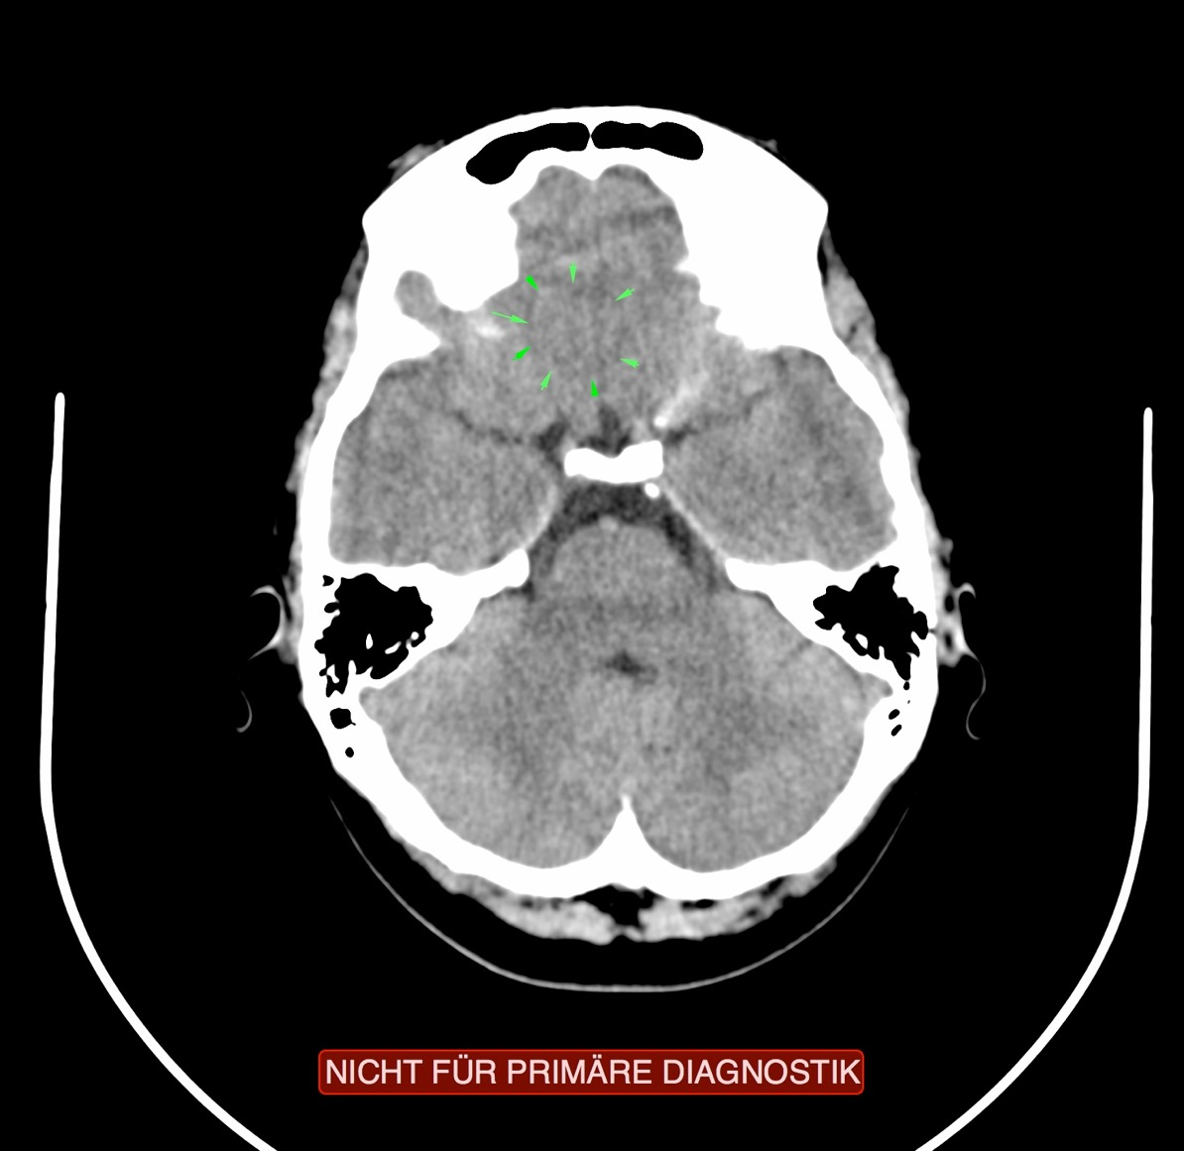
CT: Nasal Mucosa, Ectodermal, Partially Active

Slide 5
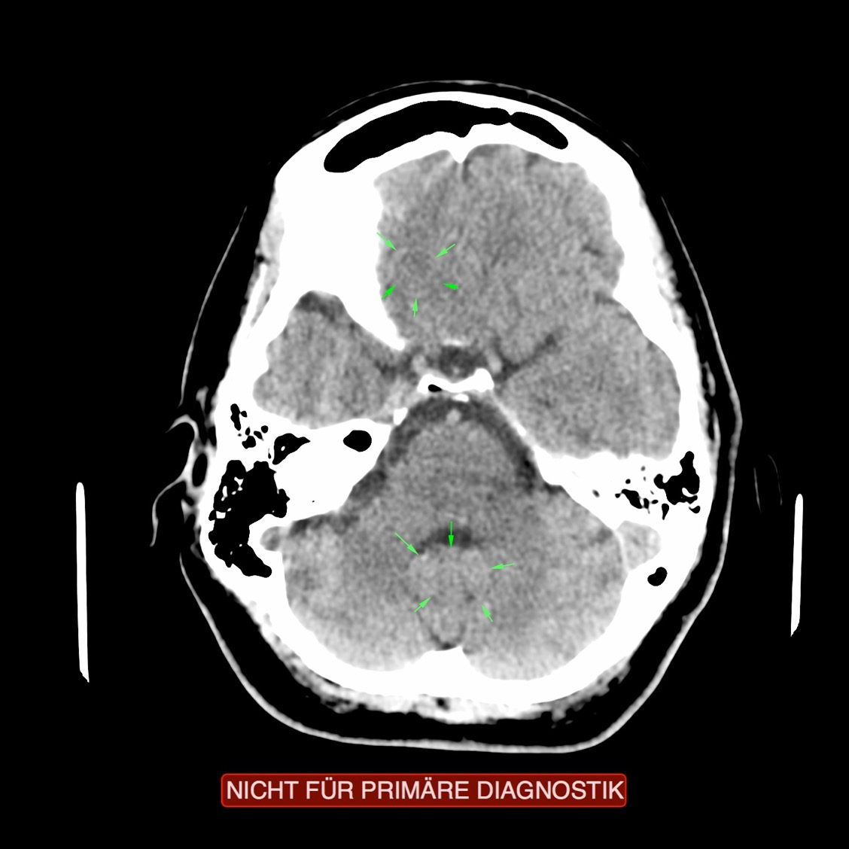
CT: Nasal Mucosa Active, Pericardium

Slide 6
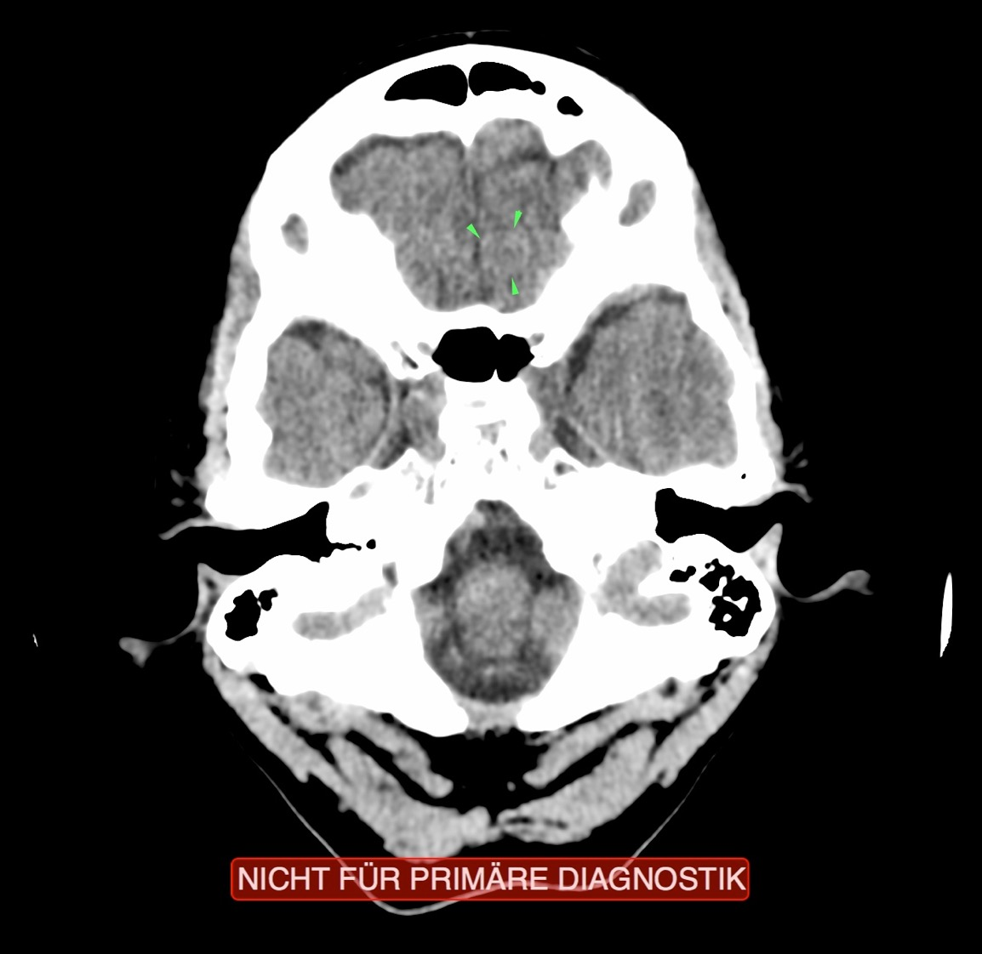
CT: Nasal Mucosa Recurring Conflict

Slide 7
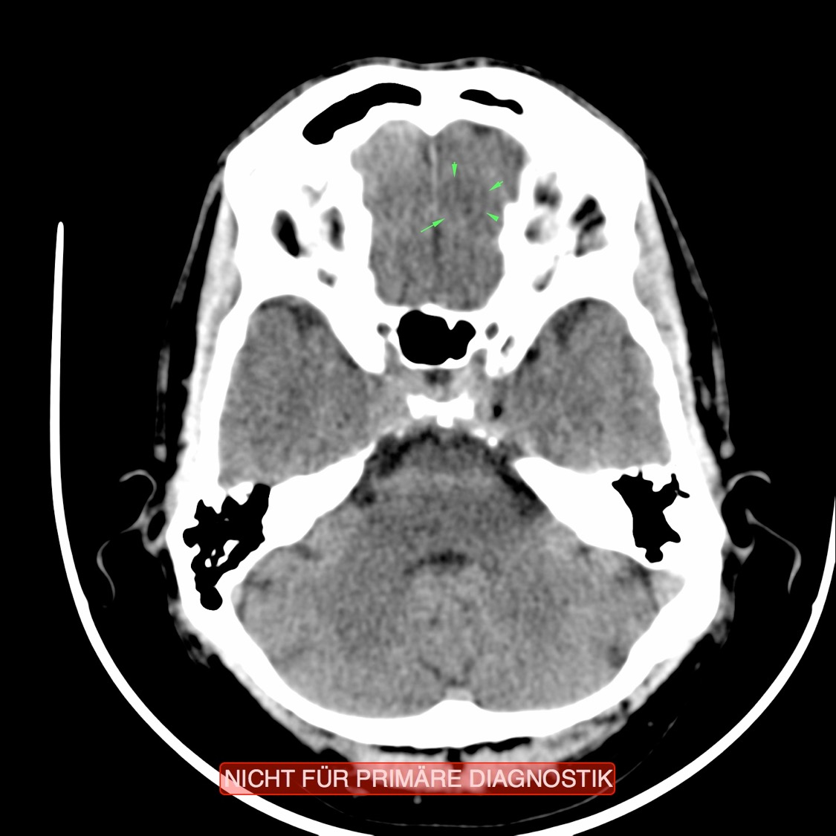
CT: Nasal Mucosa Recurring Conflict

Slide 8
Nasal Polyp – Specimen

Slide 9
Pollen (Animation) – “Hay Fever”

