Slide 1
Lymph Vessels
Spleen

Slide 2
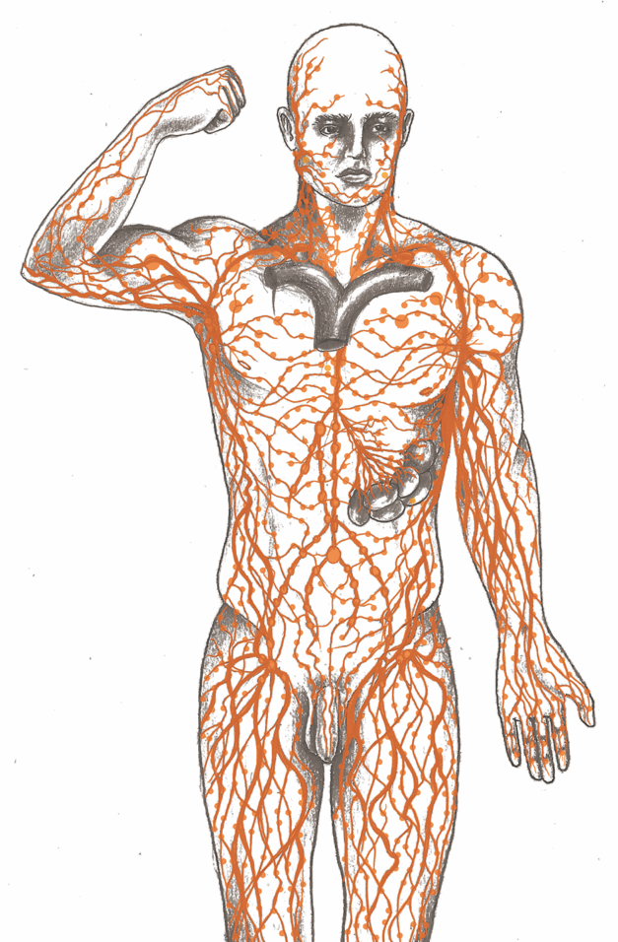
Lymphatic System Overview

Slide 3
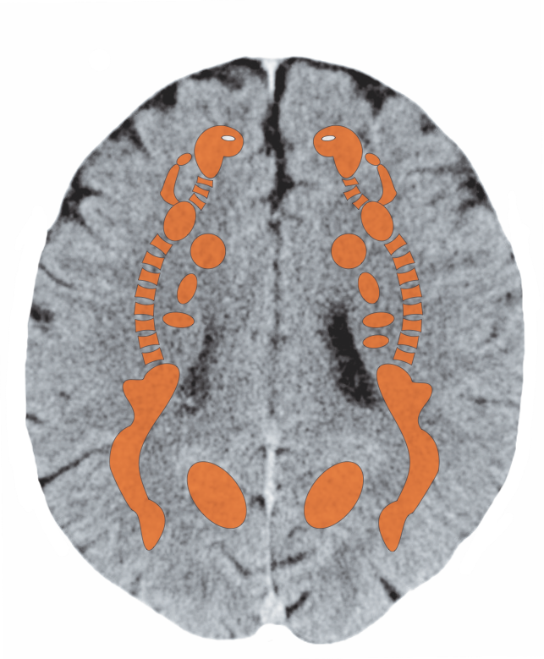
Cerebral White Matter – Spleen

Slide 4
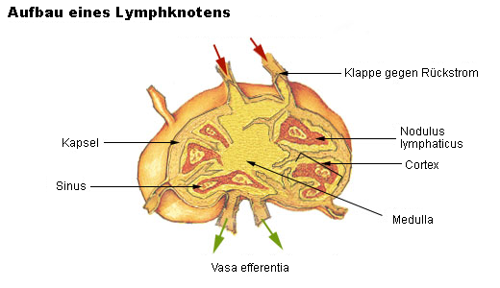
Lymph Nodes

Slide 5
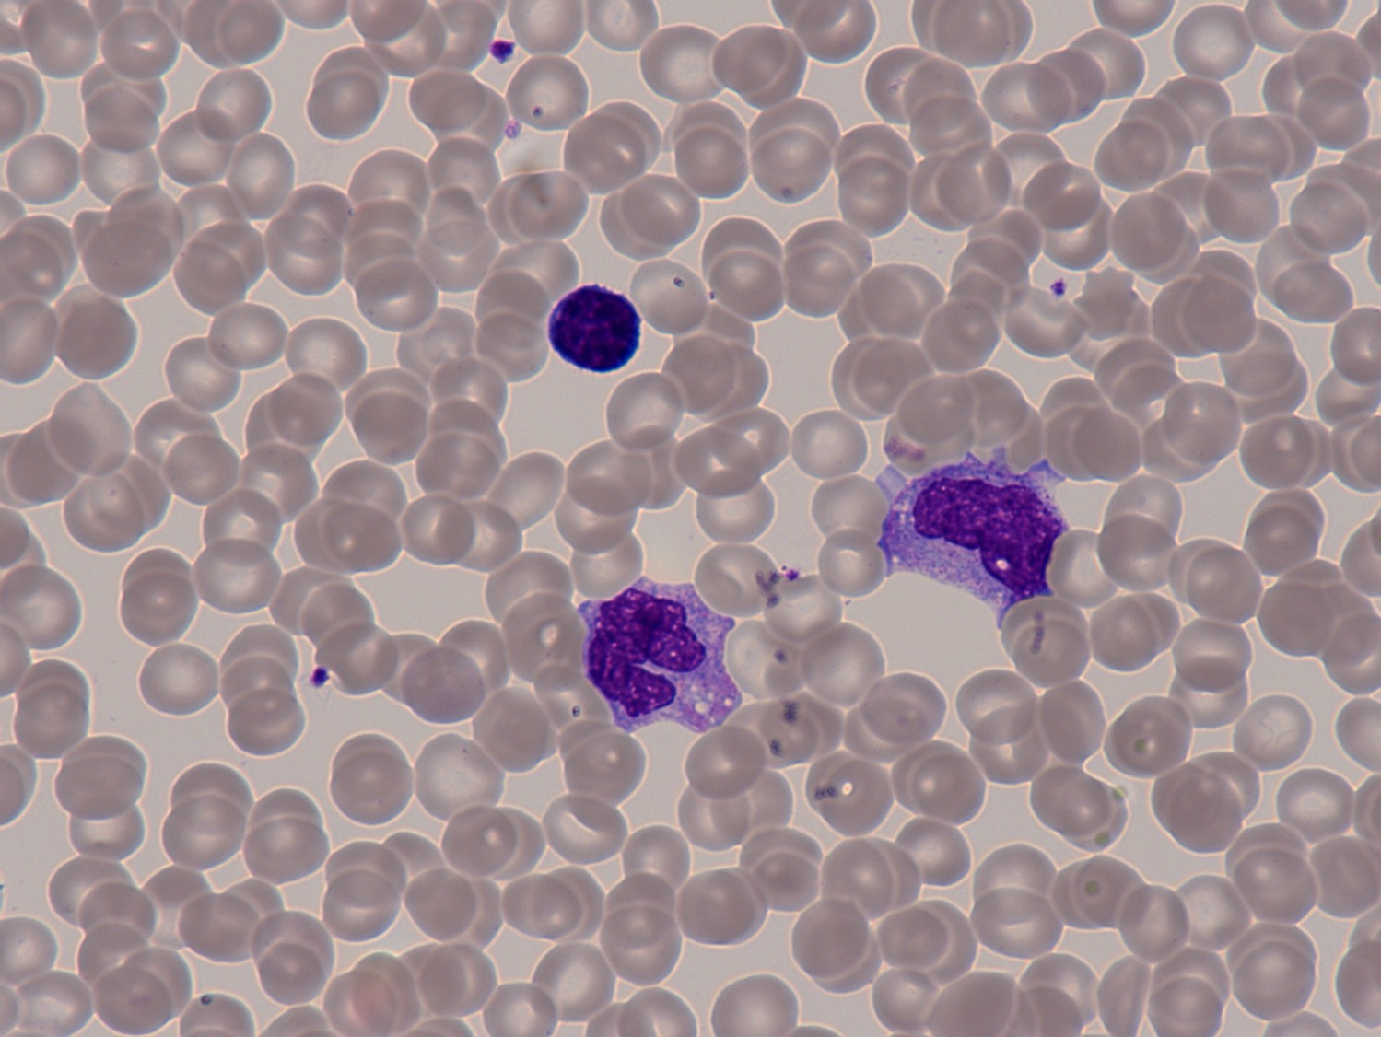
Two Monocytes and a Lymphocyte

Slide 6
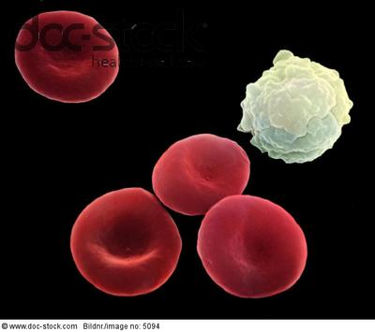
Red Blood Cells and a Lymphocyte (5000x zoom)

Slide 7
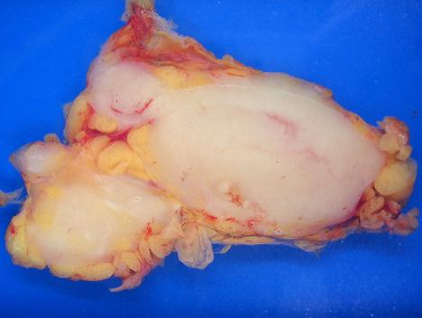
Lymphom
Lymphoma – Specimen

Slide 8
Hodgkin's Disease - Lymph Gland Cancer

Slide 9
Lymph Congestion in the Right Leg

Slide 10
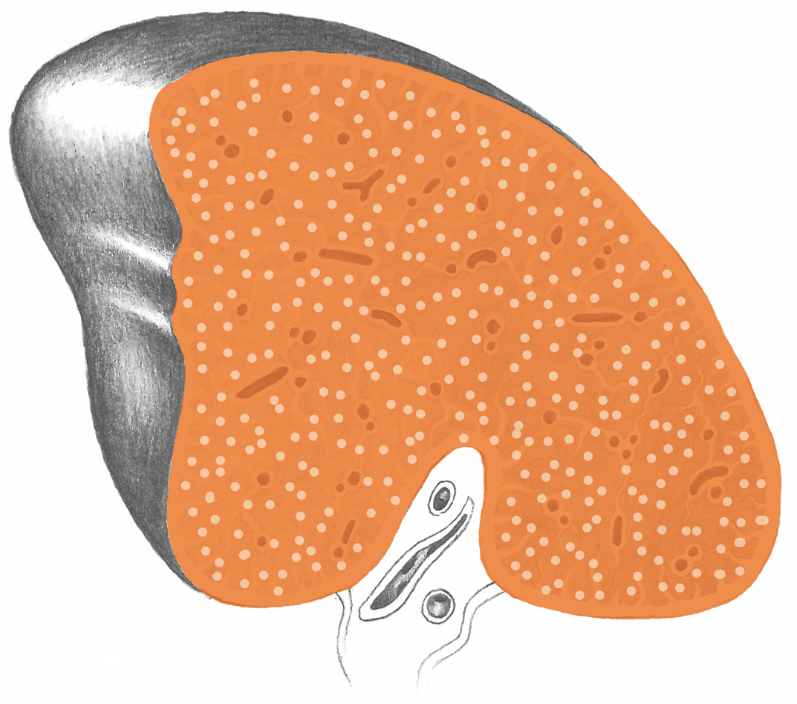
Spleen

Slide 11
Spleen – Blood Platelets

Slide 12
Spleen – Specimen

Slide 13
Spleen Cysts – Specimen

Slide 14
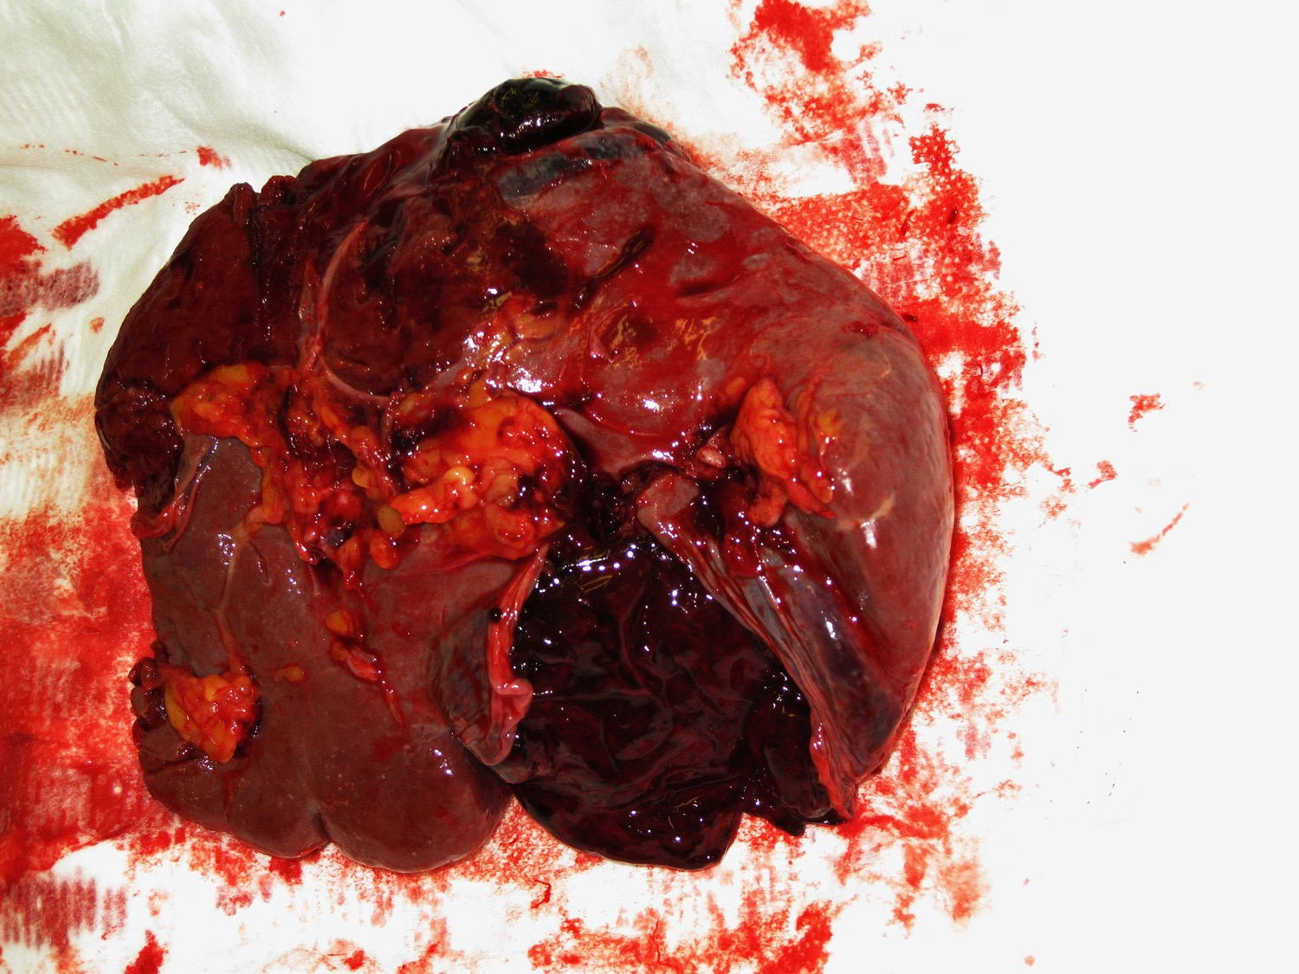
Spleen Rupture

Slide 15
Spleen after the Removal of a Cyst

Slide 16
Spleen Lymphoma

Slide 17
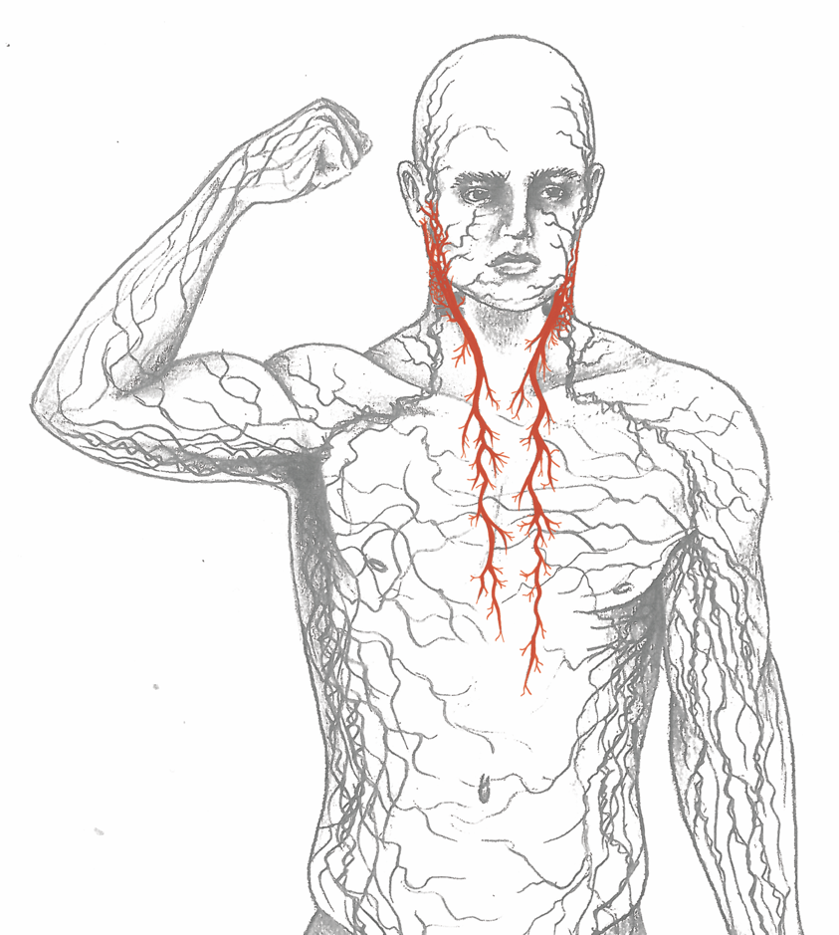
Branchial Arches

Slide 18
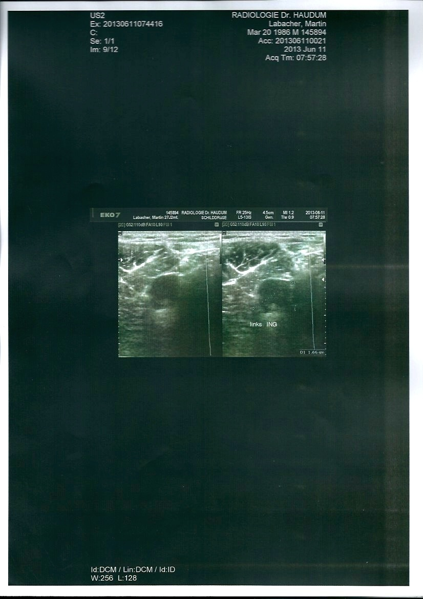
Branchial Arches - Cysts

Slide 19
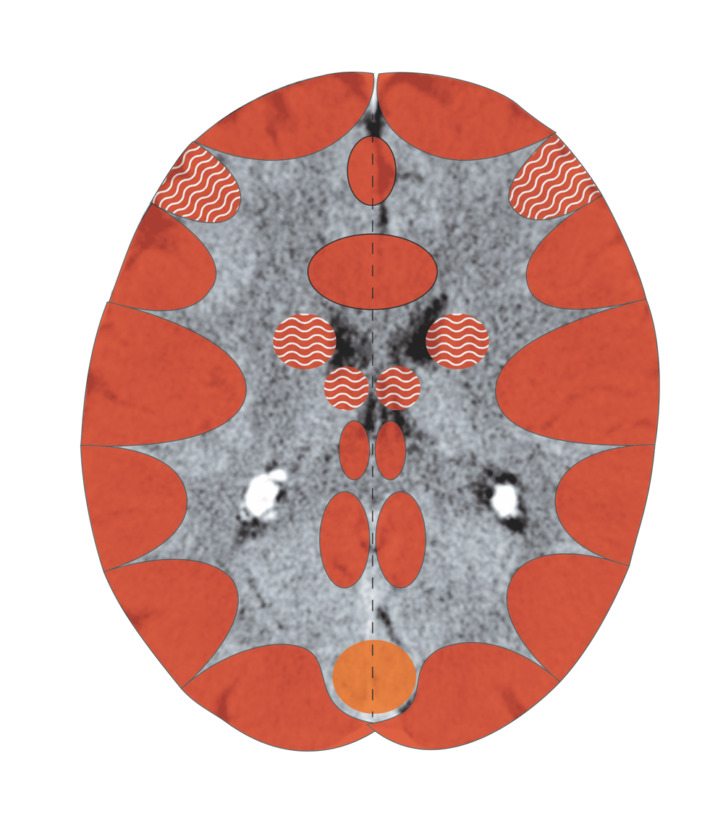
Cerebral Cortex – Branchial Arches
Notes:
19

Slide 20
Non-Hodgkin’s Lymphoma – Specimen

