Slide 1
Blood and
Blood Vessels

Slide 2
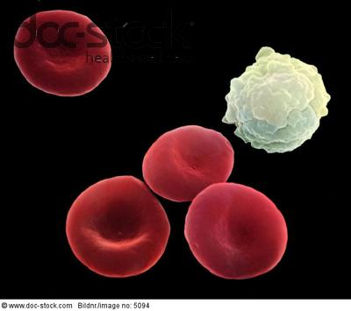
Red Blood Cells and one White Cell (5000x zoom)

Slide 3
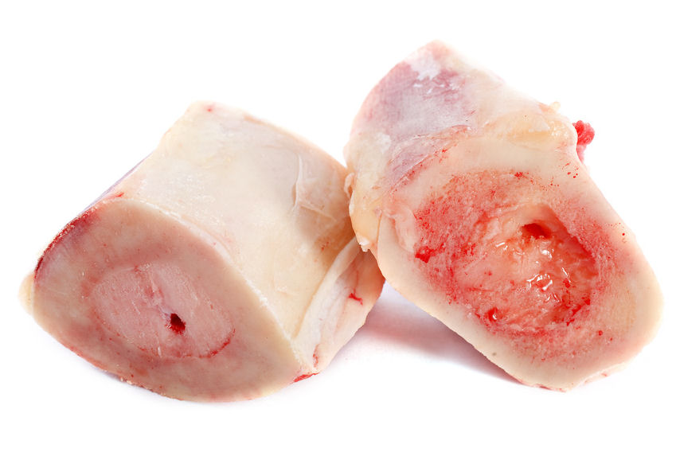
Formation in the Bone Marrow

Slide 4
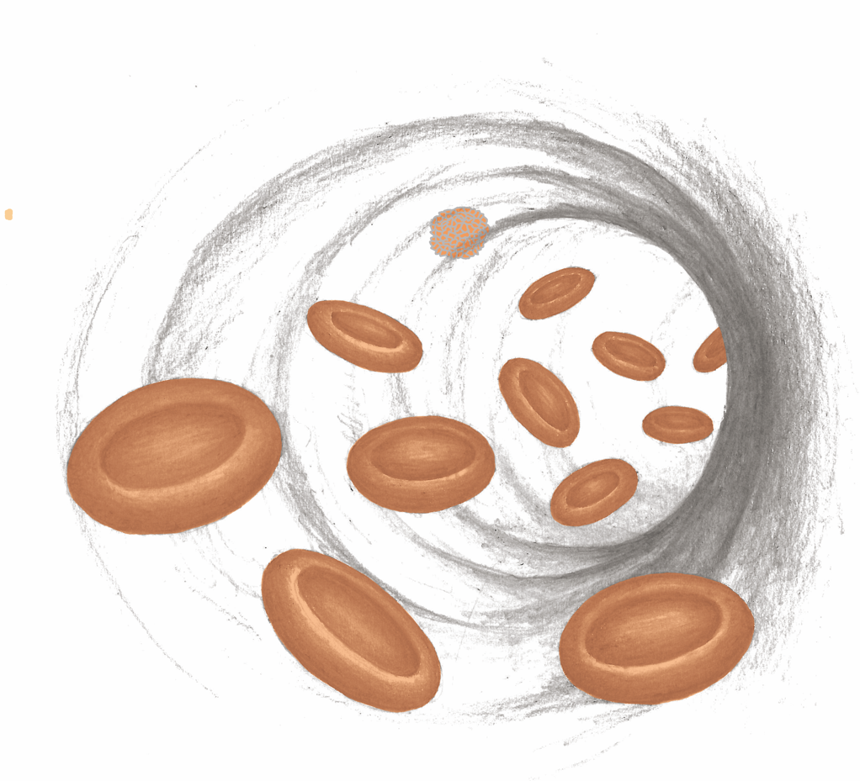
Red Blood Cells and One White Blood Cell

Slide 5
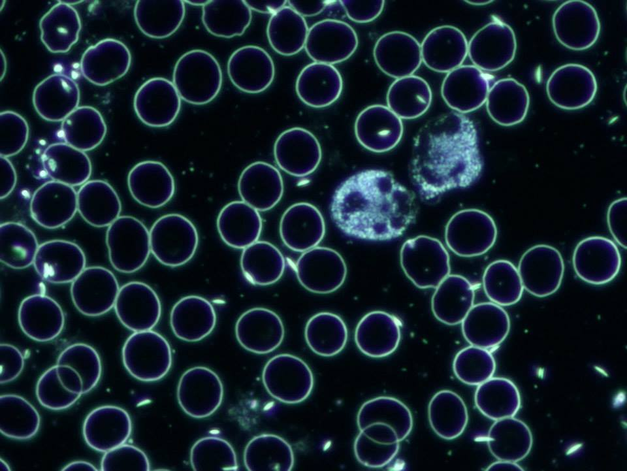
Dark Field Microscope Image

Slide 6
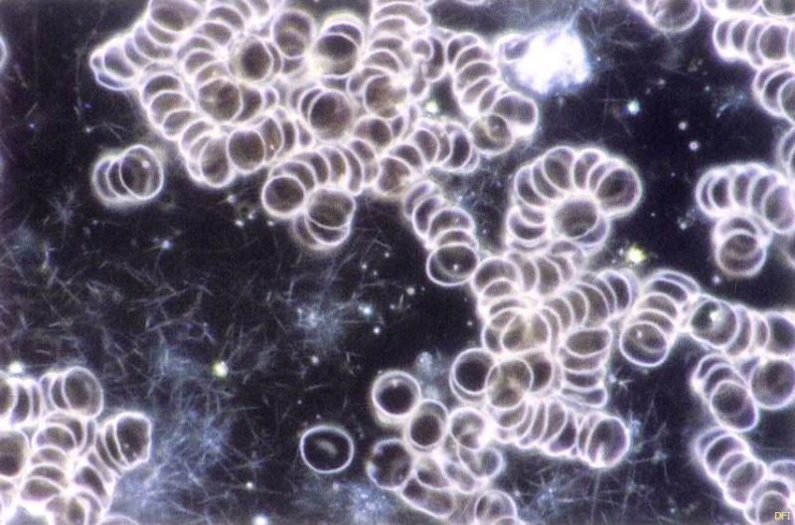
Dark Field Microscope Image

Slide 7
AIDS

Slide 8
ANIMATION – HIV Virus

Slide 9
ANIMATION – HIV Virus

Slide 10
ANIMATION – HIV-Virus

Slide 11
German Ministry of Health on AIDS
“The prevailing opinion
of medical science
assumes that it is an
infectious disease!”

Slide 12
German Minister of Health 2004
"Of course, the HIV virus is
considered to be scientifically
proven by the international
scientific consensus!"

Slide 13
Kaposi’s Sarcoma

Slide 14
Kaposi’s Sarcoma

Slide 15
Kaposi’s Sarcoma

Slide 16
Pulmonary Tuberculosis – Due to a
Fear of Death Conflict from an AIDS Diagnosis

Slide 17
AIDS Test Package Instructions:
The test is not proof of antibodies, a negative
test result does not exclude contact, a positive
result does not prove someone has AIDS.
The AIDS test does not work!

Slide 18
AIDS Test Package Instructions
“HIV-Antibody Test” by Abbott:
There is no standard presently
recognized for confirming the
presence of HIV-1 antibodies in
human blood or the lack thereof.

Slide 19
The Distribution of AIDS

Slide 20
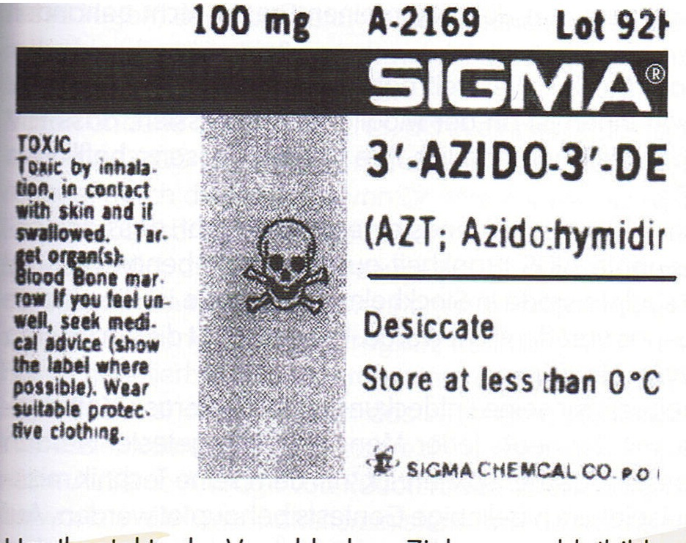
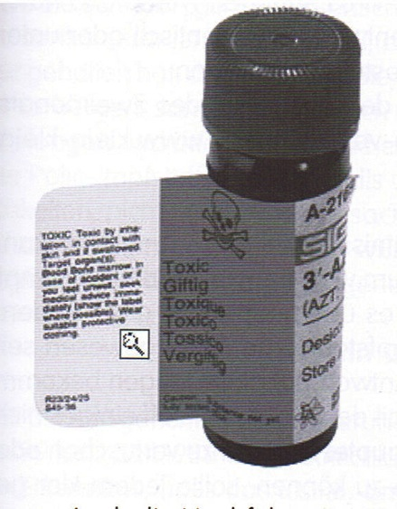
AIDS- “Medicine” – AZT
Verpackung für Laborpersonal:
„Giftig bei Inhalation, Hautkontakt oder Verschlucken.
Schutzkleidung tragen!“

Slide 21
AZT – Study by Glaxo-Smith-Kline
Harrowing result: “It make people sick!”
The results were only made public after 2 years!
Shortly after the publication of the results,
those responsible were run over at the
Glaxo production facilities!

Slide 22
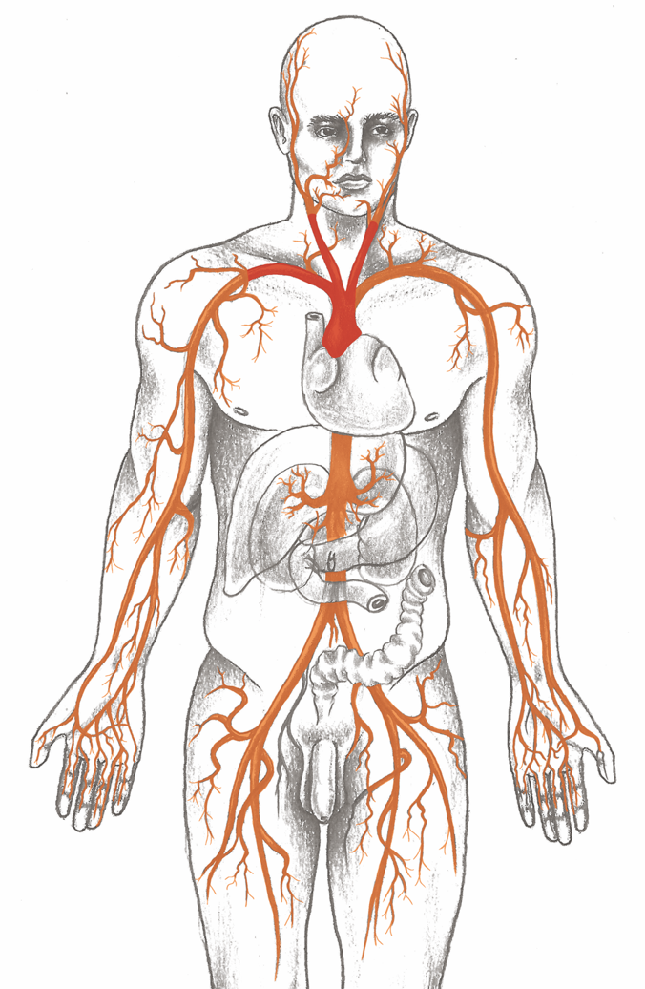
Arteries

Slide 23
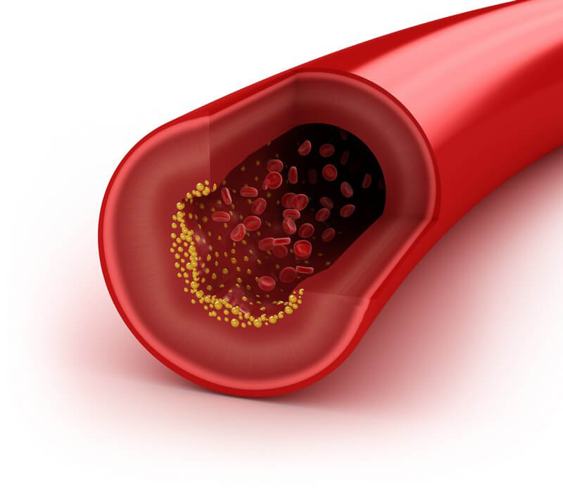
Arteries

Slide 24
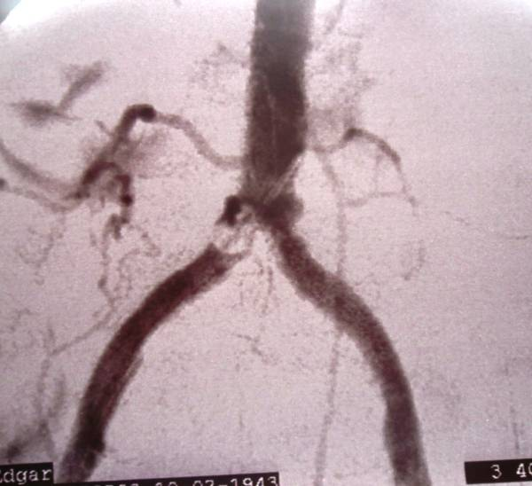
Arterial Stenosis

Slide 25
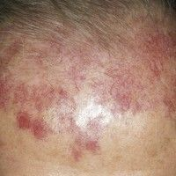
Hemangioma

Slide 26
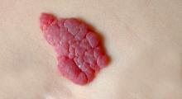
Hemangioma

Slide 27
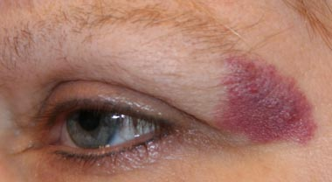
Hemangioma

Slide 28
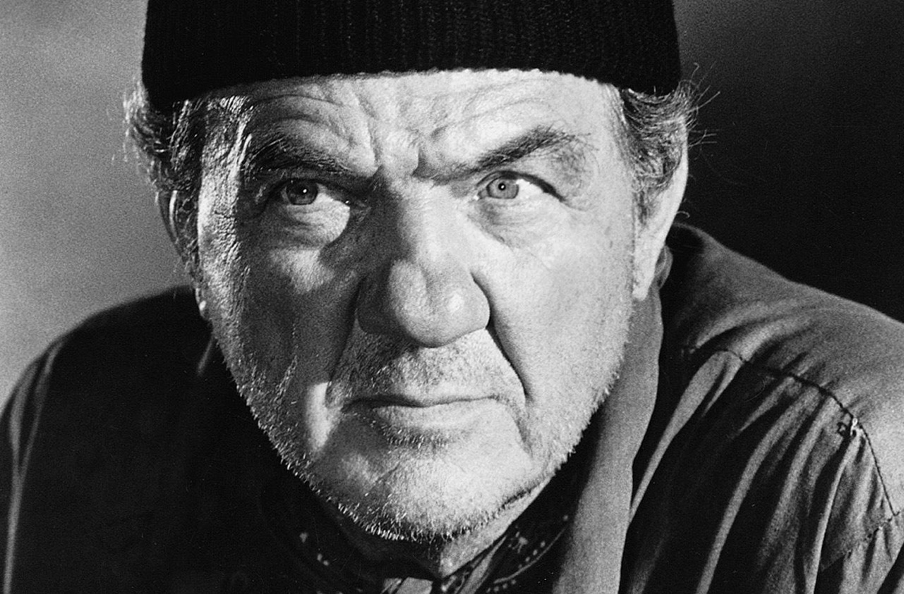
Karl Malden – Rosacea or Rhinophyma

Slide 29
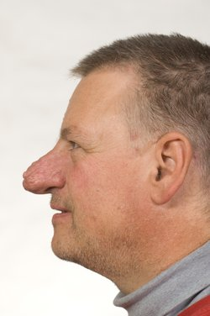
Rhinophyma (Bulbous Nose)

Slide 30
Rhinophyma (Bulbous Nose)

Slide 31
Veins

Slide 32
Veins

Slide 33
Varicose Veins

Slide 34
Varicose Veins

