Slide 1
Endocrine
Glands

Slide 2
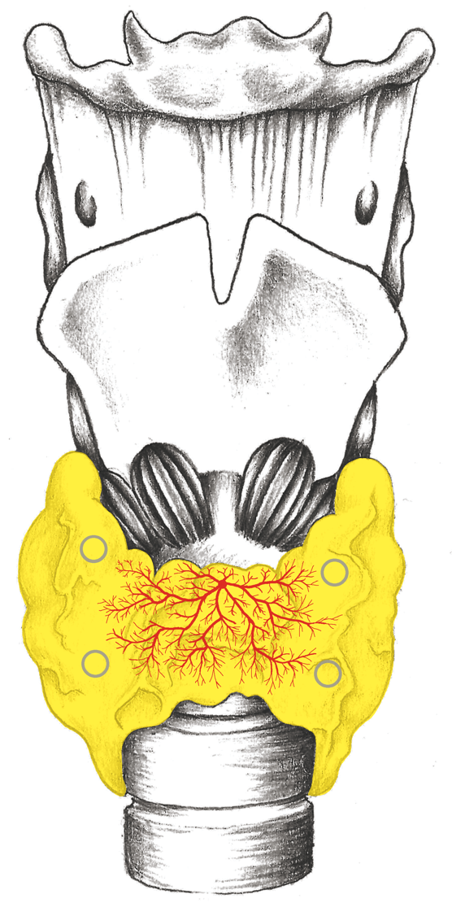
Thyroid

Slide 3
Thyroid – Specimens

Slide 4
Hyperthyroidism - Exophthalmos

Slide 5
Hypothyroidism – Brittle Hair

Slide 6
Thyroid - Endoderm

Slide 7
Thyroid Adenoma (Extreme Case)

Slide 8
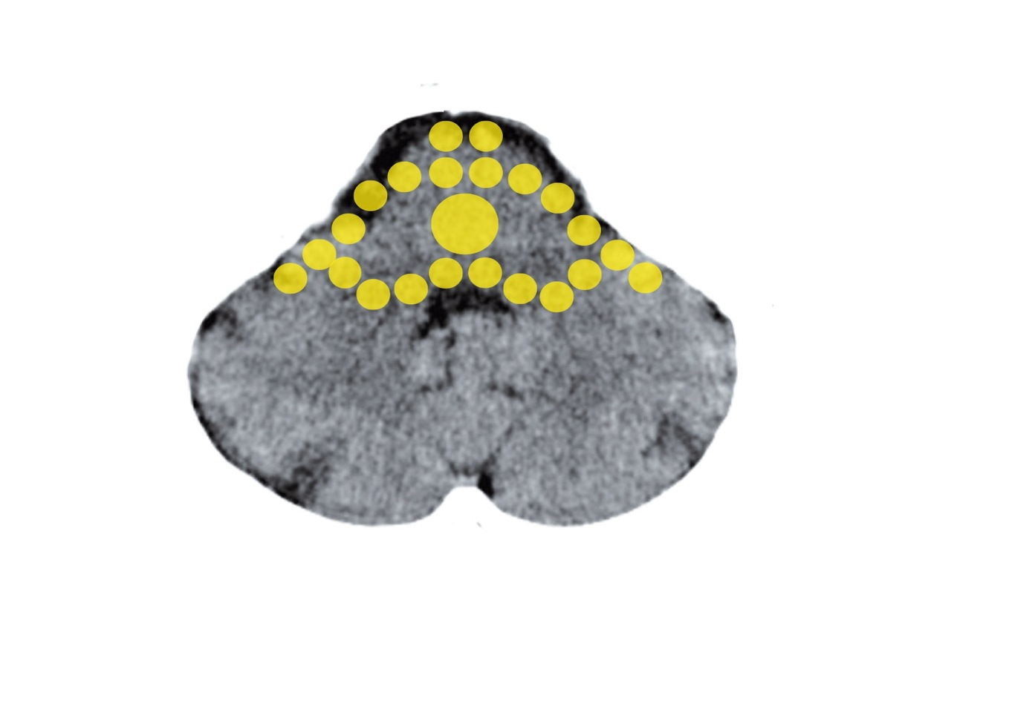
Brain Stem: Thyroid, Pituitary Gland, Adrenal Medulla
Mittelohr und Tuba eustachii - Stammhirn

Slide 9
Thyroid Excratory Ducts

Slide 10
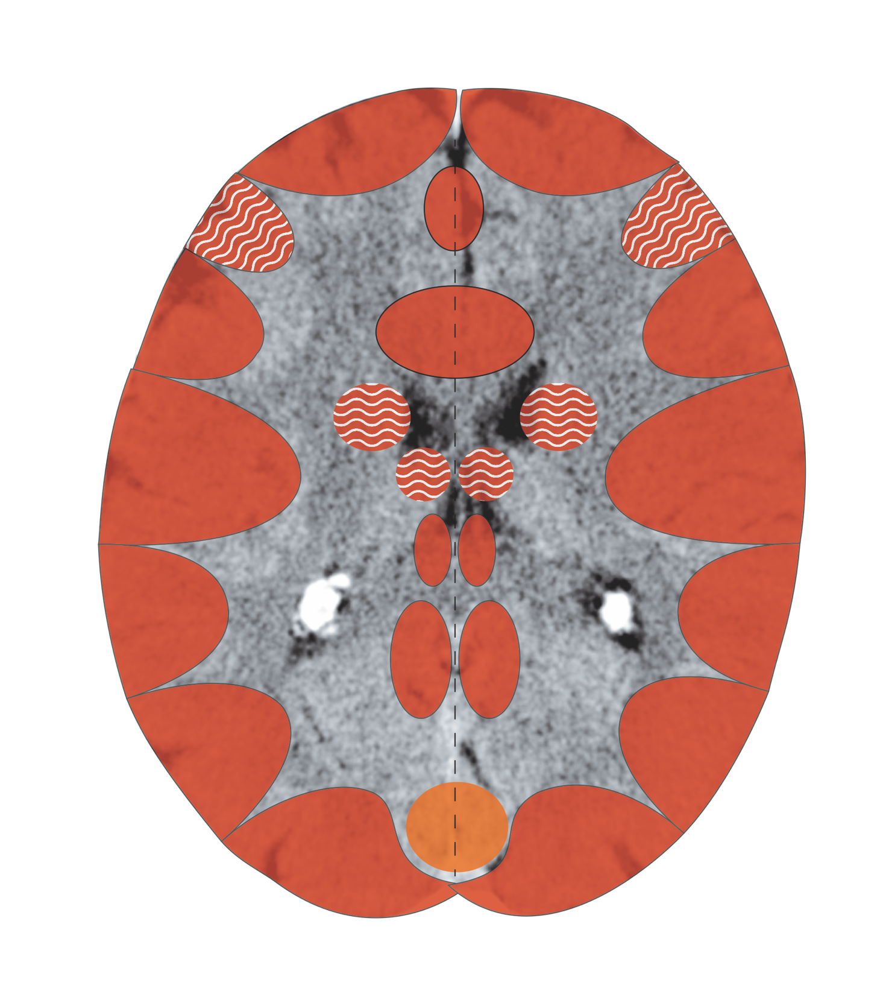
Cerebral Cortex – Thyroid Excretory Ducts
Notes:
10

Slide 11
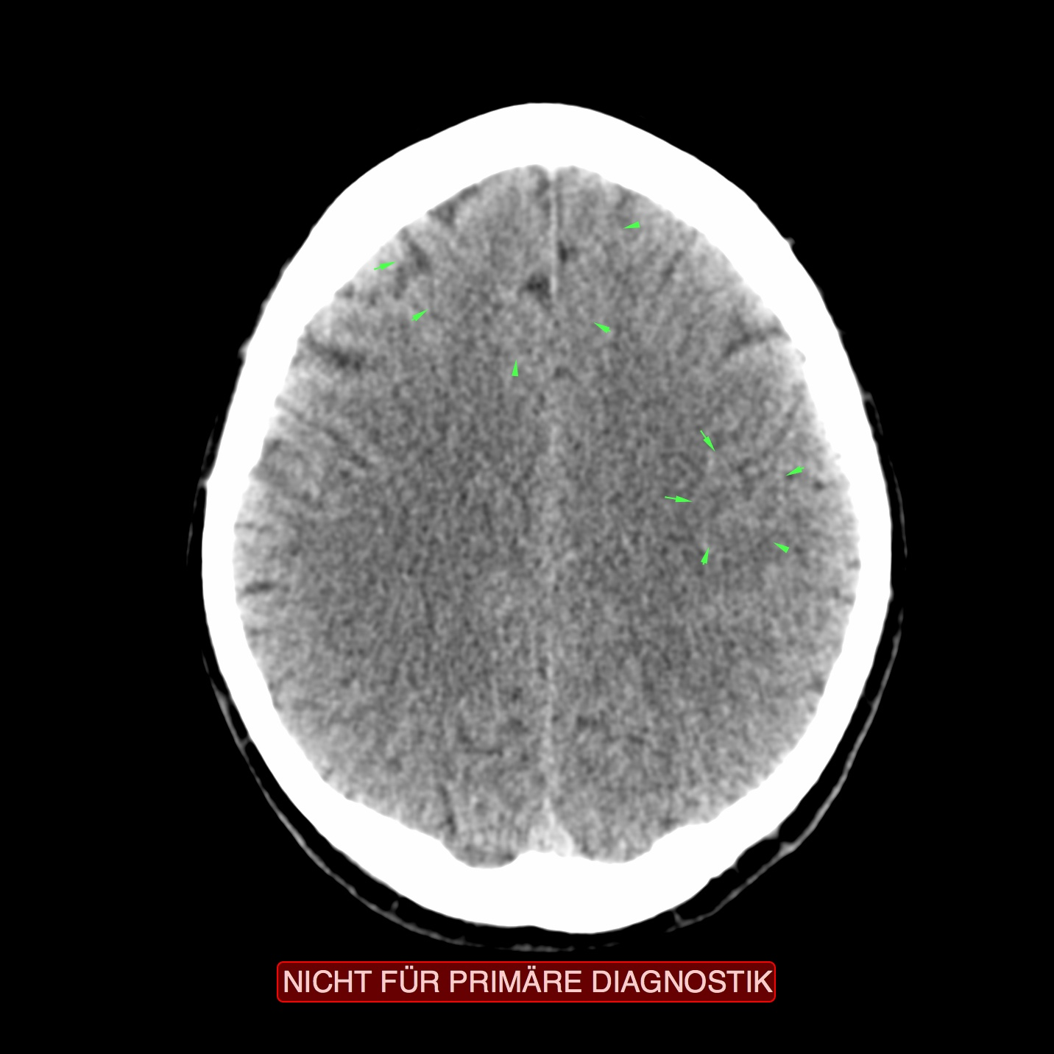
CT: Thyroid Excretory Ducts, Active

Slide 12
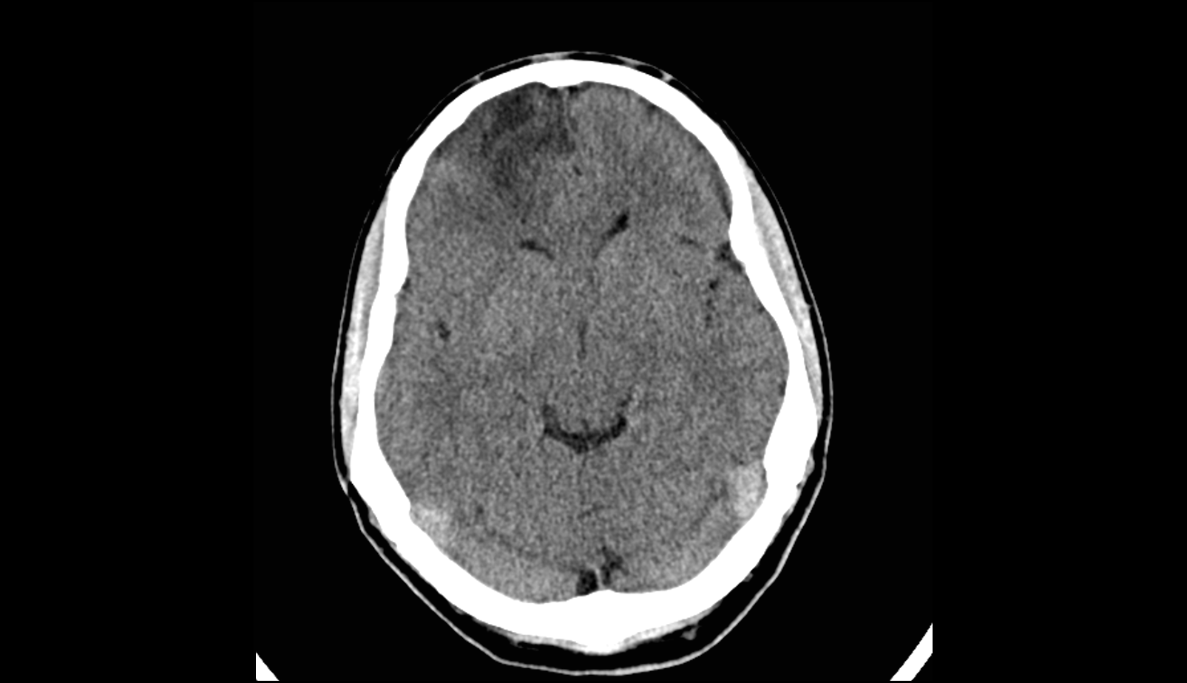
CT: Thyroid Excretory Ducts in Repair
Diagnosis: Hashimoto

Slide 13
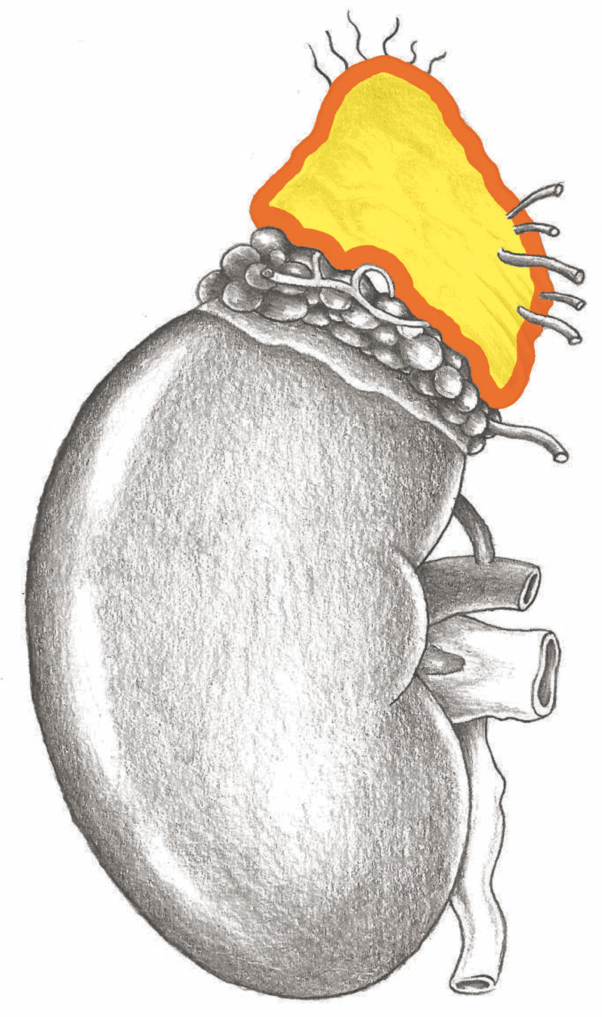
Adrenal Glands

Slide 14
Adrenal Glands – New-Mesoderm

Slide 15
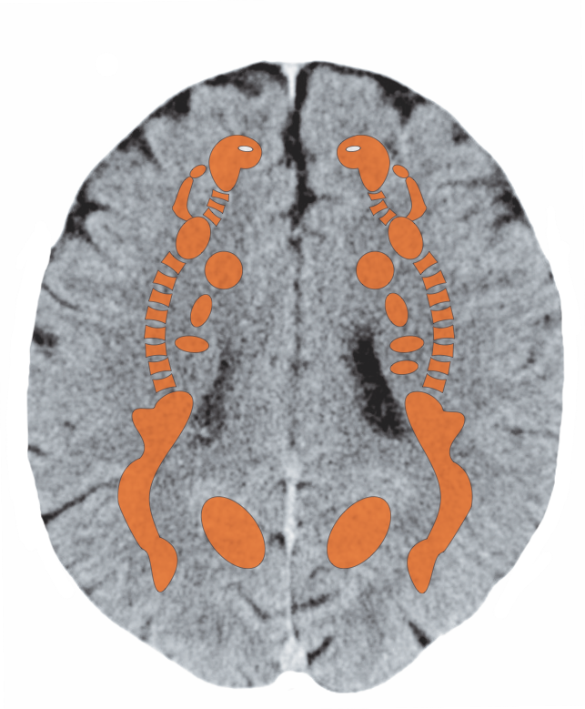
Cerebral White Matter – Adrenal Glands

Slide 16
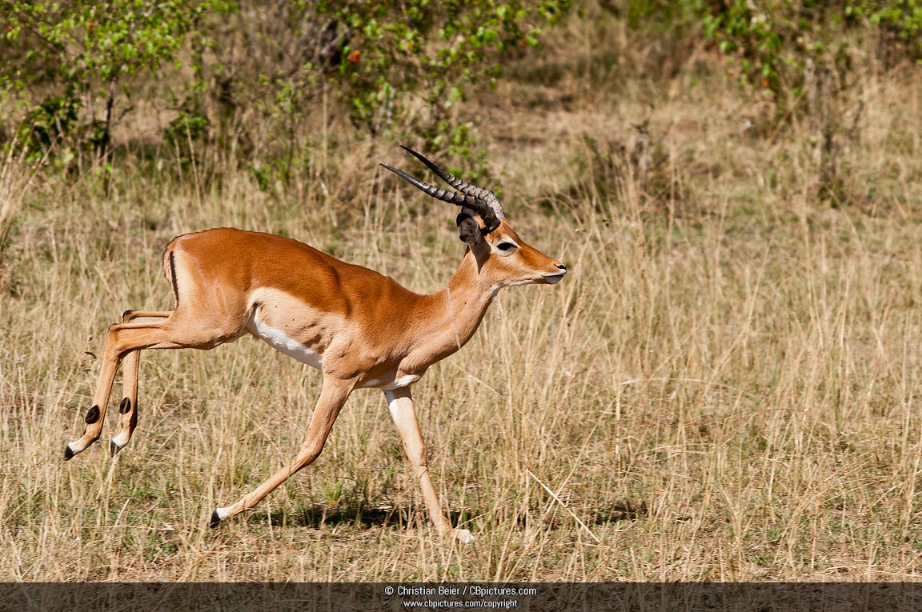
Adrenal Glands

Slide 17
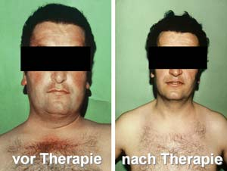
Adrenal Glands (before & after therapy)

Slide 18
Adrenal Medulla - Endoderm

Slide 19
Adrenal Medulla
Mittelohr und Tuba eustachii - Stammhirn

Slide 20
Active Phase: Neuroblastoma, Pheochromocytoma
Mittelohr und Tuba eustachii - Stammhirn

Slide 21
Pituitary Gland

Slide 22
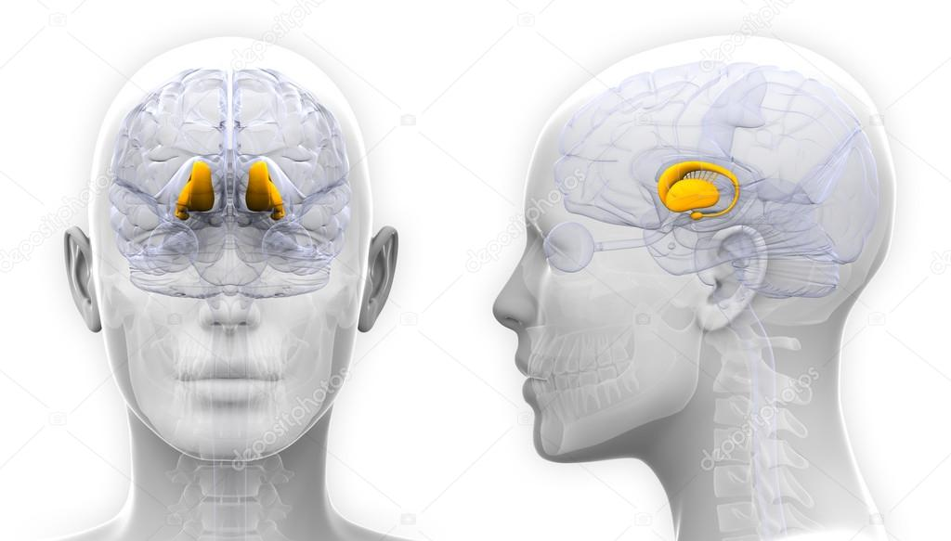
Thalamus

Slide 23
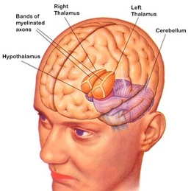
Thalamus, Hypothalamus

